Slide 1
Project ECHO® - UNM
HIV TeleECHO Clinic
Treatment of Latent Tuberculosis Infection in People with HIV
Bernadette Jakeman, PharmD, PhC, BCPS, AAHIVP
Associate Professor
University of New Mexico College of Pharmacy
Notes:
Version_ 03 2022

Slide 2
Conflict of Interest Disclosure Statement
Speaker is a consultant for Lexicomp®, Wolters Kluwer.
This presentation was reviewed by UNMHSC and SCAETC faculty to ensure it meets Continuing Education guidelines.
This project is supported by the Health Resources and Services Administration (HRSA) of the U.S. Department of Health and Human Services (HHS). Under grant number U1OHA33225 (South Central AIDS Education and Training Center). It was awarded to the University of New Mexico. No percentage of this project was financed with non-governmental sources. This information or content and conclusions are those of the authors and should not be construed as the official position or policy of, nor should any endorsements be inferred by HRSA, HHS, or the U.S. Government.

Slide 3
Learning Objectives
Identify latent tuberculosis infection (LTBI) treatment regimens recommended by the United States Department of Health and Human Services (DHHS) HIV Guidelines (updated 2/2022).
Describe advantages and disadvantages of rifamycin-based regimens for LTBI treatment in people with HIV (PWH).
Recognize potential drug interactions between HIV antiretroviral therapy (ART) and LTBI regimens.

Slide 4
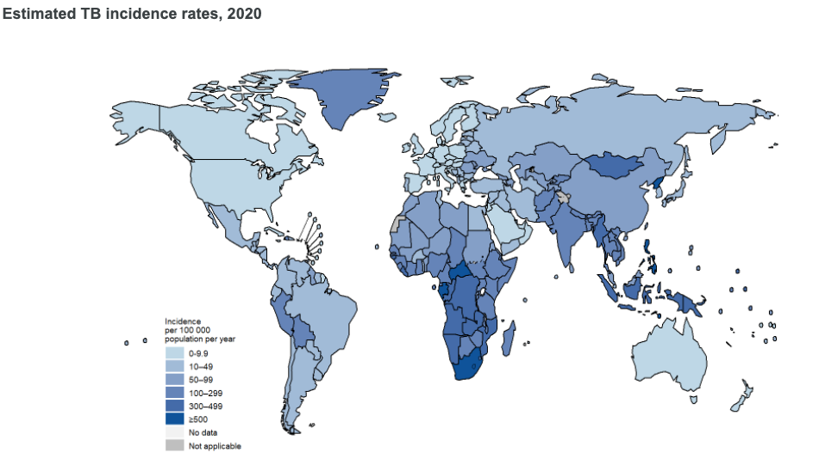
US 7,163
total active cases
Global Tuberculosis Report 2021, World Health Organization. https://www.who.int/teams/global-tuberculosis-programme/tb-reports/global-tuberculosis-report-2021. Accessed March 14,2022. Deutsch Felman M, et al. MMWR;70(12):409-414

Slide 5
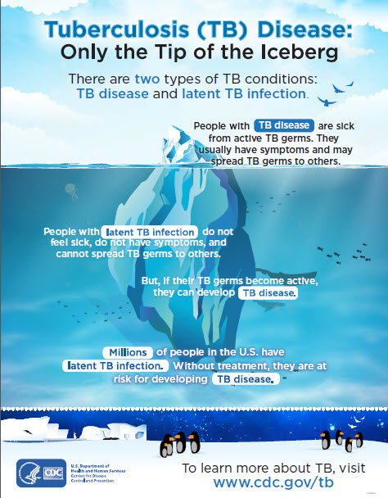
LTBI in the U.S.
Approximately 13 million people in the U.S. have LTBI
5-10% of cases progress to active tuberculosis (TB) disease during their lifetime
LTBI treatment effectively reduces risk of developing active TB disease
Miramontes R, et al. PLoS One 2015;10:e0140881; CDC. MMWR 2000; 49: 1; Sterling TR, et al. CDC. MMWR 2020;69:1.

Slide 6




TB in PWH
~5% of active TB cases in U.S. are co-infected with HIV
Risk of progression to active TB disease in PWH not receiving antiretroviral therapy (ART) is ~5-10%/year
ART and LTBI treatment decrease risk of progression in PWH
Testing:
  At diagnosis regardless of risk
    If negative and CD4 <200 cells/mm³ at diagnosis, repeat after ART initiation and CD4 >200 cells/mm³
  Annually if ongoing risk
  Contact with known active TB case
CDC. TB statistics. https://www.cdc.gov/tb/statistics/reports/2020/table11.htm. Accessed March 14, 2022; Selwyn PA, et al. N Engl J Med. 1989;320:545; Horsburgh CR Jr. N Engl J Med. 2004;350:2060; Temprano ANRS Study Group. N Engl J Med. 2015;373:808; Badje A, et al. Lancet Glob Health. 2017;5(11):e1080; Golub JE, et al. AIDS. 2007;21(11):1441-1448; DHHS Guidelines of the Prevention and Treatment of OIs in Adults and Adolescents with HIV https://clinicalinfo.hiv.gov/en/guidelines/adult-and-adolescent-opportunistic-infection/mycobacterium-tuberculosis-infection-and?view=full. Accessed March 14, 2022.

Slide 7
LTBI Treatment in PWH
Indications:
Positive screening test
  No evidence of active disease
  No history of treatment for active disease or latent infection
Close contact with a person with active TB disease
  Regardless of screening test result
DHHS Guidelines of the Prevention and Treatment of OIs in Adults and Adolescents with HIV https://clinicalinfo.hiv.gov/en/guidelines/adult-and-adolescent-opportunistic-infection/mycobacterium-tuberculosis-infection-and?view=full. Accessed March 14, 2022.

Slide 8
TB Screening and Treatment Cascade Among PWH
TST = Tuberculin Skin Test; Tx = Treatment
Diaz A, et al. BMC Infect Dis 2010;10:267.

Slide 9
LTBI Treatment in PWH >50kg
(Guidelines updated 2/2022)
Preferred Regimens* | Interval | Duration | Pill Burden
Isoniazid 900mg + Rifapentine 900mg (3HP) + directly observed therapy** | Weekly | 3 months | 9
Isoniazid 300mg + Rifampin 600mg (3HR)† | Daily | 3 months | 5
Alternative Regimens* | Interval | Duration
Isoniazid 300mg (6H or 9H) | Daily | 6 months | 1
 | Daily | 9 months | 1
Rifampin 600mg (4R)† | Daily | 4 months | 2
Isoniazid 300mg + Rifapentine 600mg (1HP)‡ | Daily | 1 month | 5
DHHS Guidelines of the Prevention and Treatment of OIs in Adults and Adolescents with HIV https://clinicalinfo.hiv.gov/en/guidelines/adult-and-adolescent-opportunistic-infection/mycobacterium-tuberculosis-infection-and?view=full. Accessed March 14, 2022..
Notes:
*All isoniazid-containing regimens should be supplemented with pyridoxine (vitamin B6)
**For patients virally-suppressed on efavirenz-, twice-daily raltegravir-, or once-daily dolutegravir-based regimen
†Must consider drug-drug interactions with antiretroviral regimen
‡Recommended in patients receiving efavirenz-based regimens

Slide 10
3HP in PWH
Sterling T et al. AIDS. 2016;30:1607. (PREVENT TB Trial)
  Prospective, randomized, non-inferiority trial that included 403 PWH in 6 countries including US who received either 3HP or 9H for LTBI
  Exclusion criteria: patients on or planning to start ART within 90 days
  Median age 36y, 70% male, 84% had CD4>350
  3HP non-inferior to 9H
  Treatment completion was higher with 3HP (89% vs 64%; p<0.001)
  Drug discontinuation due to hepatotoxicity higher with 9H (4% vs 1%, p=0.05)
Martinson NA et al. N Engl J Med. 2011;365:11.
  Prospective, randomized in South Africa that included 1148 PWH not on ART who received 3HP or 6H
  No difference between 6H vs 3HP (p>0.05)
  Serious side effects (Grade 4) more common in INH group (4.3% vs 1.2%)
3HP=Isoniazid (INH) 900mg + Rifapentine 900mg weekly x 3 months
6H=Isoniazid 300mg daily x 6mo; 9H=Isoniazid 300mg daily x 9mo

Slide 11
3HR in PWH
Whalen CC et al. NEJM. 1997;337:801.
  Randomized controlled trial (RCT) in Uganda that included 2018 PWH not on ART with positive PPD who received 6H, 3HR, 3HRZ or placebo
  Incidence of TB lower in all treatment groups compared to placebo (6H aRR 0.32, 95% CI 0.14-0.76; 3HR aRR 0.41, 95% CI 0.19-0.89; 3HRZ aRR 0.43, 95% CI 0.20-0.92)
  3HRZ was associated with significantly more side effects
Johnson JL et al. AIDS. 2001;15:2137.
  RCT in Uganda that included 2736 PWH not on ART with positive PPD who received 6H, 3HR, 3HRZ or placebo
  Incidence of TB lower in all treatment groups compared to placebo (6H aRR 0.67, 95% CI 0.42-1.07; 3HR aRR 0.40, 95% CI 0.29-0.82; 3HRZ aRR 0.41, 95% CI 0.22-0.76)
Rivero A et al. Enferm Infecc Microbiol Clin. 2007;25:305.
  RCT in Spain that included 316 PWH who received 6H, 3HR or 2RZ
  No difference in incidence of TB and adverse drug events (ADEs) between regimens
3HRZ = 3 months of daily isoniazid, rifampin, and pyrazinamide
2RZ = 2 months daily rifampin plus pyrazinamide
Notes:
ppd=purified protein derivative skin test for prior tuberculosis infection
RCT=randomized controlled trials
ARR =absolute risk reduction
RR=relative risk

Slide 12
4R in PWH
Limited data in PWH
Menzies D et al. N Engl J Med. 2018;379:440.
  Prospective randomized trial in 9 countries
  6859 patients received 9H or 4R, only 255 PWH (53% on ART)
  4R non-inferior to 9H in all patients
  4R had higher completion rates and ADEs were less common
  Post-hoc analysis of PWH showed no difference in TB incidence but 4R group had lower rates of treatment discontinuation due to ADEs (risk difference -1.9%; 95% CI -2.7 to -1.1)
Campbell JR et al. Clin Infect Dis 2020. doi: 10.1093/cid/ciaa1169.
4R= Rifampin 600mg daily x 4mo

Slide 13
1HP in PLWH
Swindells S, et al, BRIEF TB Study Team. N Engl J Med. 2019;380:1001.
  Prospective, randomized non-inferiority study in 10 countries
  3000 HIV patients received 9H or 1HP
    54% women, median Cd4 cell count 470 cells/mm³ (13% <250 cells/mm³)
    Only 23% had a positive TB test
    50% of patients were on ART (efavirenz- or nevirapine-based)
    Patients were followed for 3.3 years
  1HP non-inferior and significantly higher completion rates

Slide 14
Rifamycin-Based Treatment Considerations
Cost
Pill burden
Adherence
Most studies conducted in patients not on ART
Drug-drug interactions (e.g., ART, warfarin, oral contraceptives, antifungals) for up to 2 weeks after discontinuation of rifamycin
ADEs: discoloration of bodily fluids/feces, rash and thrombocytopenia
Regimen-specific:
  3HP: For patients virally suppressed on efavirenz-, twice daily raltegravir-, or daily dolutegravir-based regimen; consider directly observed therapy; flu-like syndrome
  3HR: Higher rates of hepatotoxicity than other rifamycin-based regimens
  4R: Caution in PWH with low CD4 counts
  1HR: For patients receiving efavirenz-based regimens, data in PWH in high TB burden setting

Slide 15
Drug interactions with LTBI Treatment
 | DTG | BIC | RAL BID | DRV/r or c | DOR | EFV | ETR | RPV | TAF | TDF | FTC or 3TC | ABC
INH | ✓ | ✓ | ✓ | ✓ | ✓ | ✓ | ✓ | ✓ | ✓ | ✓ | ✓ | ✓
RPT | C=QD* | X | ✓ | X | X | ✓ | X | X | X | ✓ | ✓ | ✓
RIF | C=BID | X | 800 mg BID | X | X | ✓ | X | X | X | ✓ | ✓ | C
✓=ok to co-administer; C=use with caution; X=do not co-administer
INH= Isoniazid; RPT=rifapentine; RIF=rifampin; DTG=dolutegravir; BIC=bictegravir; BID RAL=twice daily raltegravir; DRV/r or c=darunavir boosted with ritonavir or cobicistat; TAF=tenofovir alafenamide; TDF=tenofovir ; FTC or 3TC=emtricitabine or lamivudine; ABC=abacavir; DOR=doravirine; EFV=efavirenz; ETR=etravirine; RPV=rilpivirine
Liverpool HIV Drug-Interaction Checker. https://www.hiv-druginteractions.org
*Dooley KE et al. Lancet HIV 2020;7:e401.

Slide 16
Monitoring
Baseline liver function tests
  Repeat if abnormal or other risk factors (e.g., viral hepatitis)
Assess adherence monthly
Evaluate for possible drug toxicity monthly
Other considerations
  Prescribe 1-month vs 3-month supply depending on regimen
  Consider close monitoring of HIV viral load in patients with potential drug-drug interaction
  Rifamycin drug induction takes 1-2 weeks

Slide 17
Summary
3HP and 3HR are preferred LTBI regimens for PWH
  3HP has the most data in PWH
  Use may be limited due to drug-drug interactions
4R may be considered in PWH who are unable to take INH
  Hepatotoxicity
  INH-resistant contact
Notes:
3HP=Isoniazid (INH) 900mg + Rifapentine 900mg weekly x 3 months
3HR=Isoniazid 300mg + Rifampin 600mg daily x 3 months
4R= Rifampin 600mg daily x 4mo

Slide 18
Resources
National Clinician Consultation Center http://nccc.ucsf.edu/
  HIV Management
  Perinatal HIV
  HIV PrEP
  HIV PEP line
  HCV Management
  Substance Use Management
Present case on ECHO http://echo.unm.edu hivecho@salud.unm.edu
AETC National HIV Curriculum https://aidsetc.org/nhc
AETC National Coordinating Resource Center https://targethiv.org/library/aetc-national-coordinating-resource-center-0
Additional trainings scaetcecho@salud.unm.edu
www.scaetc.org
Notes:
Find additional TeleECHO sessions in your area: https://echo.unm.edu/locations-2/echo-hubs-superhubs-united-states/
https://hsc.unm.edu/echo/get-involved/join-an-echo/
IDEA Platform: Infectious Diseases Education & Assessment. https://idea.medicine.uw.edu/
AETC National HIV Curriculum: 6 core modules for self study; regularly updated; CME, CNE
Hepatitis C Online Curriculum: https://www.hepatitisc.uw.edu/
Hepatitis B Online Curriculum: https://www.hepatitisb.uw.edu/
National STD Curriculum: https://www.std.uw.edu/

