Slide 1


Project ECHO® - UNM
HIV TeleECHO Clinic
Immune Reconstitution Inflammatory Syndrome
04/19/2022
Michelle Iandiorio, MD
SCAETC, Clinical Director
UNM HSC, DOIM, Div ID; Professor
Notes:
Version date_ 04 2022

Slide 2
Conflict of Interest Disclosure Statement
I have no disclosures
This project is supported by the Health Resources and Services Administration (HRSA) of the U.S. Department of Health and Human Services (HHS). Under grant number U1OHA33225 (South Central AIDS Education and Training Center). It was awarded to the University of New Mexico. No percentage of this project was financed with non-governmental sources. This information or content and conclusions are those of the authors and should not be construed as the official position or policy of, nor should any endorsements be inferred by HRSA, HHS, or the U.S. Government.

Slide 3
Learning Objectives
Identify patients who are at greatest risk of developing immune reconstitution inflammatory syndrome (IRIS) and recognize the clinical signs and symptoms.
Recognize the appropriate management of IRIS in people with HIV (PWH) with an opportunistic infection or malignancy.

Slide 4
Immune Reconstitution Inflammatory Syndrome (IRIS) in HIV
Disease or pathogen-specific inflammatory response in HIV-infected patients triggered by initiation or re-initiation of antiretroviral therapy (ART)
Most cases in those with low CD4 and high viral loads
Usually accompanied by an increase in CD4 cell count and/or a rapid decrease in viral load
Usually within the first 4-8 weeks after initiation of ART

Slide 5
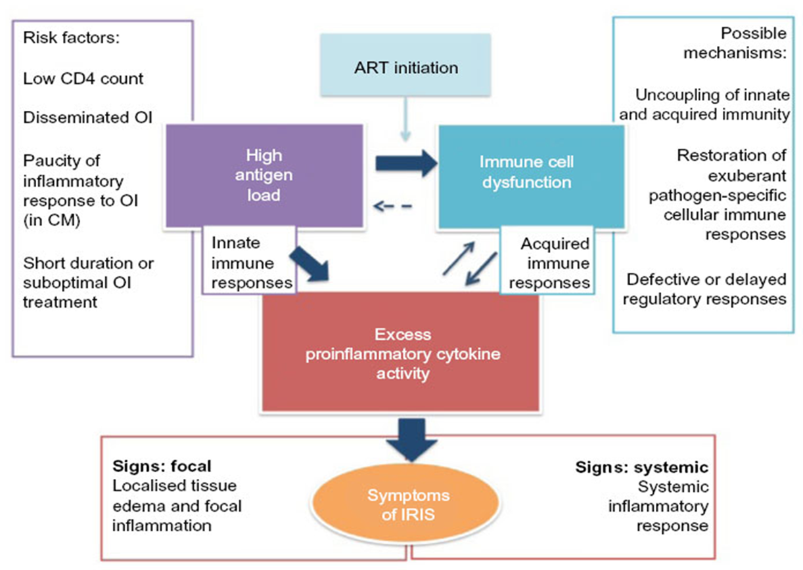
IRIS:
Multifactorial pathogenesis
Walker, N. et al. HIV AIDS 2015;7:49-64.
Notes:
Pathophysiology involves combination of factors including reconstitution of immune cell numbers and function, redistribution of lymphocytes, defects in regulatory function, changes in Th cell profile, underlying antigenic burden, and host genetic susceptibility
Host-related: low CD4 at ART initiation, OI, genetic predisposition, paucity of immune response at OI diagnosis
Pathogen-related: degree of dissemination of OI/burden of infection, high pre-ART HIV VL
Treatment-related: shorter duration of OI tx prior to starting ART, rapid suppression of HIV VL
After initiation of ART, T cells become more functional, produce Th1 cytokines that in turn help mature the hyperactivated macrophages, leading to excessive inflammatory cytokine production and immunopathology. Possible central role of IL-6 (pro-inflammatory cytokine).
Other proinflammatory cytokines: TNF-alpha, IL-18; chemokines: IL-8
Effective ART in HIV-positive patients decreases the circulating and infecting viral load, enhances lymphocyte proliferation, and improves the quantity and function of the immune cells. The recovery of the immune system leads to an awakening of the normal immune responses to a variety of dormant antigens leading to a burst of inflammation.​

Slide 6
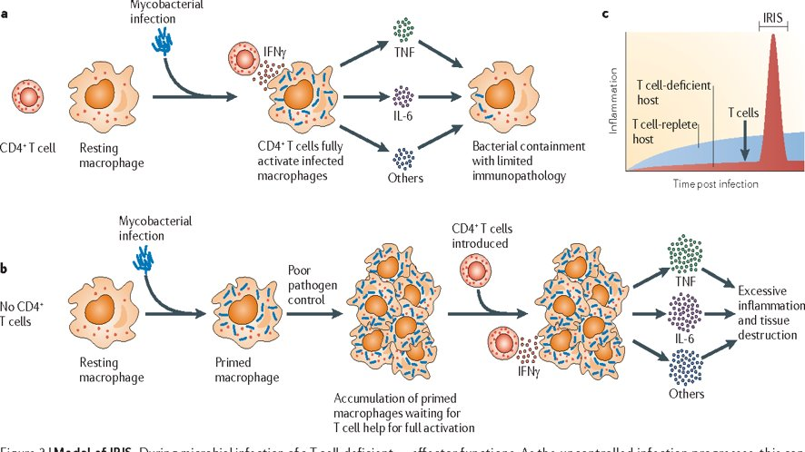
IRIS:
Hyper-responsiveness of innate immune system
Barber, DL et al. Nature Reviews Microbiology. 2012; 10:150-156.
Notes:
https://www.nature.com/articles/nrmicro2712
Tissue-destructive inflammation when CD4 T-cells re-emerge
Proposals
-Dysregulation of expanding population of CD4 T cells specific for a co-infecting opportunistic pathogen
-Alternate proposal described above: hyper-responsiveness of the innate immune system to T cell help, a mechanism that may be shared by the many manifestations of IRIS that occu following the reversal of other types of immunosuppression in pathogen-infected hosts

Slide 7
IRIS in HIV
Inflammatory reactions to many pathogens have been described
  Mycobacteria: TB, MAC
  Fungi: Cryptococcal meningitis, Pneumocystis pneumonia
  Viruses: CMV retinitis, PML from JC, HSV, VZV, Hep B/C, HPV
  Bacteria: Bartonella, T. pallidum
  Parasites: Toxoplasma, Strongyloides
May include worsening of some malignancies and autoimmune phenomena
  Kaposi’s sarcoma
  Sarcoidosis, Malignancies, Grave’s disease, inflammation at site of tattoo
Notes:
Criteria from prior studies:
Progressive organ dysfunction worsening of pre-existing lesions after definite clinical improvement with pathogen-specific therapy before the initiation of ART
Increase in an immune response specific to the relevant pathogen, i.e. DTH
3 major clinical predictors of IRIS are: severe CD4+ cell depletion at initiation of ART; pre-existing opportunistic infection (even if subclinical); and shorter treatment period for an opportunistic infection before starting ART, which can be associated with presence of higher antigen loads.

Slide 8
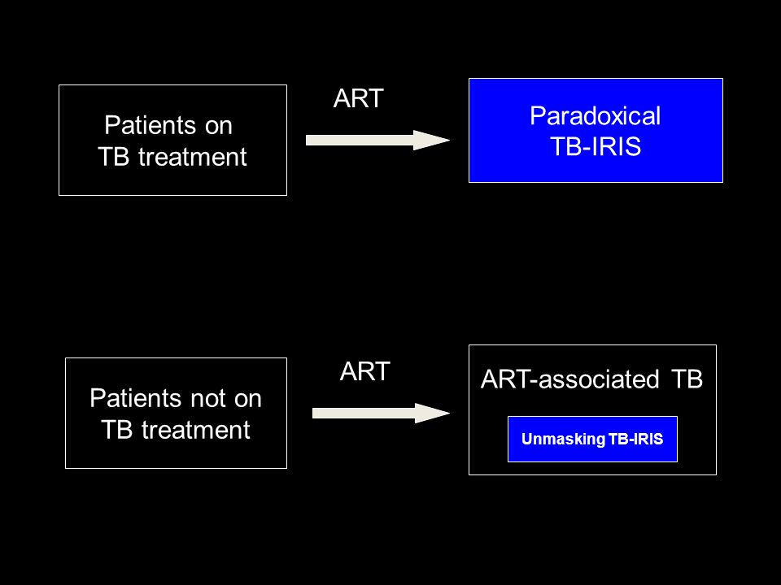
IRIS in HIV
Unmasking: from previously undiagnosed condition
  Example: MAC
Paradoxical worsening: exacerbation of known condition on treatment
  Need to rule out suboptimal treatment of condition
Image: Graeme Meintjes University of Cape Town
Notes:
Additional/optional reference: AIDS 2014;28(16):2461-72. “With the potential exception of mycobacterial infections, unmasking IRIS does not appear to be common complication of cART initiation in high-income countries.
[Unmasking analogy: thief robbing house when you have no lights versus panic when he turn lights on]

Slide 9
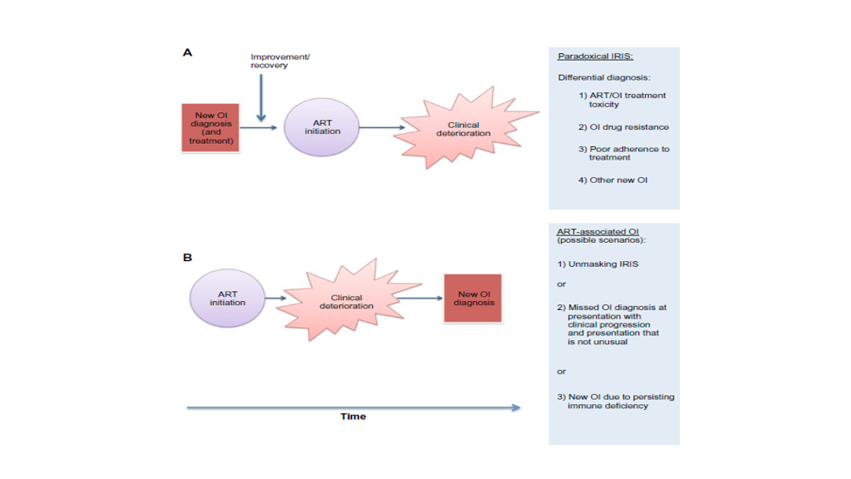
IRIS in HIV
Walker NF et al. HIV/AIDS Research and Palliative Care. 2015;7:49-64.
Notes:
https://www.dovepress.com/immune-reconstitution-inflammatory-syndrome-in-hiv-infected-patients-peer-reviewed-fulltext-article-HIV

Slide 10
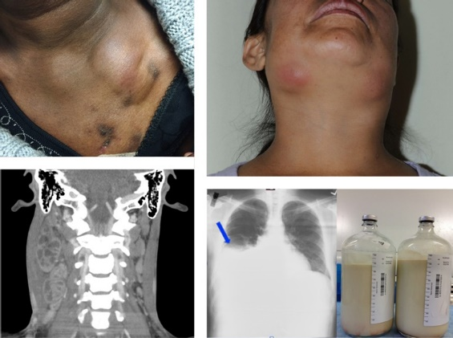
Examples of IRIS in People with HIV
Sereti. Top Antivir Med. 2020;27(4):106-111.
Notes:
Irini Sereti: Immune Reconstruction Inflammatory Syndrome in HIV Infection: Beyond What Meets The Eye: Top Antivir Med. 2020 Jan; 27(4): 106–111.
Published online 2020 Jan 1.
Upper left: a patient with tuberculosis (TB) who developed persistent and relapsing immune reconstitution inflammatory syndrome (IRIS) in the form of necrotic lymphadenopathy. The patient had undergone several drainages when the photograph was taken. Upper right: a patient who came to the US from Mexico and presented with disseminated histoplasmosis and mycobacterium avium complex (MAC) and exhibited enlarged and inflamed lymph nodes after ART initiation. Bottom left: a patient who had unmasking MAC lymphadenitis that caused necrotic lymphadenopathy that was compressing the trachea and jugular vein. The condition required corticosteroid treatment and lymph node drainage. Bottom right: a patient with miliary TB, TB arthritis, and osteomyelitis who developed severe persistent IRIS that caused blockage of the thoracic duct and chylothorax

Slide 11
When to Start ART
Start ART in PWH who have an active opportunistic infection as soon as possible (within 2 wks)¹
  ACTG A5164 study²: benefit outweighs risk
  Especially Pneumocystis pneumonia but also include cryptosporidiosis, microsporidiosis, progressive multifocal leukoencephalopathy (PML), Kaposi’s sarcoma, serious bacterial infections
  Be aware of need to address drug-drug interactions
Possible Exceptions:
  Tuberculosis (TB): delay 2 to 8-12 weeks
  Cryptococcal meningitis: delay 2-12 weeks
  CNS Toxoplasmosis: no evidence, most defer 2-3 weeks
http://aidsinfo.nih.gov/contentfiles/lvguidelines/adult_oi.pdf
Zolopa, A et al. PLoS ONE. 2009;4(5):e5575
CNS=central nervous system
Notes:
ACTG A5164 study²: 63% with PCP had lower incidence of AIDS progression or death in early tx (median 12d) versus deferred ART (median 45d)

Slide 12
When to Start ART in
Active Pulmonary TB
Trial | Delay of ART Initiation | Median CD4 | Results
SAPIT^{1,2} | No delay, after intensive phase, after completion | <500 | 56% lower mortality in first 2 groups Benefit of early ART greatest for those with CD4<50
CAMELIA³ | 2 vs 8 week | 25 | Risk of death 18% vs 27%
A5221⁴ | 2 vs 8-12 week | 77 | New OI or death 12.9% vs 16.1% CD4<50: 15.5% vs 26.6% TB-IRIS: 11% vs 5%
Abdool Karim S, et al. NEJM 2010;362(8):697-706. 2. Abdool Karim S, et al. NEJM 2011;365(16):1492-1501.
3. Blanc F, et al. NEJM 2011;365(16):1471-1481. 4. Havlir DV et al. NEJM 2011;365(16):1482-1491.

Slide 13
When to Start ART in TB
Delaying initiation of ART after starting treatment for TB (within 8 weeks) has been shown to decrease the incidence of IRIS^{1, 2}
In those with CD4<50, benefit of early ART (within 2 weeks) outweighs risk of IRIS³⁻⁵
1. Shelburne, SA et al. AIDS 2005;19:399-406. 2. Schiffer, JT et al. JAIDS 2007;44:229-234. 3. Lawn, SD et al. AIDS 2007;21:335-341. 4, Battegay, M et al. J Antimicrob Chemother 2008;62:41-44. 5. Uthman OA et al. Ann Intern Med 2015;163(1):32-9. 6. Meintjes et al, 2018 NEJM
Notes:
2015 Meta-analysis: Early ART improves survival in those with CD4<50 but associated with 2-fold higher frequency of TB-IRIS. In those with CD4>50, evidence is insufficient to support or refute a survival benefit conferred by early vs delayed ART initiation.
Meintjes G, et al. NEJM 2018;379(20):1915-1925. Prednisone during first 4 wks after initiation of ART in pts with TB resulted in lower incidence of TB-associated IRIS without evidence of increased risk of severe infections or cancers. Pts had CD4<100. Pred 40mg qday x 14d then 20mg x 14d.
Walker, NF et al. Curr Opin HIV AIDS. 2018;13(6):512-521. Incidence of paradoxical TB-IRIS 18%, may be >50% in high-risk groups. Prednisone with ART in pts with CD4<100 reduced risk of paradoxical TB-IRIS by 30%. (cited above article)
The International Network for the Study of HIV-associated IRIS (INSHI) definition of TB-associated IRIS includes the major clinical criteria of: new or enlarging lymph nodes, cold abscesses, or other focal tissue involvement; new or worsening radiologic features of TB; new or worsening central nervous system (CNS) TB; and new or worsening serositis (pleural effusion, ascites, or pericardial effusion). Minor clinical criteria (>2 required) consist of: new or worsening constitutional symptoms; new or worsening respiratory symptoms; and new or worsening abdominal pain accompanied by peritonitis, hepatomegaly, splenomegaly, or abdominal adenopathy
Meintjes, G et al. CROI 2017. 240, median CD4 49, median VL 337,775. TB micro confirmed in 175. 18 LTFU. TB-IRIS 56 in placebo (46.7%) and 39 in prednisone arm (32%; RR0.7). In pts at high risk of paradoxical TB-IRIS, prednisone during first 4 weeks of ART (40mg x 2wks, 20mg x 2wks) reduced risk of TB-IRIS by 30% and further reduced requirement for corticosteroids to treat TB-IRIS by 53%. Well tolerated without excess risk of infection or malignancy.

Slide 14
When to Start ART in TB Meningitis
Data limited
  Study in Vietnam¹: No delay vs 2-month delay
    No survival benefit and more severe adverse events in early ART
    Overall mortality 58%, severe adverse events 90% (may not be generalizable)
Delay therapy 8-12 weeks²
If CD4<50, start ART within 2 weeks²
Corticosteroid taper x 12 weeks is added in those with TB meningitis to improve survival²⁻⁵
1. Torok ME et al. CID 2011;52(11):1374-83 2. http://aidsinfo.nih.gov/contentfiles/lvguidelines/adult_oi.pdf 3. Thwaites GE et al. NEJM 2004;351(17):1741-1751. 4. Pepper DJ et al. CID 2009;48(11):e96-07. 5. Meintjes G et al. AIDS 2010;24(15):2381-2390. 6. Manea E et al. Pneumologia 2015;64(4):32-6.
Notes:
Steroids also used in TB pericardium.
About 50% those with TB-IRIS meningitis will develop IRIS (Chang et al)
Study in Vietnam¹: No delay vs 2mo delay; Overall mortality 58%, severe adverse events 90% (may not be generalizable)
IDSACDC/ATS guidelines recommend pts with TB meningitis should not start ART before 8 weeks of TB tx is completed, regardless of CD4 count
Many experts recommend that PWH with TB meningitis, ART should be initiation within first 2-8 wks after starting anti-TB, opting for first 2 weeks in those with CD4 <50 in settings where close monitoring oof drug-related toxicities and CNS adverse events is feasible.

Slide 15
When to Start ART in
Cryptococcal Meningitis (HIV-CM IRIS)
Guidelines recommend delay 4-6 weeks, especially in those with elevated ICP and low CSF TNC
Less risk when ART started after CNS cultures negative
No adjunctive steroids
IRIS treated with repeated therapeutic lumbar punctures +/- steroids
Trial | Delay of ART Initiation | Results
Boulware 2014¹ | 1-2wks vs 4-6 weeks | 6mo mortality 45% vs 30%
Beardsley 2016² | steroid taper- dexamethasone | No improved survival Higher adverse events seen
1. Boulware DR et al. NEJM 2014;370(26):2487-2498. 2. Beardsley J et al. NEJM 2016;374(6): 542-554.
Notes:
2 week delay in non-CNS cryptococcal cases to reduce risk of IRIS
COAT trial- Boulware et al,- Cryptococcal Optimal Antiretroviral timing trial determined the optimal timing of ART initiation to be >5 weeks following initiation of CM antifungal treatment, this delay allows time for CD4 T‐cell count restoration and re‐establishment of the Th1 and Th2/17 balance, which is thought to be the immune response needed for fungal clearance. RCT 3 sites n Africa compared pts with cryp meningitis who started ART within 1-2 weeks (median 8d) after dx iwith meningitis with pts for whom ART delayed for 4-6 wks (median 35d) after dx. ; ampho B + fluconazole for induction’; a significantly greater in crease in 6-mo mortality occurred in early ART group than in delayed ART group (45% vs 30%, P-0.3); increase most pronounced during first 8 to 30d of study. Difference in mortality between early ART group and delayed ART group even greater among individuals with CSF WBC<5. Excess deaths in early ART group likely attributable to paradoxical IRIS>
Chang et al- study found that patients with cryptococcal meningitis who were CSF culture-negative at the initiation of ART had a greater than 60% reduction in risk of clinical deterioration than those who were culture-positive and that those with sterile CSF had a greater than 60% reduction in risk of IRIS than those without sterile CSF.
Balasko A et al. HIV Med. 2019;20(1):1-10. Shedding light on IRIS: from pathophysiology to treatment of crypt. Menin and IRIS in HIV. Immune response Th2/Th17 rather than Th1, leading to inefficient fungal clearance at the time of ART initiation and subsequent overexaggeration fo the Th1 response and life-threatening IRIS development. Tx include corticosteroids, thalidomide (TNF-alpha cytokine antagonist).
Eshun-Wilson, et al. Cochrane Database Syst Rev. 2018. Early vs delayed ART in PLWH with cyrptococcal meningitis. Review for low and middle-income countries. Unable to pool results. Possible bias due to selective outcome reporting. Evidence is low certainty that higher mortality risk related to cr men-IRIS.
While other TNF‐α antagonists are applied in noninfectious settings (e.g. rheumatoid arthritis), such as infliximab, the only TNF‐α antagonist applied in the HIV‐CM setting is thalidomide; thalidomide has been proved to be safe in immunocompromised HIV‐infected patients. Clinically, thalidomide has been proven effective in HIV‐infected patients experiencing IRIS following ART initiation 46. Two HIV‐infected patients with CM and one HIV/TB‐coinfected patient showed rapid clinical remission and were able to stop corticosteroid treatment following treatment with thalidomide, allowing successful IRIS resolution. Another two HIV‐CM IRIS patients treated with thalidomide showed dramatic improvement. Further, thalidomide was used successfully to treat CM‐related IRIS in an immunocompetent individual who was clinically deteriorating with an elevated ICP, despite corticosteroid use
INSHI definition of cryptococcal IRIS includes the antecedent criteria of cryptococcal infection that has improved with antifungal treatment and the clinical criteria of clinical deterioration within 12 months of starting ART, with the development of meningitis, intracranial lesions, skin lesions, pulmonary nodules, or lymphadenopathy. Nonadherence to ART and other diagnoses, including other infections or malignancies, must be excluded
Zolopa 2009¹ Delay of ART initiation 14d. Safe.
Makadzange 2010² Delay of ART initiation 72hr vs 10 weeks. Early therapy had worse outcomes but suboptimal tx (fluconazole only, older ART)

Slide 16
Monitoring for IRIS
CMV Retinitis
  If history of CMV retinitis, screen for IRIS with dilated ophthalmologic exam every 3 months for the first year after initiation of ART and immediately if there is a change in visual acuity of development of floaters
Hepatitis B or C
  Co-infected patients should have baseline transaminase measure and checked monthly for the first 3 months after initiation of ART
6/17 New York State Department of Health AIDS Institute IRIS Guidelines.
Notes:
Delay initiation of ART in CMV retinitis (or other CMV end organ disease) for 1-2 weeks (but most experts wouldn’t delay any longer than that). Even if CNS dz.
Ortega-Larrocea G et al. AIDS 2005;19(7):735-738. Risk IRIS Immediate vs 2 weeks: 71% vs 31%
The incidence of such IRIS is as high as 20% in people with chronic hepatitis and fatalities have been reported. Risk of IRIS is increased with higher HBV viral burden (adjusted odds ratio per logio increase, 1.36; P=.003) or HCV viral load (adjusted odds ratio per log₁₀ increase, 1.30; P=.04). It has also been observed in patients who are HBV core antigen (HBcAg) antibody-positive (HBcAb+) alone. The syndrome has been associated with increased levels of 1L-10, 1L-18, and CXCL10. Despite the clinical deterioration or liver function test abnormalities, it may lead to clearance of HBV envelope antigen (HBeAg) or seroconversion. Differential diagnosis should include drug toxicities.

Slide 17
How to Treat IRIS
Evaluate for additional undiagnosed OI or malignancy or medication reaction
Continue ART
Continue/start treatment for opportunistic infection and/or malignancy
Consider NSAIDS > steroids, drainage
6/17 New York State Department of Health AIDS Institute IRIS Guidelines.
Walker, N. et al. HIV AIDS 2015;7:49-64. Chang CC et al. Curr HIV/AIDS Rep 2014;11:223-232.
Notes:
ART should not be interrupted in pts with IRIS except in life-threatening cases
Cryptococcal meningitis management: repeated therapeutic lumbar punctures to lower intracranial pressure
Prednisone 1-2mg/kg for 1-2 weeks followed by taper

Slide 18
Resources
National Clinician Consultation Center http://nccc.ucsf.edu/
  HIV Management
  Perinatal HIV
  HIV PrEP
  HIV PEP line
  HCV Management
  Substance Use Management
Present case on ECHO http://echo.unm.edu hivecho@salud.unm.edu
AETC National HIV Curriculum https://aidsetc.org/nhc
AETC National Coordinating Resource Center https://targethiv.org/library/aetc-national-coordinating-resource-center-0
Additional trainings scaetcecho@salud.unm.edu
www.scaetc.org
Notes:
Find additional TeleECHO sessions in your area: https://echo.unm.edu/locations-2/echo-hubs-superhubs-united-states/
https://hsc.unm.edu/echo/get-involved/join-an-echo/
IDEA Platform: Infectious Diseases Education & Assessment. https://idea.medicine.uw.edu/
AETC National HIV Curriculum: 6 core modules for self study; regularly updated; CME, CNE
Hepatitis C Online Curriculum: https://www.hepatitisc.uw.edu/
Hepatitis B Online Curriculum: https://www.hepatitisb.uw.edu/
National STD Curriculum: https://www.std.uw.edu/

Slide 19
Resources
Panel on Opportunistic Infections in HIV-Infected Adults and Adolescents. http://aidsinfo.nih.gov/contentfiles/lvguidelines/adult_oi.pdf
University of Liverpool HIV Drug Interactions Databases www.hiv-druginteractions.org/
Immune Reconstitution Inflammatory Syndrome (IRIS) in HIV-Infected Patients. Last updated 6/2017. New York State Department of Health AIDS Institute: https://www.hivguidelines.org/antiretroviral-therapy/iris/
Walker, N. et al. Immune reconstitution inflammatory syndrome in HIV-infected patients. HIV AIDS 2015;7:49-64.
Zolopa, A et al. Early Antiretroviral Therapy Reduces AIDS Progression/Death in Individuals with Acute Opportunistic Infections: A Multicenter Randomized Strategy Trial (ACTG A5164 study). PLoS ONE. 2009;4(5):e5575.
Meya D et al. The immunopathogenesis of cryptococcal IRIS: understanding a conundrum. Curr Opin Infect Dis 2016;29:10-22.
Chang CC et al. Immune Reconstitution Disorders in Patients with HIV Infection: From Pathogenesis to Prevention and Treatment. Curr HIV/AIDS Rep 2014;11:223-232.
Sainz-de-la-Maza S et al. Incidence and prognosis of IRIS in HIV-associated PML. European Journal of Neurology 2016; 23:919-925.
Mu A et al. IRIS in Pts with AIDS and Dissemintated Coccidiodomycosis: A Case Series and Review of the Literature. J Int Assoc Provid AIDS Care. 2017;16(6):540-545.
Meintjes G, et al. NEJM 2018;379(20):1915-1925.

