Slide 1
Fentanyl: A Hidden Epidemic Friday, April 15
Matthew Feist, MS Senior Public Health Advisor
OASH Office of Regional Health Operations, Region 10
Randi Pedersen, MS Syringe Exchange Program Manager, Idaho Department of Health and Welfare
Emalie Huriaux, MPH Integration, Hepatitis C, and Drug User Health Program Manager Washington State Department of Health
Jessica Filley, MPH
Epidemiology Specialist II
Alaska Department of Health & Social Services
Everett Maroon Executive Director Blue Mountain Heart to Heart
Notes:
Thank you for the HRSA Office of Regional Operations for inviting the MWAETC to be part of this important program.

Slide 2
Logistics
This webinar is being recorded.
Participant microphones are muted.
Type in questions or comments through the chat box or Q/A at anytime.
After today’s session you will receive an email with a link to an evaluation for today’s session- we would appreciate you filling this out.
AAFP CE credits provided.

Slide 3
Fentanyl A hidden epidemic
Mountain West AIDS Education and Training Center MEETING
4-15-2022
Notes:
Our presentation will be sent out to everyone afterwards.

Slide 4
Learning Objectives
By the end of the presentation and discussion, participants will be able to:
Summarize drug overdose mortality trends in HHS Region 10
Describe core infrastructure states are using to respond to the overdose epidemic
Articulate at least three opportunities to improve overdose response within their sphere of influence
Present a community-based organization’s approach to harm reduction and naloxone distribution

Slide 5
Background: Illicit Fentanyl

Slide 6
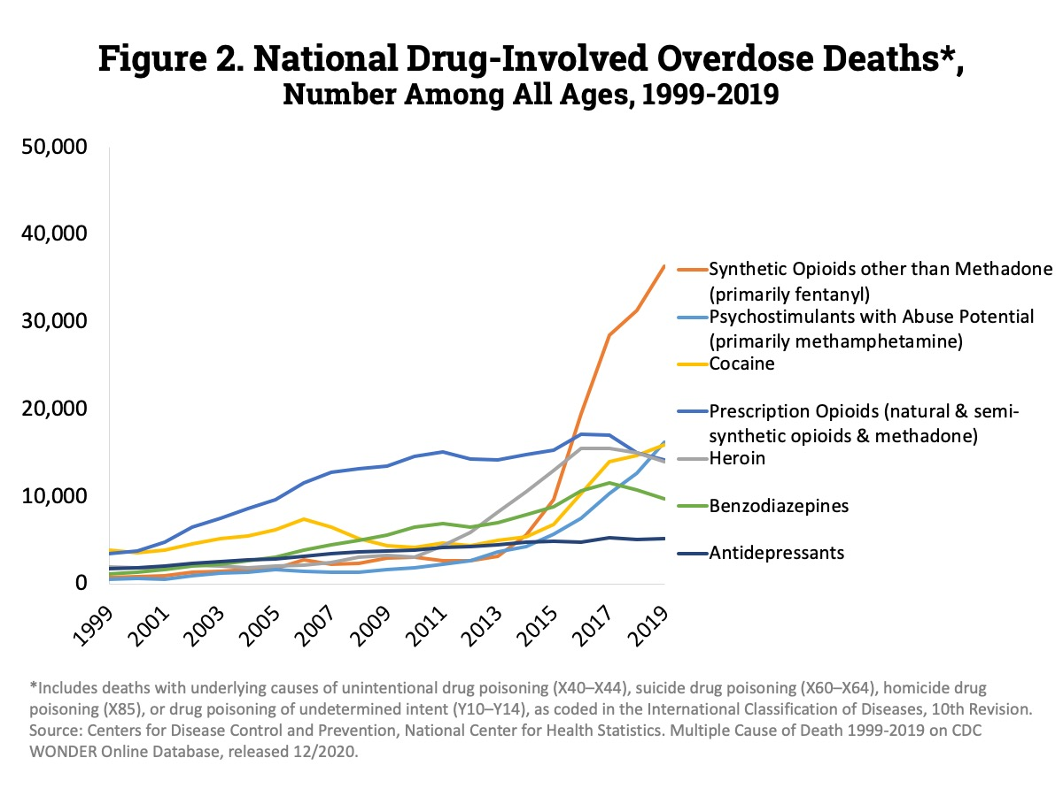
Nation

Slide 7
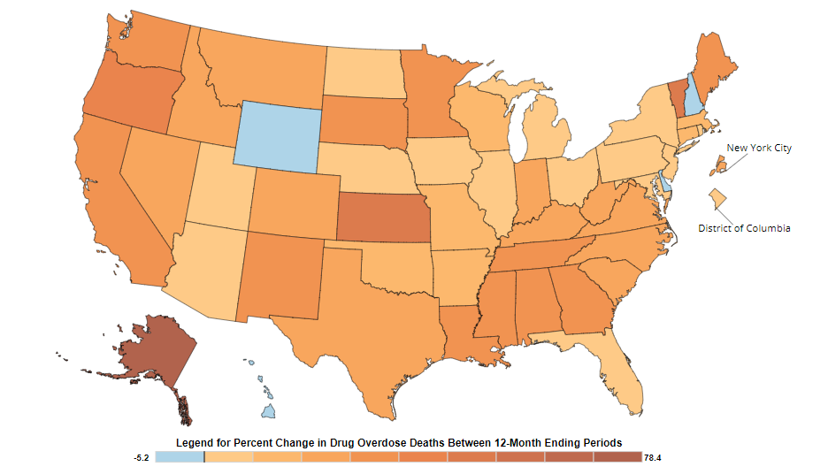
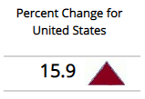
Nation

Slide 8
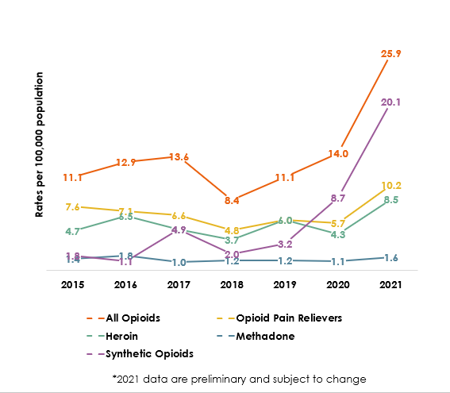
Alaska

Slide 9
Idaho
* 2021 data is preliminary and a crude death rate. The age-adjusted death rate is expected to increase as pending investigations are finalized and reported to Idaho BVRHS.

Slide 10
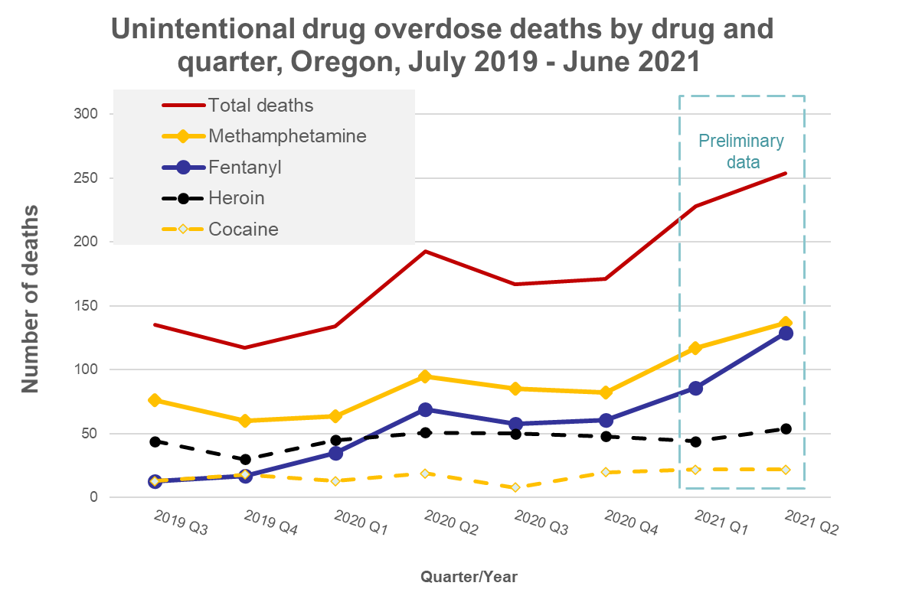
Oregon

Slide 11
Washington

Slide 12
Response & Resources
At the regional level, all states have basic infrastructure to respond to the current synthetic opioid overdose epidemic including:
- Medication for Opioid Use Disorder
- Syringe service programs
- Overdose education and naloxone distribution
- Behavioral health and recovery support services
- HIV and viral hepatitis screening & linkage to care
Acknowledge known barriers in federal and state policies, allowable uses of federal funding, and workforce-capacity.

Slide 13
Syringe Service Programs: Integrating Services for Rural Service Delivery
April 2022
Everett Maroon
Executive Director, Blue Mountain Heart to Heart

Slide 14
Models of Care in Rural Areas for Stigmatized Populations
Medication-Assisted Treatment Models
Behavioral Therapy Models
Harm Reduction Models
Care Delivery Models
Peer-based Recovery Support Models
Prevention Models
Source: https://www.ruralhealthinfo.org/toolkits/substance-abuse/2/program-models
Notes:
The increase in opioid prescribing, resultant addiction into misuse and opioid use disorder, and overdose deaths over the last twelve to fifteen years has not gone unnoticed by public health and public policy agencies. This opioid crisis has resulted in utilization of some older models of care from disciplines as varied as chemical dependency to public health prevention models to newer concepts coming out of behavioral health and peer services.
Syringe services fits into this varied set of models as a Harm Reduction Model. That will be the focus of this presentation. This is not to say that the other models of care aren’t useful or aren’t part of the crisis response infrastructure here in the Tri-Cities, just that where syringe services and exchange programs fit in, is as a harm reduction program.

Slide 15
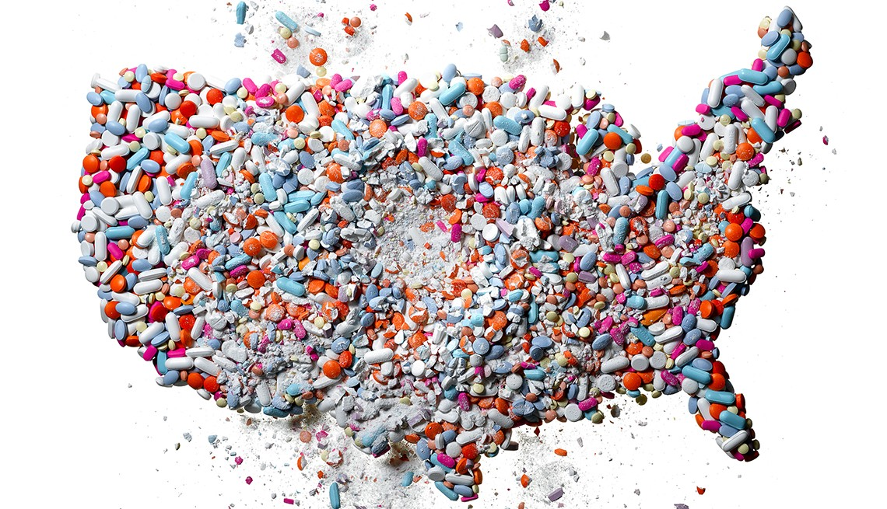
What Harm Reduction Does
It prevents the spread of blood borne pathogens. Not just HIV, but including HIV and hepatitis C, among others.
It reduces morbidity among people who inject drugs by providing clean needles and other supplies like alcohol wipes and Epsom salts. We see fewer infections—cellulitis, MRSA, for example—fewer amputations, fewer incidents of vein collapse, less tissue damage.
It reduces mortality associated with opioid overdose in part because exchangers learn to test their dope, because they tend to use less once they are in these programs, and because increasingly SSPs give out naloxone to reverse overdose.
It increases the likelihood that the exchanger will get into recovery and attempt sobriety.

Slide 16
How Harm Reduction Works
Harm reduction is a set of practical strategies and ideas aimed at reducing the negative consequences associated with drug use.
These strategies are translated into practices at the program level, and based on the body of evidence that identifies which practices work well (“best practices”) and which do not.
Harm reduction strategies work best when predicated on an individual community’s needs and population.

Slide 17
BMHTH’s Approach to SSPs
Warm Greeting—de-medicalize what is essentially a medical supplies transaction
Need-Based Exchange—estimate/count what comes in, document what goes out
Staff and Exchanger Safety—touch syringes as little as possible, use precautions, PPE, bloodborne pathogen protocols
Assess Stage of Change—use how people talk about themselves to offer low-barrier treatment, etc.
Ask about Other Needs—injection-related materials, health of body, need for referrals, antibody tests, vaccines, mental health, etc.
Naloxone Determination—for themselves or those they know
Genuine Goodbye—finish with a request to see us again
Notes:
What we’re trying to do with our engagement with program participants is build a relationship. The relationship increases trust between our staff and the program participants, which is the foundation for hearing what’s really going on with them so we can make the best referrals and get them into appropriate services. While harm reduction itself seeks only to mitigate the harm that injection drug use brings to them, we are also committed to supporting individuals into recovery from substance use. But we know that if we push the point or make their interactions around recovery or abstinence – in other words, if we repeat the stigmas they already encounter in the rest of their day – we won’t see them return, and then the program becomes another dead end for them instead of a bridge.
I know this point is challenging to make, because I know that this idea of “enabling” is very persistent until people have more experience with how the syringe services program works. What UW’s Dr. Banta-Green has shown is that with ongoing opioid use, the endorphin pathway of the brain – which opioids mimic very closely – makes it extremely difficult for people with OUD to quit cold turkey. And what we know from our surveys with our participants is that the great majority of them (78% in our 2017 study) want to stop using drugs. If we need a trust relationship for that to happen, then that is why we have centered our practices on creating that trust relationship. The reality is that the majority of people injecting drugs are going to keep doing it until they get support and medication for continued recovery. The relapse rate for people with OUD without any MAT is grim.
So what happens when someone comes into the exchange site is that we say hello and we ask them how they are that day. This is their first opportunity to say something honest or vulnerable with us. We produce a unique code by having them answer a few quick questions, and then we ask them a couple of demographic questions and where they live. They show us how many syringes they have and either we watch them count these out if they are rubber banded together in groups of ten, or we look through the clear lids of their sharps containers to estimate how many they have brought in to us. As you can see in the photo, the quart-sized containers we use hold a maximum of 50 needles. We don’t hand count every syringe because we don’t want to increase the likelihood of a needle stick injury to our staff, volunteers, or program participants. Then we write on our transaction log how many syringes we give out to the participant. Because they all have their own code we can track these exchanges over time per participant. If they are a little short on their count, we will round up to the nearest ten. We do this because we know from the evidence base that giving out less than what was brought in encourages needle reuse, which we don’t want to see. And we know that when program participants receive slightly more than they brought in they are more likely to offer clean syringes to their networks.
We then find out what else they need from the program. Anything that is known to transmit disease is offered at the site – so participants tell us if they need bandages, tourniquets, sterile water, and so on. We ask if they need any referrals to services. We ask if they know their HIV or hepatitis C status, and if they don’t, we offer them free antibody testing. We ask if they have naloxone, and then we have an opportunity to talk about how to identify opioid overdose and how to reverse one in progress. We tell people about how the Good Samaritan Law works in the state. At some point during this conversation the participant may offer that they have a health issue, so starting this week we will be able in Kennewick to refer them to wound care right across the street, provided by Ideal Option. When all is said and done we give them a genuine goodbye and tell them to come back again.
These aren’t just nice things to do for people, they are centered on what’s known as the spiral stages of change model to shift behavior. The stages are:
Precontemplation – not thinking about changing.
Contemplation – beginning to think change may be a good thing.
Preparation – making small changes.
Action – undertaking the new behavior.
Maintenance – the new behavior becomes habitual
We are focused on moving our program participants from precontemplation to action.

Slide 18
BMHTH’s Approach to SSPs, con’t.
Unique Codes—having de-duplicated data gives us much more information on how the program is working at the individual level, which helps us learn more about community health (more than 10,000 observations since 2018)
Ending Isolation—we may be seeing individuals who are not contacting other sectors in the community, like family court, primary care, social services, so we want to connect people to resources and shift their posture toward getting help
Connection to Self-Driven Change—our goal is to help exchangers become healthier, more self-aware, and more focused on improving their lives, up to and including recovery from opioid abuse
Notes:
Before we were grantees on the naloxone contract from SAMHSA, we collected only transactional data that didn’t tell us much about individual participants. The aggregate data were themselves astonishing … how did we go in Walla Walla from 70,000 syringes, to 84,000, to 108,000, and on until last year’s 577,000? Why was that trend mirrored across the state at all of the sites? Once we starting using unique identifying codes in 2017, we could see so much more data about individuals. We could see that it took four visits for 100 percent of participants to have naloxone. We could see the full range of visit frequency (in 2017 it was from 1 to 21 visits). We could compare exchanges brought in over time by individual participants, compare that to how often they got naloxone, and compare that to housing status and interest in getting into recovery. These more granular data helped inform practice changes at our sites in Walla Walla and Pasco because we continue to refer back to the deduplicated data to ensure our practices not only meet the gold standard for syringe services, but that they also are relevant to the participants here.

Slide 19
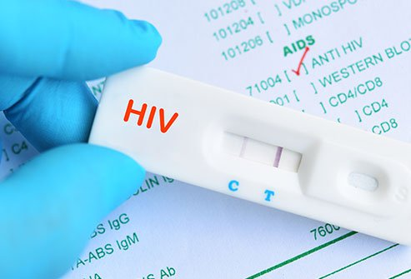
Infectious Disease Testing at SSP Sites—Logistics
Provide confidentiality (space considerations)
Provide rapid PCR testing (HIV, HCV, COVID)
Consider testing even when screener does not suggest high risk (people often deflate risk)
Offer vaccinations! Especially one-dose vaccine
Have culturally competent service delivery, know who your clients are
Be prepared to make referrals if test is reactive (e.g., confirmatory test, case management)

Slide 20
Mobile Low-Barrier Buprenorphine
Go where the clients are!
You need a private space for UA testing, consulting with clients
Complete clinical consult (e.g., COWS, SBIRT, vitals)
Set up separate waiting area and consult spaces (e.g., inside and outside of the mobile unit)
Consider TeleHealth for followup after dosing
Schedule in-person followup with in-house or partner orgs

Slide 21
Effects of COVID-19 on Service Provision
Protocols Changed
Moved operations outdoors
Screened participants for symptoms
Increased supplies distributed (10 ➡️ 50 syringes)
Participants Felt the Stress
Fentanyl took over regional drug supply
Movement from injectables to smoking
Higher stress lead to relapse … and overdose
Supply Chains Struggled
Long-term offline Pfizer naloxone
Plastics factory fire hurt sharps container production
Short allocations affected ordering process
Greater demand on PPE (e.g., gloves)

Slide 22
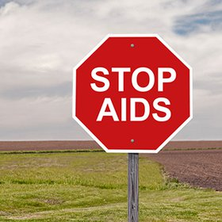
SSPs Can Become One-Stop Basic Clinics
Full STI testing (urine and blood samples)
Low-Barrier Buprenorphine Prescribing
HIV and HCV treatment sites
PrEP Prescribing
Case Management Services & Care Coordination
Housing Assistance
Free Wound Care Clinics
Free Individual and Peer Counseling
Overdose Prevention/Naloxone Distribution
Other services would first need legal support in WA State

Slide 23
Best Practice Documents
SSPs: Developing, Monitoring, and Implementing Programs
https://www.cdc.gov/hiv/pdf/risk/cdc-hiv-developing-ssp.pdf
World Health Organization/UN AIDS: Guide to Starting and Managing Needle & Syringe Programs
http://www.who.int/hiv/pub/idu/ needleprogram/en/
CDC: Evidence-Based Strategies for Preventing Opioid Overdose: What’s Working in the United States
https://www.cdc.gov/drugoverdose/pdf/pubs/2018-evidence-based-strategies.pdf
Recommended Best Practices for Effective Syringe Exchange Programs* in the United States: Results of a Consensus Meeting
https://harmreduction.org/wp-content/uploads/2012/01/NYC-SAP-Consensus-Statement.pdf

Slide 24
Newest guidance
SAMHSA resources page: https://www.samhsa.gov/find-help/harm-reduction
Evidence-Based Strategies for Preventing Opioid Overdose, CDC, 2018: https://www.cdc.gov/drugoverdose/pdf/pubs/2018-evidence-based-strategies.pdf
CDC Explanation on Requesting a Determination of Need for SSPs: https://www.cdc.gov/hiv/pdf/risk/cdc-hiv-syringge-Presentation_HHS_SSP_Guidance_Webinar.pdf
Cost-Effectiveness of Scaling up HCV Treatment with SSPs and MAT Services for People Who Inject Drugs in San Francisco and Rural Kentucky: https://ashecon.confex.com/ashecon/2018/webprogram/Paper6685.html
Dynamics of the HIV outbreak and response in Scott County, IN, USA, 2011–15: a modelling study, Gregg Gonsalves and Forrest Crawford, The Lancet HIV, October 2018
Notes:
Last remarks: Public health prevention work is difficult to describe to people, and here I mean beyond syringes and drug use and the opioid crisis. Just prevention in general, requires a bit of trust in the people doing the prevention work. It’s a little like figure skating. If it is done right, it looks effortless. The success belies all of the labor and energy that went into those outcomes. Sadly we do have counter-examples to show … like the following three HIV outbreaks.
Scott County, Indiana: Key Findings:
The outbreak had peaked by January 2015, further indicating time of public health response was too late and showing that the initial infections that gave rise to the outbreak were not detected for several years
Based on estimated actual incidence of 183/184 by August 2015, the model projects that:
Implementation in April 2011 would have resulted in between 0 and 10 cumulative infections (at least 173 infections averted, therefore preventing the outbreak)
Implementation in January 2013 would have resulted in between 0 and 56 cumulative infections (at least 127 infections averted, therefore mitigating the outbreak)
https://forrestcrawford.shinyapps.io/indiana-hiv/
Lawrence and Lowell, MA:
As of June 30, 2018, a total of 129 persons meeting the case definition were identified; 74 (57%) were male, 94 (73%) were aged 20–39 years at diagnosis, 87 (67%) were non-Hispanic white, and 38 (29%) were Hispanic. Most (114; 88%) reported a history of injection drug use (Figure), including four (3%) who also reported male-to-male sexual contact; 116 (90%) had laboratory evidence of past or current hepatitis C virus infection. Median CD4+ cell count at diagnosis was 550 cells/μL (range = 1–1,470), suggestive of a number of recent infections (3).
Seattle, WA:
Across King County, from 2017 to 2018, HIV diagnoses have risen threefold for heterosexuals who inject drugs.
The rapid increase of the infection rate is likely the coupling of a growing homeless population and the exploding opioid epidemic, said Dr. Matthew Golden, director of Public Health’s HIV/STD program.
“What we have is a growing population at risk,” he said.
The HIV strain showing up in this population worries public-health officials because homeless drug users are often hard to reach and connect with medical care and prevention programs. Public Health began working with medical providers, social-services agencies and others in the North Seattle cluster last summer when the outbreak was identified.
On-the-spot HIV testing has been expanded in the area of North Seattle around Aurora Avenue, as has the distribution of clean needles. Despite King County’s large needle-exchange program, it wasn’t reaching people in this area and added to the virus’ spread, said Golden.
Walla Walla County has roughly 50 prevalent HIV cases. BMHTH has 41 clients on our HIV service, and all but one of them is virally suppressed, meaning they cannot transmit the virus to another person. The Tri-Cities has approximately 220 HIV, with 105 cases managed by the Benton Franklin Health District. Roughly 75-80% of those cases, or 79 people, are virally suppressed. It is reasonable to say that we could have an HIV outbreak here, because people here are no different to HIV than people anywhere else. And regionally public health officials have been battling gonorrhea outbreaks, syphilis outbreaks, and spikes in hepatitis C.
From our own hepatitis C testing among people who inject drugs at our Pasco SSP site, BMHTH found:
2018-2019: 15 reactive antibody tests for HCV
Syringe service programs are good public health policy, they are compassionate, and they are effective in the four ways I described earlier. Some day we will look back on this opioid crisis with hindsight and deep perspective. Will we be able to say we responded with evidence and care to help the people who are struggling among us, or that we left them to climb onto the banks themselves? Thank you all for listening.

Slide 25
Questions?
Everett Maroon, Executive Director, Blue Mountain Heart to Heart
Regional Coordinator, SE Washington, SAMHSA WA PDO Project
Co-Chair, Greater Columbia Accountable Community of Health, Opioid Transformation Project
e.maroon@bmh2h.org
509-529-4744

