Slide 1
Best Practices for Finding and Crediting Images
Benton Cheung
Digital Project Manager UCSF Center for HIV Information
3/6/23

Slide 2
Agenda
Copyright and copyright statuses
Types of licenses
How to credit images or photos
Where to find images and photos online
Documenting copyright information
How to check copyright on images
Other considerations in image selection

Slide 3
Copyright and Copyright Statuses

Slide 4
What is copyright?
From Merriam-Webster:
the exclusive legal right to reproduce, publish, sell, or distribute the matter and form of something (such as a literary, musical, or artistic work)

Slide 5
About Copyright
Applies to images and photos that you find on the internet (and in print)
Fine of $200 to $150,000 for each work infringed
Copyright is automatically assigned to creators of the work
If you cannot find copyright information, always assume it is copyrighted.

Slide 6
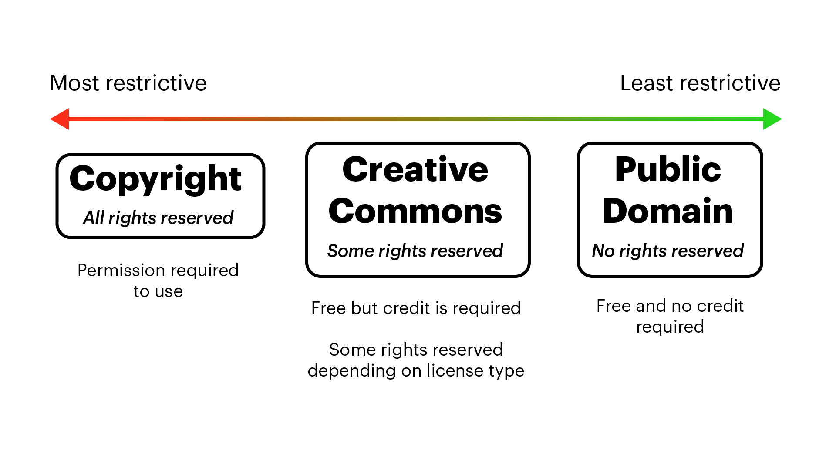
Copyright statuses

Slide 7
Creative Commons
Creative commons licenses allow you to use a creator’s work for free but with certain reservations depending on the type of license
There are 6 different creative commons licenses:
CC BY
CC BY-SA
CC BY-NC
CC BY-NC-SA
CC BY-ND
CC BY-NC-ND

Slide 8
Public domain
When a work is in the public domain, you are free to use the material in any way without restrictions and credit
Works produced before January 1, 1924 are automatically in the public domain
Works also enter public domain 70 years after creator’s death
Works that are produced by the U.S. government are also in the public domain
Search .gov website for images

Slide 9
Types of Licenses

Slide 10
When and how can we use images?
Unless a work is in the public domain, you must have a license
Exception: fair use doctrine
A doctrine under U.S. law that permits you to use material without obtaining permission
Usually for education or news
Determining fair use is a legal gray area
When in doubt, license or use something in the public domain

Slide 11
Common licenses
Creative Commons licenses
Royalty-free, Rights-managed, or Rights-ready
Commonly used in stock image websites
Editorial Use license
Typically used in news or education. Non-commercial uses only

Slide 12
Creative Commons licenses
There are 6 (+ 1) types of creative commons licenses. The type of license determines what you can do with the image or photo.
CC BY
CC BY-SA
CC BY-NC
CC BY-NC-SA
CC BY-ND
CC BY-NC-ND
+ CC0
BY: Credit must be given to the creator
SA (Share Alike): Adaptations must be shared under the same terms
NC (Noncommercial): Only noncommercial uses of the work are permitted
ND (No Derivatives): No derivatives or adaptations of the work are permitted
CC0 is treated as public domain

Slide 13
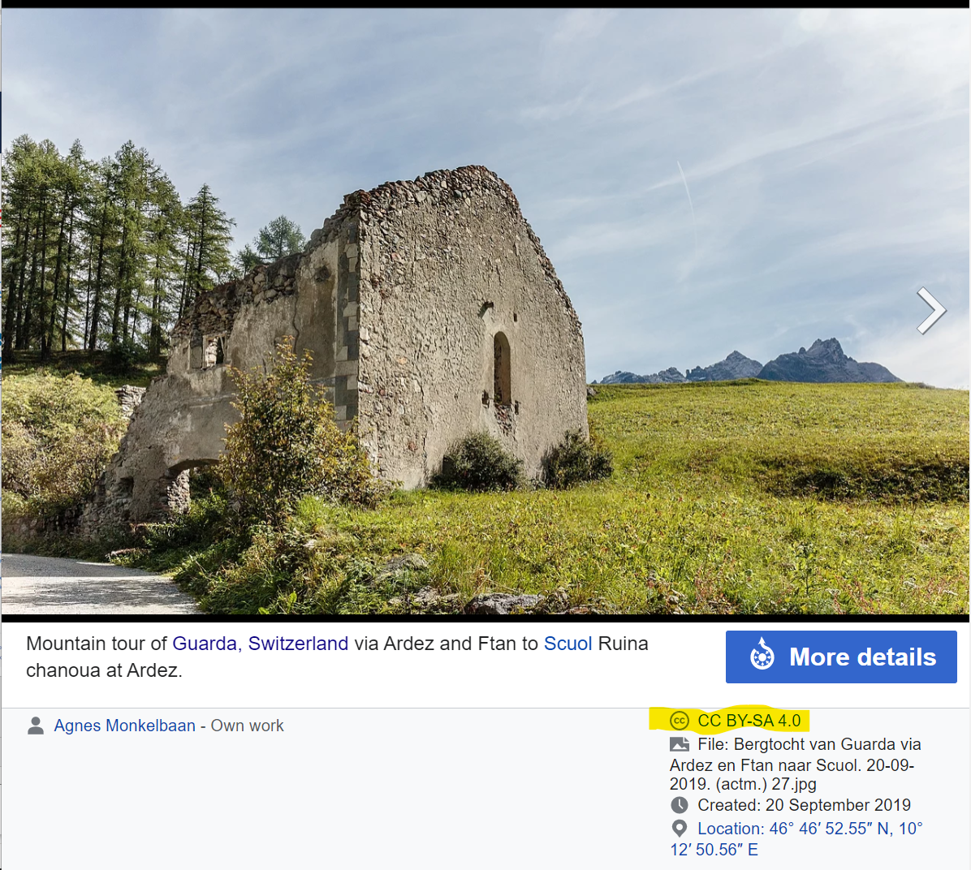
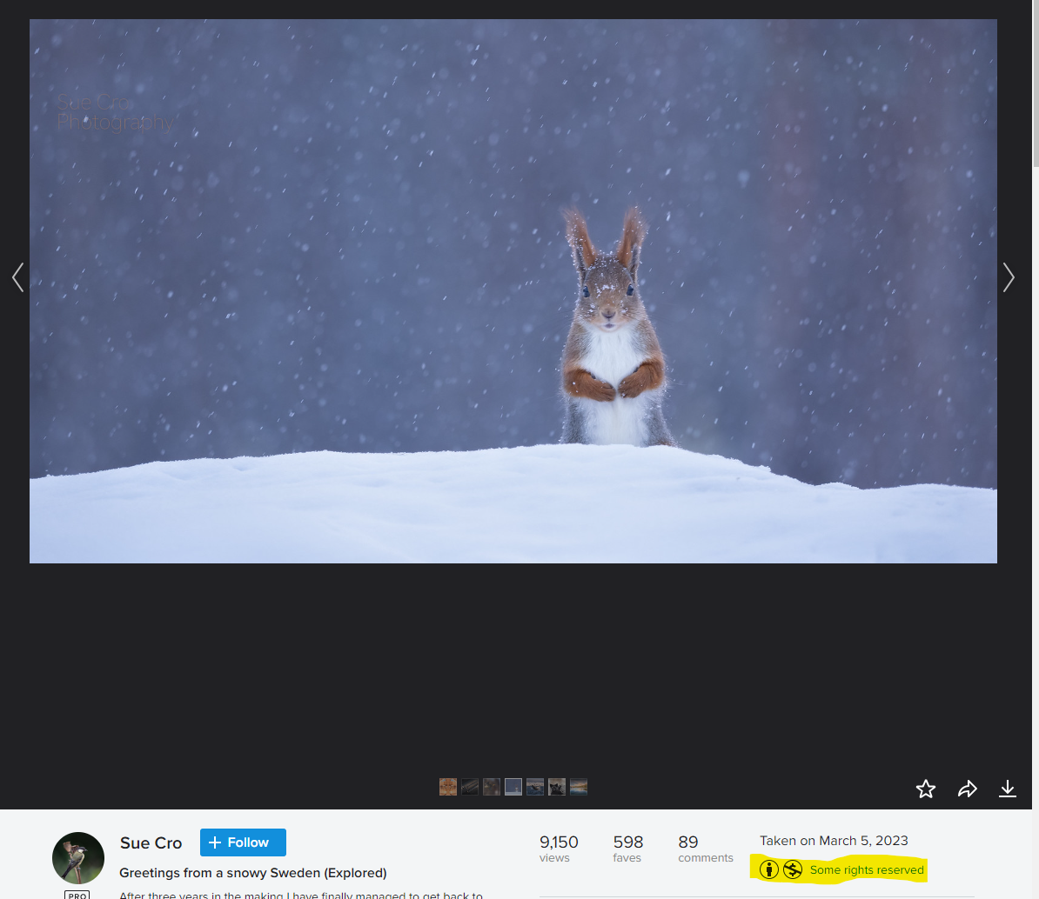
Creative Commons examples
Wikimedia Commons
Flickr

Slide 14
Royalty-free, rights-managed, rights-ready
These licenses are typically used in stock photography websites.
Royalty-free: You pay a one-time fee for the license to use the photo or image as you wish. You can normally use it an unlimited amount of times without needing to give credit.
Does NOT mean free! It means you do not need to pay additional royalties for each use.
Rights-managed, rights-ready: You pay a one-time fee to use the photo or image limited to the specific use (typically a one-time use). The image must be re-licensed to use in any additional projects.

Slide 15
How to Credit Images or Photos

Slide 16
How to give credit
When you use a CC-licensed work, it is recommended to include the Title, Author, Source, License (TASL).
“Creative Commons 10th Birthday Celebration San Francisco" by Timothy Vollmer is licensed under CC BY 4.0

Slide 17
How to give credit (example 1)
This is a great attribution:
Creative Commons 10th Birthday Celebration San Francisco" by Timothy Vollmer is licensed under CC BY 4.0
Title? "Creative Commons 10th Birthday Celebration San Francisco”
Author? "Timothy Vollmer" - linked to his profile page
Source? "Creative Commons 10th Birthday Celebration San Francisco" - linked to original Flickr page
License? "CC BY 4.0" - linked to license deed
It reasonably includes all the relevant information provided by the author.
Source: “Best practices for attribution” by CC Wiki (CC BY 4.)

Slide 18
How to give credit (example 2)
This is a pretty good attribution:
Photo by Timothy Vollmer/ CC BY
Title? Title is not noted but at least the source is linked.
Author? "Timothy Vollmer”
Source? "Photo" - linked to original Flickr page
License? "CC BY" - linked to license deed
Source: “Best practices for attribution” by CC Wiki (CC BY 4.)

Slide 19
How to give credit (example 3)
This is an incorrect attribution:
Photo: Creative Commons
Title? Title of the image is not noted
Author? Author is not noted (It is a common mistake to attribute CC-licensed photos to CC, but Creative Commons is not the author!)
Source? No link to the original source
License? There is no mention of a license nor a link to the license. "Creative Commons" is the name of an organization; it does not equate to any of the licenses maintained by the Creative Commons.
Source: “Best practices for attribution” by CC Wiki (CC BY 4.)

Slide 20
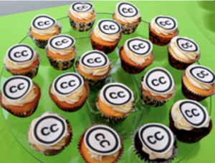
How to give credit (example 4)
This is a great attribution for an image you modified slightly:
"Creative Commons 10th Birthday Celebration San Francisco" by Timothy Vollmer, used under CC BY 4.0 / Cropped from original
Information on Title, Author, Source, and License are all included as requested by the author. The slight modification is also noted and briefly described.
Source: “Best practices for attribution” by CC Wiki (CC BY 4.)

Slide 21
How to give credit (example 5)
This is a great attribution for when you have created an adaptation:
This work, "90fied", is adapted from "Creative Commons 10th Birthday Celebration San Francisco" by Timothy Vollmer, used under CC BY 4.0. "90fied" is licensed under CC BY 4.0 by [Your name here].
Original Title, Author, Source, and License are noted.
The fact that it is an adaptation is also noted, so viewers can see what has changed.
The author and other attribution information for the new adapted work is also noted.
Source: “Best practices for attribution” by CC Wiki (CC BY 4.)

Slide 22
Where to display credit
Attribution should be next to the image or photo or at the bottom of the page or slide if it’s too obtrusive
Attribution can also be on a “credits” slide at the end of the of a slideshow. You should indicate the slide so people can find the specific image or photo
Always check whether the creator has specified a specific attribution

Slide 23
Credits slide (example)
Slide 18: Creative Commons 10th Birthday Celebration San Francisco" by Timothy Vollmer is licensed under CC BY 4.0
Slide 21: "Creative Commons 10th Birthday Celebration San Francisco" by Timothy Vollmer, used under CC BY 4.0 / Cropped from original

Slide 24
Where to Find Image and Photos Online

Slide 25
Online image libraries
Scientific Stock Images
Sciencesource (paid high-quality science stock photos)
Biorender (free educational plan available)
NIH Image Library (Public Domain and CC)
CDC Image Library (Most are public domain, but confirm status)
NIH History of Medicine (Most are public domain, but confirm status)
HIV-specific (all Public Domain)
National HIV Curriculum
Clinical Info HIV/AIDS Visual Glossary
AETC Flickr Collection
Creative Commons
Wikimedia Commons
Flickr (Watch out for copyrighted and Creative Commons images)
Disabled And Here Collection (Disabled BIPOC)
Public Domain
Pixabay
Pexels
Unsplash
Flickr (Watch out for copyrighted and Creative Commons images)
Library of Congress
Royalty-Free
Shutterstock
iStock
Getty
Alamy
Black Illustrations

Slide 26
Documenting Copyright Information

Slide 27
Keep a record of your image use
For every photo that you use, it’s recommended to save it and its copyright information in a spreadsheet or Digital Asset Management (DAM) software.
It’s good practice to keep a record:
Your program director/reviewer may need to reference it
The attribution may accidentally be deleted from the slide or page
For any legal disputes that may arise

Slide 28
What information to document
Spreadsheet
Title, Author, Source, License
Where it was used
Digital Asset Management (DAM) Software:
Adobe Bridge (free)
Bynder (paid service, typically used by teams and organizations/agencies)

Slide 29
How to check copyright on images
If you don’t have the copyright information, you can try a reverse Google search
Open the image in a web browser
Right click “Search Image with Google”
Find the source of the image and determine copyright
To open the image in a web browser, you will first need to save it on your computer.
If the image is in PowerPoint, right click and save it or take a screen shot of just the image.

Slide 30
Other Considerations in Image Selection

Slide 31
Tips and requirements
Use images to:
Illustrate a concept or setting
Create a mood
Avoid:
Personal identifiers (e.g., names, ID badge information, dates of birth, medical record numbers)
Copyrighted branding or logo (e.g., on clothing, on clinic-based materials such as boxes, medications, posters)
Visual chaos. Help viewers know where to focus their attention.

