Slide 1

National HIV Curriculum Promotional Slides
Please use any of these slides to promote the National HIV Curriculum. This free, up-to-date website is for clinicians and other healthcare professionals to learn about HIV diagnosis, treatment, and prevention.
Thank you for informing your audience about the National HIV Curriculum: www.hiv.uw.edu.
The National HIV Curriculum is supported by the Health Resources and Services Administration (HRSA) of the U.S. Department of Health and Human Services (HHS) as part of a financial assistance award totaling $1,0121,448 with 0% financed with non-governmental sources. The contents are those of the author(s) and do not necessarily represent the official views of, nor an endorsement, by HRSA, HHS, or the U.S. Government. For more information, please visit HRSA.gov.
Notes:
New 3-year CE accreditation period began September 1,2020

Slide 2
National HIV Curriculum (NHC) Promo Slides Content
The slide deck features examples from:
Promotional Materials
Overview and Features
Lessons
Question Bank Topics
Clinical Calculators
Antiretroviral Medications Section
HIV Symptom Evaluation Guides

Slide 3

www.hiv.uw.edu
The free National HIV Curriculum addresses the diagnosis, treatment, and prevention of HIV.
37 lessons and 37 corresponding question bank topics
97 free CME credit, MOC points, CNE contact hours, and CE contact hours;
70 pharmacology CE for advanced practice nurses; and Certificates of Completions
18 clinical screening tools and calculators
In-depth antiretroviral medications section
Mini-lectures on clinically relevant topics
5 practical HIV Symptom Evaluation Guides
A learning group tool for healthcare entities & training programs to enroll members,
assign units, and track progress
The National HIV Curriculum is supported by the Health Resources and Services Administration (HRSA) of the U.S. Department of Health and Human Services (HHS) as part of a financial assistance award totaling $1,021,448 with 0% financed with non-governmental sources. The contents are those of the author(s) and do not necessarily represent the official views of, nor an endorsement, by HRSA, HHS, or the U.S. Government. For more information, please visit HRSA.gov.

Slide 4

The National HIV Curriculum is supported by the Health Resources and Services Administration (HRSA) of the U.S. Department of Health and Human Services (HHS) as part of a financial assistance award totaling $1,0121,448 with 0% financed with non-governmental sources. The contents are those of the author(s) and do not necessarily represent the official views of, nor an endorsement, by HRSA, HHS, or the U.S. Government. For more information, please visit HRSA.gov.
Notes:
Postcard Front

Slide 5
University of Washington (UW) Professor of Medicine Dr. David Spach is Editor-in-Chief of this site and curricula on STDs (www.std.uw.edu), HCV (www.hepatitis.uw.edu), and HBV (www.hepatitisB.uw.edu) with free CE created by the UW Infectious Diseases Education & Assessment (IDEA) Program (idea.medicine.uw.edu).
Notes:
Postcard back

Slide 6
National HIV Curriculum Features
Comprehensive and up-to-date resource
100% federally funded, free of commercial bias
37 lessons and corresponding question bank topics
Free CME/MOC/CNE/CE
18 clinical screening tools and calculators
In-depth antiretroviral medications section
Mini-lectures on clinically relevant topics
5 practical HIV Symptom Evaluation Guides
Online learning group functionality for onboarding and training
Individualized and learning group progress trackers
Notes:
Key features summary for healthcare training programs

Slide 7
Six Modules: Lessons and Question Bank Topics
Six modules with 37 lessons and corresponding question bank topics address:
    Screening and Diagnosis
    Basic HIV Primary Care
    Antiretroviral Therapy
    Co-Occurring Conditions
    Prevention of HIV
    Key Populations
97 free CME credit, MOC points, CNE contact hours, and CE contact hours; 70 pharmacology CE for advanced practice nurses
(A learner needs about 1 hour to earn 1 CE)
University of Washington Certificates of Completion are also available
Notes:
List of Modules and information about CE

Slide 8
National HIV Curriculum Features:
Antiretroviral Medications
Course Modules
Question
Bank
Tools and Calculators
48 Medications
6 Modules
37 Lessons
462
Questions
17
Tools/ Calculators
51.5
CE Credits
46
CE Credits
97.5
Total CE Credits
Notes:
70 pharmacology CE for advanced practice nurses

Slide 9
General Principles of National HIV Curriculum
Addresses comprehensive spectrum of HIV clinical care
Relevant for a broad range of healthcare providers
Recommendations are based on U.S. federal guidelines
Developed core competencies to inform curriculum
Delivers a free educational resource
Provides dual functionality: Quick Reference or Self-Study
Offers online learning group functionality to onboard and train healthcare professionals

Slide 10
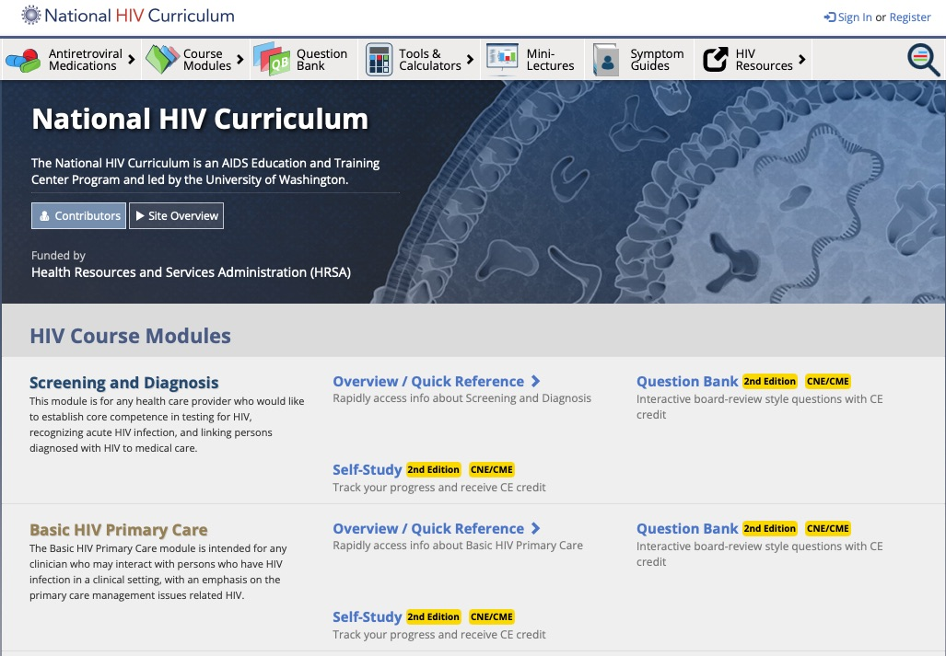
An AIDS Education and Training Center Program led by the University of Washington
Editor-in-Chief: David H. Spach, MD
Funded by a grant from the Health Resources and Services Administration
Notes:
Dr. David Spach is also Editor-in-Chief of the National STD Curriculum, Hepatitis C Online and the Hepatitis B Online. All of our federally funded curricula offer free CE and are part of the Infectious Disease Education and Assessment (IDEA) e-learning platform.

Slide 11
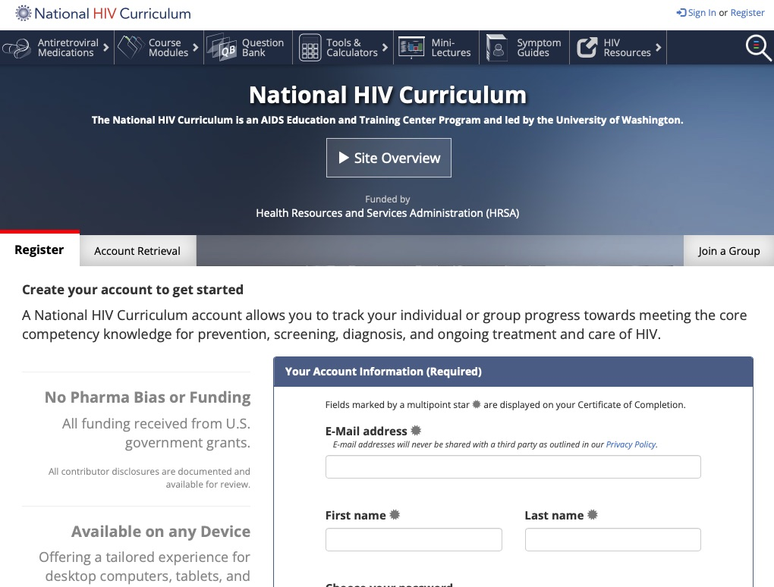
Dual Functionality
Quick Reference
Highly organized interface
Quick search
On demand topics
Downloadable PDF option
Ideal for staying updated
Self-Study (Modular)
Sequential (Step-by-Step) or choose topics
Flexible modular options
Certificate program
Ideal for training programs
Notes:
Click on ”Register” on the upper right, watch the site overview video, and complete the participant form. Registrants have same user name and password on IDEA' National STD Curriculum, Hepatitis C Online, and Hepatitis B Online.

Slide 12
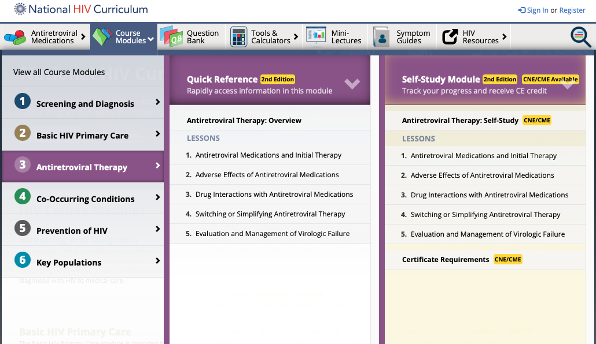
Drop down menu gives dual access for Quick Reference or Self Study
Notes:
6 modules: 37 lessons. The amount of CE available in the self-study lessons varies. The 37 question bank topics mirror the lessons.

Slide 13
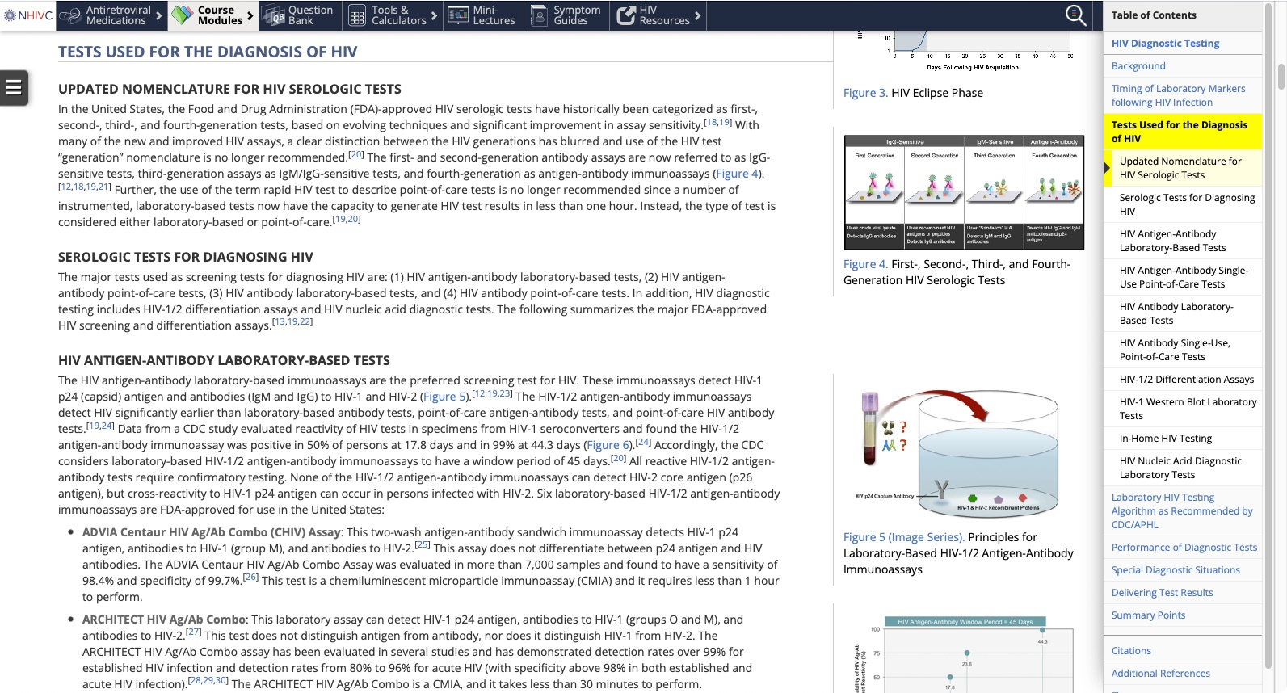
Modules cover 37 major HIV topics
Notes:
An example of one lesson and the available navigational tools. The site has an extensive bibliography.

Slide 14
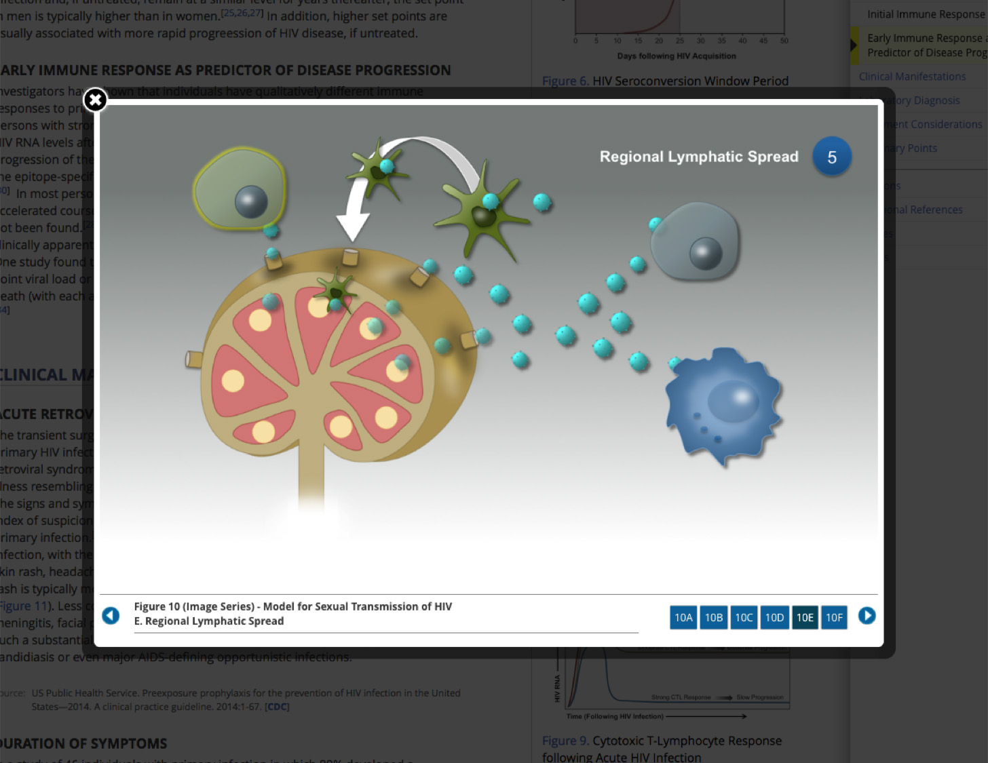
Image Series: Concepts
Notes:
The site features easy-to-understand, high-resolution images which demonstrate complex clinical events.

Slide 15
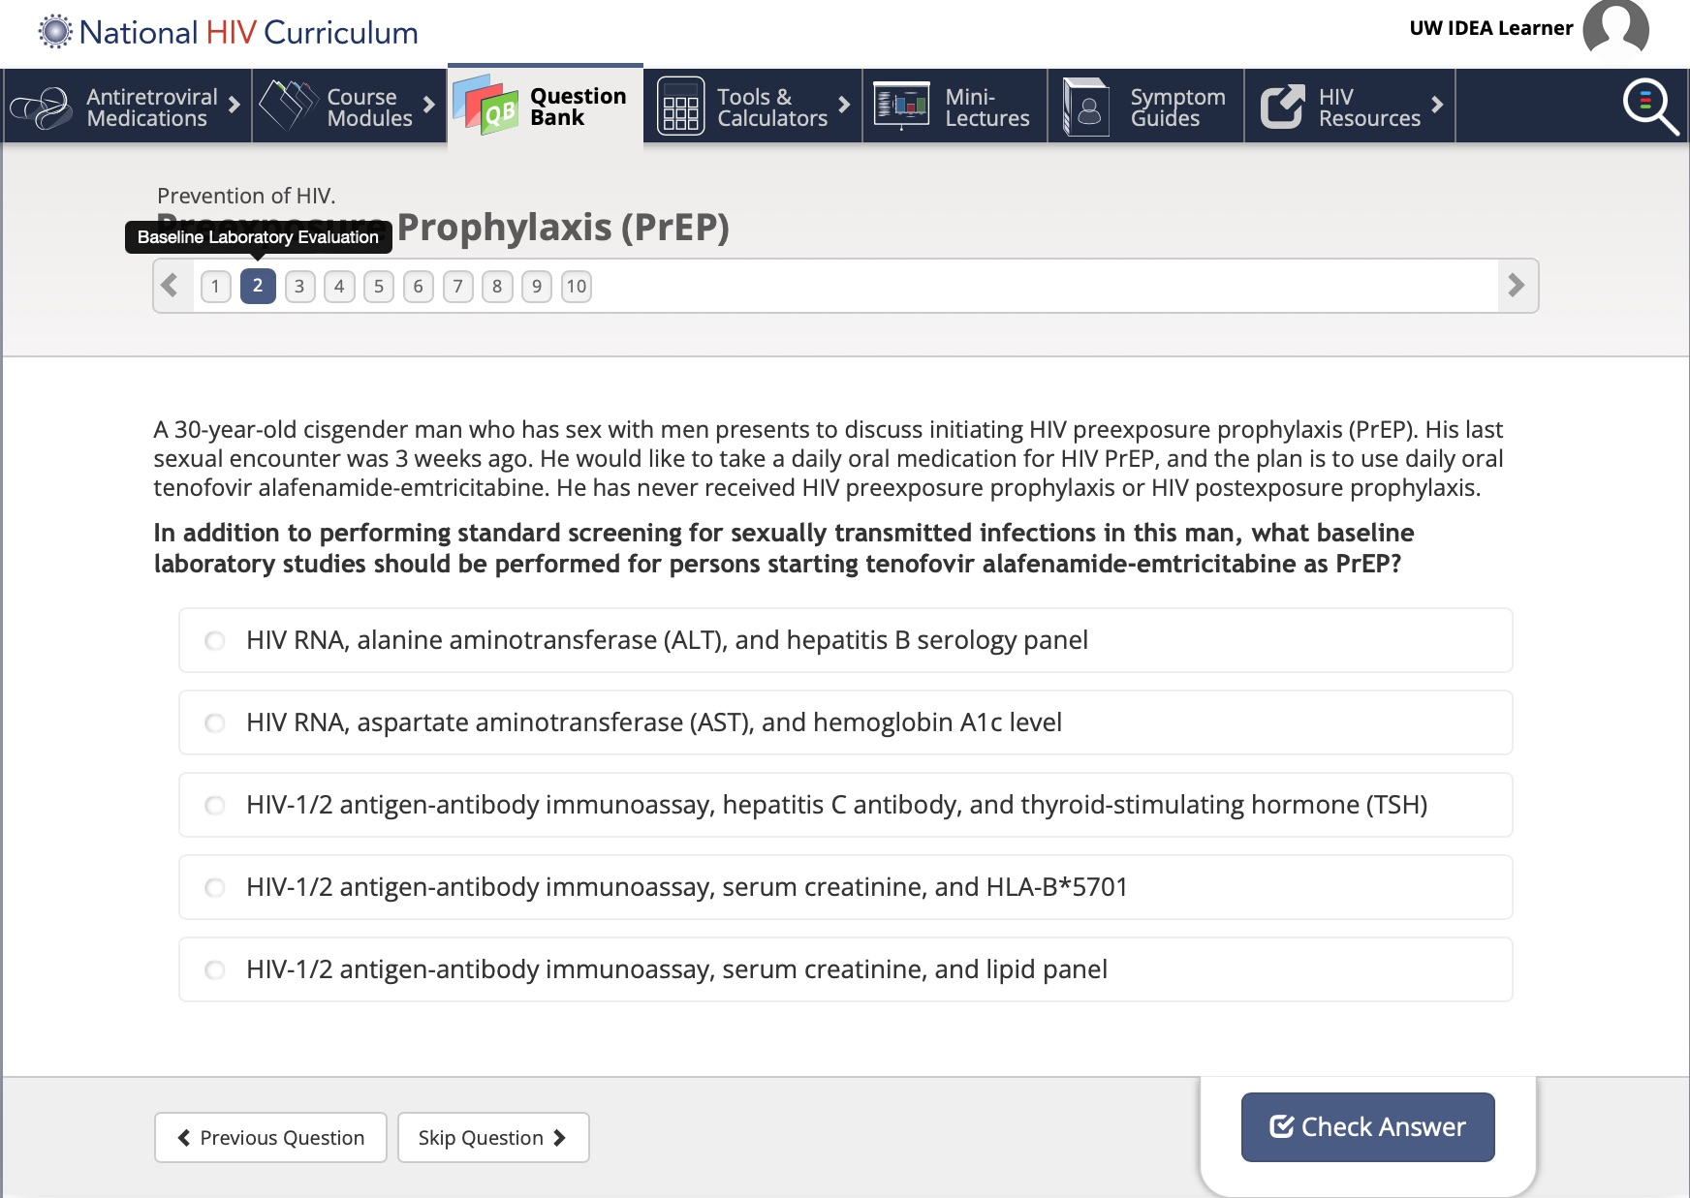
Question Bank
450+ Board Review Style Learning and Assessment Questions
Notes:
Question bank topics mirror the lessons. Any user can access question bank topics but to track progress, the user must register on the site. Registered learners can earn CME and CNE credit when at least 80% of a topic’s answers are correct. Available CE credit varies by the number of questions but, generally, five questions are equivalent to .5 CE. This sample unit has 1.0 CE available.

Slide 16
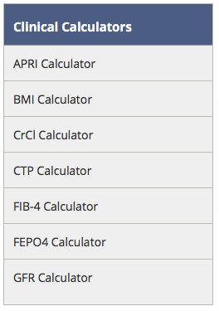
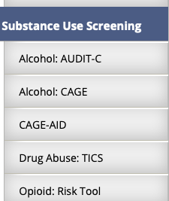
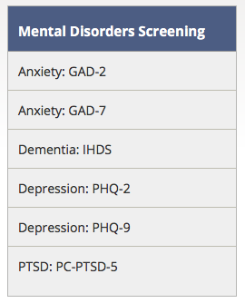
18 Clinical Calculators & Screening Tools
Using your own electronic device, you can access:
Notes:
Free and easily accessible calculators and tools that users can access on their phones or other electronic devices to help with clinical decision making.

Slide 17
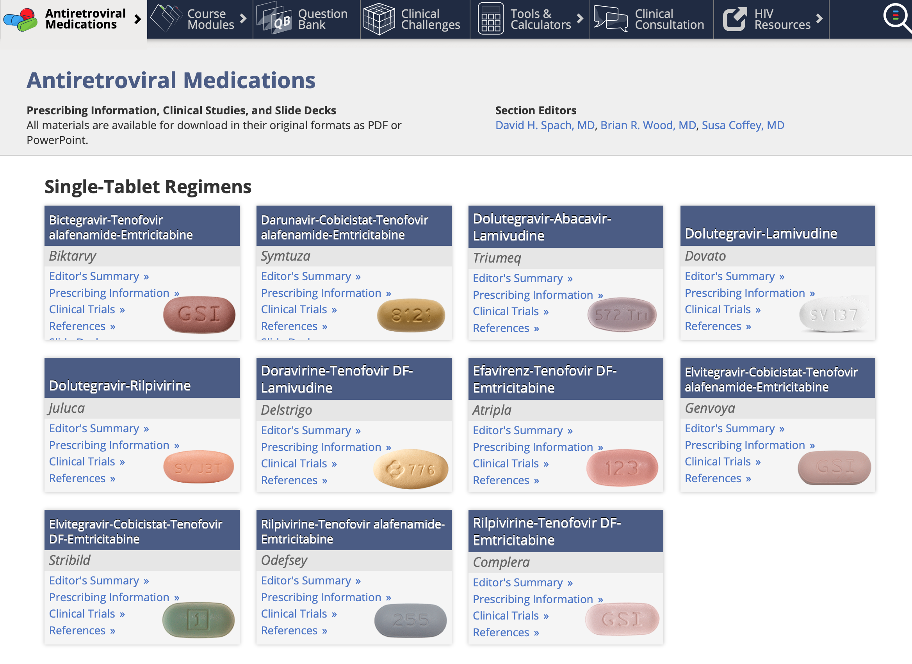
Antiretroviral Medications
Notes:
Downloadable prescribing information, clinical studies, and slide decks are only one click away. Treatments not approved by the FDA are clearly marked “Investigational” with a blue triangle icon.

Slide 18
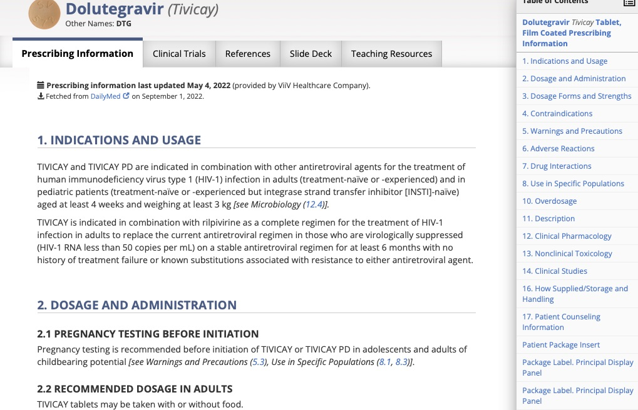
Antiretroviral Medications
Comprehensive ARV medications resource, including Power Point slides for trials
Notes:
An example of what information is available on ARV medications and the many navigational tools which can be used to move quickly through the section.

Slide 19
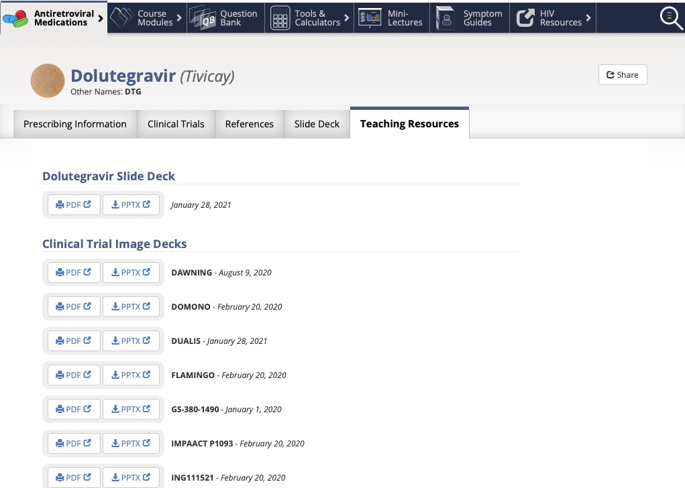
Antiretroviral Medications
Teaching Resources: Downloadable PDFs and PowerPoint Slide Decks
Notes:
Slide decks can be downloaded and used without permission.

Slide 20
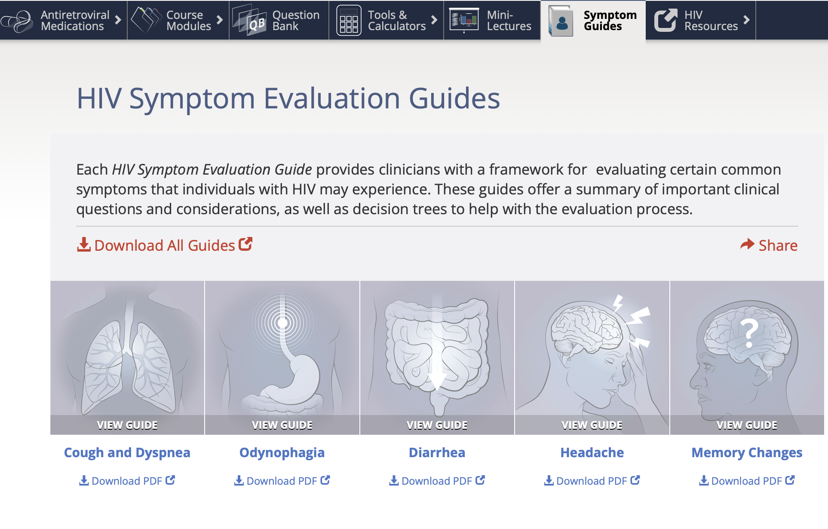
HIV Symptom Evaluation Guides
Teaching Resources: Downloadable PDFs
Notes:
The five, 6-page guides can be viewed, shared or downloaded.

Slide 21
Why Online Learning Groups are Formed
Train or onboard staff and residents by assigning selected topics
Review group progress reports to track CE and shape future trainings
Implement a training plan across multiple locations
Augment medical, nursing, pharmacy, dental and other healthcare professionals training programs

