Slide 1
ARVs for Initial Therapy: Characteristics and Adverse Effects
Guidelines for the Use of Antiretroviral Agents in Adults and Adolescents
April 2023

Slide 2
About This Presentation
These slides were developed using the Guidelines updated in September 2022.
The intended audience is clinicians involved in the care of patients with HIV.
Because the field of HIV care is rapidly changing, users are cautioned that the information in this presentation may become out of date quickly.
It is intended that these slides be used as prepared, without changes in either content or attribution. Users are asked to honor this intent.

Slide 3
Guidelines for the Use of Antiretroviral Agents in HIV-1-Infected Adults and Adolescents
Developed by the Department of Health and Human Services (DHHS) Panel on Antiretroviral Guidelines for Adults and Adolescents – A Working Group of the Office of AIDS Research Advisory Council (OARAC)
https://clinicalinfo.hiv.gov

Slide 4
ARVs for Initial Therapy: Characteristics and Adverse Effects, Outline
ARV classes and agents – advantages and disadvantages
ARV adverse effects (AE)

Slide 5
Available ARV Classes and Medications
NRTI
Abacavir (ABC)
Didanosine (ddI)
Emtricitabine (FTC)
Lamivudine (3TC)
Stavudine (d4T)
Tenofovir DF (TDF)
Tenofovir alafenamide (TAF)
Zidovudine (AZT, ZDV)
NNRTI
Delavirdine (DLV)
Doravirine (DOR)
Efavirenz (EFV)
Etravirine (ETR)
Nevirapine (NVP)
Rilpivirine (RPV)
Integrase Inhibitor (INSTI)
Bictegravir (BIC)
Cabotegravr (CAB)
Dolutegravir (DTG)
Elvitegravir (EVG)
Raltegravir (RAL)
PI
Atazanavir (ATV)
Darunavir (DRV)
Fosamprenavir (FPV)
Indinavir (IDV)
Lopinavir (LPV)
Nelfinavir (NFV)
Saquinavir (SQV)
Tipranavir (TPV)
Pharmacokinetic (PK) Booster
Ritonavir (RTV, /r)
Cobicistat (COBI, /c)
Fusion Inhibitor
Enfuvirtide (ENF, T-20)
CCR5 Antagonist
Maraviroc (MVC)
Entry Inhibitor
Fostemsavir (FOS)
Ibalizumab (IBA)
Capsid Inhibitor
Lenacapavir (LEN)

Slide 6
Commonly-used ARV Medications
NRTI
Abacavir (ABC)
Didanosine (ddI)
Emtricitabine (FTC)
Lamivudine (3TC)
Stavudine (d4T)
Tenofovir DF (TDF)
Tenofovir alafenamide (TAF)
Zidovudine (AZT, ZDV)
NNRTI
Delavirdine (DLV)
Doravirine (DOR)
Efavirenz (EFV)
Etravirine (ETR)
Nevirapine (NVP)
Rilpivirine (RPV)
Integrase Inhibitor (INSTI)
Bictegravir (BIC)
Cabotegravir (CAB)
Dolutegravir (DTG)
Elvitegravir (EVG)
Raltegravir (RAL)
PI
Atazanavir (ATV)
Darunavir (DRV)
Fosamprenavir (FPV)
Indinavir (IDV)
Lopinavir (LPV)
Nelfinavir (NFV)
Saquinavir (SQV)
Tipranavir (TPV)
Pharmacokinetic (PK) Booster
Ritonavir (RTV, /r)
Cobicistat (COBI, /c)
Fusion Inhibitor
Enfuvirtide (ENF, T-20)
CCR5 Antagonist
Maraviroc (MVC)
Entry Inhibitor
Fostemsavir (FOS)
Ibalizumab (IBA)
Capsid Inhibitor
Lenacapavir (LEN)

Slide 7
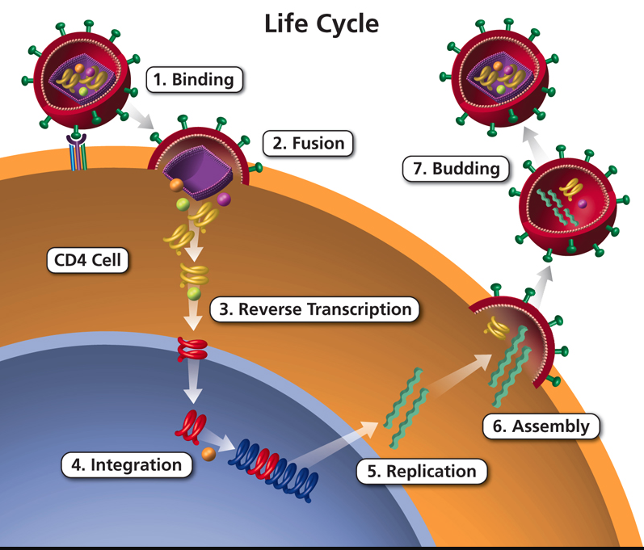
HIV Life Cycle and Targets for ARVs
Graphic: clinicalinfo.nih.gov

Slide 8
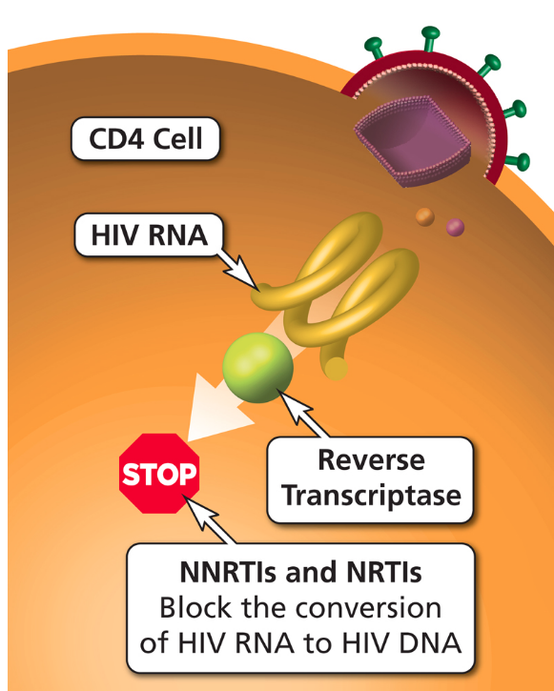
ARV Components in Initial Therapy: NRTI Pairs
ADVANTAGES
Established backbone of combination therapy
Minimal drug interactions
DISADVANTAGES
Lactic acidosis and hepatic steatosis reported with most NRTIs (rare)
Graphic: clinicalinfo.nih.gov

Slide 9
Initial Therapy: Dual-NRTI Pairs (1)
ABC/3TC
Once-daily dosing
Coformulated with DTG in single-pill regimens
Use only for patients who are negative for HLA-B*5701 (risk of hypersensitivity reaction if positive)
Possible risk of cardiovascular events; caution in patients with CV risk factors
Possible inferior efficacy if baseline HIV RNA >100,000 copies/mL and used with EFV, ATV/r, or RAL
Should not be used for treatment of HBV

Slide 10
Initial Therapy: Dual-NRTI Pairs (2)
TDF/FTC, TDF/3TC
Once-daily dosing
In several single-pill regimen coformulations
Active against HBV
Potential for renal and bone toxicity (more than with TAF); exacerbated by PK boosters
Avoid if renal disease or osteoporosis
Lower lipid levels (vs ABC and TAF)
TAF/FTC
Once-daily dosing
In several single-pill regimen coformulations
Active against HBV
Renal and bone toxicity; less common than with TDF/FTC
Approved for eGFR ≥30 mL/min
Excess weight gain (vs ABC and TDF) in some studies

Slide 11
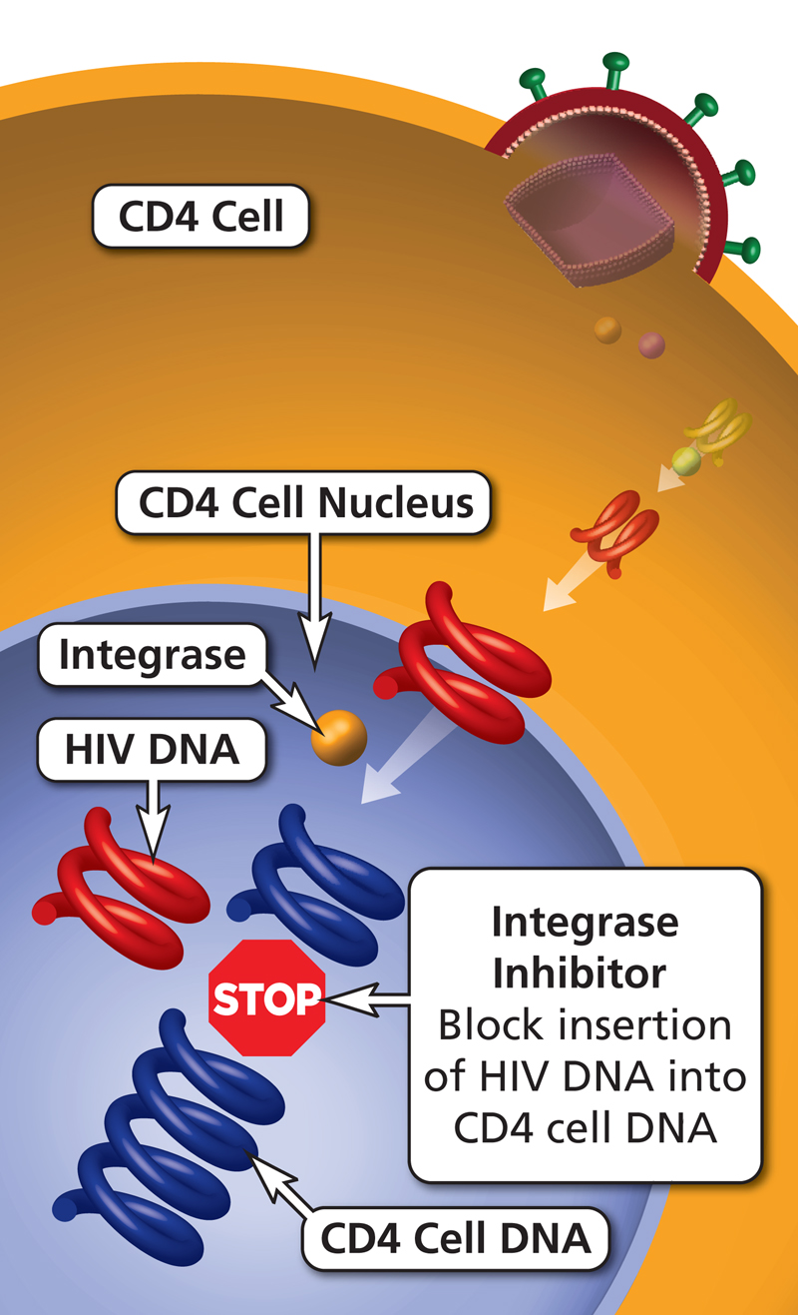
ARV Components in Initial Therapy: INSTIs
ADVANTAGES
DTG, BIC: higher barrier to resistance than RAL, EVG
Low rates of AEs
Few drug-drug interactions (not true of EVG/COBI)
Single-pill combination regimens available with BIC, DTG, EVG/COBI
CAB: long-acting injectable formulation
DISADVANTAGES
RAL, EVG: lower genetic barrier to resistance than DTG, BIC, PIs
COBI: many drug-drug interactions
Greater weight gain (especially with TAF)
Graphic: clinicalinfo.hiv.gov

Slide 12
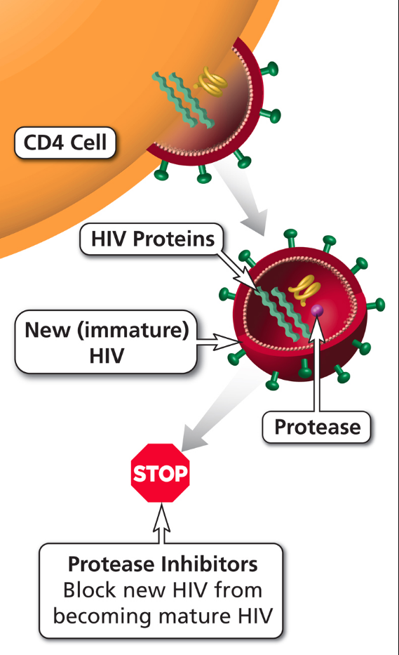
ARV Components in Initial Therapy: PIs
ADVANTAGES
High genetic barrier to resistance
PI resistance uncommon with failure of boosted PIs
Single-pill combination regimen available with DRV
DISADVANTAGES
Metabolic complications (less likely with DRV and ATV than with older PIs)
GI intolerance
Higher potential for drug interactions (CYP450), especially with RTV
Graphic: clinicalinfo.hiv.gov

Slide 13
ARV Components in Initial Therapy: NNRTIs
ADVANTAGES
Long half-lives
Less metabolic toxicity (dyslipidemia, insulin resistance) vs. some PIs
Single-pill combination regimens available with DOR, EFV, and RPV
RPV: long-acting injectable option
DISADVANTAGES
Low genetic barrier to resistance
High rates of NNRTI resistance if virologic failure
Cross-resistance among most NNRTIs
EFV: high rate of CNS adverse effects
RPV: lower efficacy if HIV RNA >100,000 or CD4 <200
Rash; hepatotoxicity
CYP450 drug interactions
Graphic: clinicalinfo.hiv.gov

Slide 14
Adverse Effects
Important to anticipate and overcome ART toxicities in order to achieve ART success over a lifetime
Consider potential adverse effects when selecting ARV regimen; also consider overlapping toxicities of patient’s other medications, drug-drug interactions, patient’s comorbidities, and previous history of ARV intolerance

Slide 15
Adverse Effects: NRTI Class Effects
Lactic acidosis and hepatic steatosis (with older NRTIs; not likely with 3TC, FTC, ABC, TAF, TDF)
Lipodystrophy (with older NRTIS, especially d4T, AZT; not likely with 3TC, FTC, ABC, TAF, TDF)

Slide 16
Adverse Effects: Individual NRTIs (1)
Emtricitabine (FTC)
Minimal toxicity
Hyperpigmentation
In HBV coinfection, exacerbation of HBV if discontinued
Lamivudine (3TC)
Minimal toxicity
In HBV coinfection, exacerbation of HBV if discontinued

Slide 17
Adverse Effects: Individual NRTIs (3)
Abacavir (ABC)
Hypersensitivity reaction (contraindicated if HLA-B*5701 positive)
Rash
Possible increased risk of MI
Tenofovir alafenamide (TAF) Tenofovir disoproxyl fumarate (TDF)
Renal impairment* (increased Cr, proteinuria, metabolic acidosis, other)
Decrease in bone-mineral density*
In HBV coinfection, exacerbation of HBV if discontinued
Headache
GI intolerance
Weight gain (TAF)
* Less likely with TAF vs TDF

Slide 18
Adverse Effects: INSTI Class Effects
Rash, hypersensitivity reaction
Insomnia, depression
Possible weight gain

Slide 19
Adverse Effects: Individual INSTIs
Bictegravir (BIC) and Dolutegravir (DTG)
Headache
Insomnia
DTG: increased Cr*
Weight gain
Cabotegravir (CAB) - Long-acting injectable formulation
Injection site reactions
Elvitegravir/ cobicistat (EVG/c)
Increased Cr*
Increased risk of TDF-related nephrotoxicity
Nausea, diarrhea
Weight gain
Raltegravir (RAL)
Nausea
Headache
Diarrhea
CPK elevation, myopathy, rhabdomyolysis
* Inhibition of Cr secretion; no effect on glomerular function

Slide 20
Adverse Effects: PI Class Effects
Hyperlipidemia (boosted PIs)
Lipodystrophy (not likely with ATV or DRV)
Hepatotoxicity
GI intolerance
Possibility of increased bleeding risk for hemophiliacs
Drug-drug interactions

Slide 21
Adverse Effects: Individual PIs
Atazanavir (ATV)
Hyperbilirubinemia
PR prolongation
Nephrolithiasis, cholelithiasis
CKD
Darunavir (DRV)
Rash
Liver toxicity
Possible increased risk of cardiovascular events

Slide 22
Adverse Effects: Pharmacokinetic Boosters
Both PK boosters:
GI intolerance
Increased risk of renal toxicity if given with TDF
Increased lipids if given with PIs
Ritonavir (RTV, /r)
Hyperglycemia
Hepatitis
Cobicistat (COBI, /c)
Increased serum Cr (inhibition of Cr secretion; no effect on glomerular function)

Slide 23
Adverse Effects: NNRTI Class Effects
Rash, including Stevens-Johnson syndrome
Hepatotoxicity (especially NVP)
Drug-drug interactions

Slide 24
Adverse Effects: Individual NNRTIs
Efavirenz (EFV)
Neuropsychiatric
Dyslipidemia
QTc prolongation
Doravirine (DOR)
Sleep disturbance, dizziness
Depression
Etravirine (ETR)
Nausea
Rilpivirine (RPV)
Depression, insomnia
QTc prolongation
Increased serum Cr (inhibition of Cr secretion; no effect on glomerular function)
Long-acting injectable formulation: injection site reactions

Slide 25
Adverse Effects: Individual Entry Inhibitors
Maraviroc (MVC)
Rash
Abdominal pain
Cough
Hepatotoxicity
Musculoskeletal symptoms
Orthostatic hypotension, especially if severe renal disease
Enfuvirtide (ENF, T-20)
Injection-site reactions
Hypersensitivity reaction
Increased risk of bacterial pneumonia
Ibalizumab (IBA)
Diarrhea
Rash
Increased creatinine
Fostemsavir (FOS)
Nausea, diarrhea
QTc prolongation

Slide 26
Adverse Effects: Capsid Inhibitor
Lenacapavir
Injection site reactions
Headache
Nausea, diarrhea

Slide 27
Websites to Access the Guidelines
AETC National Coordinating Resource Center https://aidsetc.org
Clinical Info https://clinicalinfo.hiv.gov

Slide 28
About This Slide Set
This presentation was prepared by Susa Coffey, MD, for the AETC National Resource Center in April 2023.
Visit the AETC NCRC website for the most current version.
https://aidsetc.org

