Slide 1
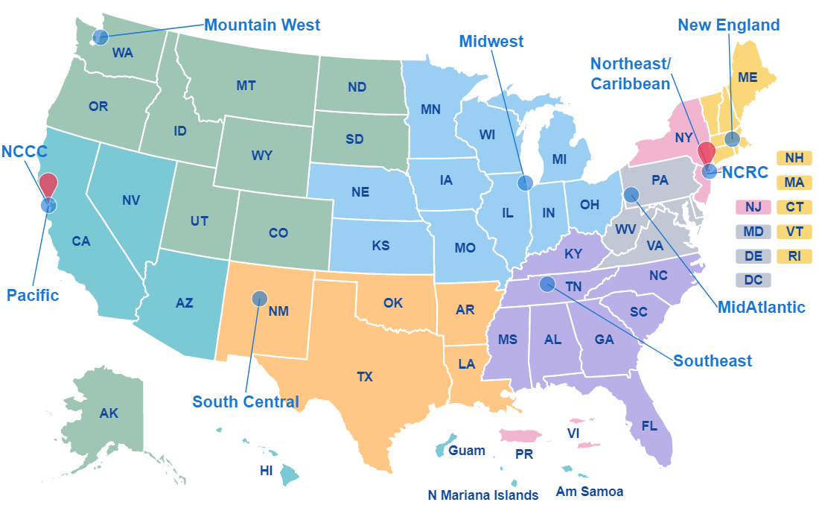
AIDS Education & Training Center Program Regional Centers
Notes:
United States Map showing the states and what regions they belong to:
MidAtlantic AETC: Pennsylvania, Virginia, West Virginia, Maryland, Delaware, Washington DC.
Midwest AETC: Michigan, Missouri, Ohio, Illinois, Indiana, Iowa, Wisconsin, Kansas, Nebraska
Mountain West AETC: Alaska, Washington, Oregon, Montana, Wyoming, Colorado, Idaho, Utah, Colorado, North Dakota, South Dakota
New England AETC: Maine, Vermont, New Hampshire, Massachusetts, Connecticut, Rhode Island
Northeast/Caribbean AETC: New York, New Jersey, Puerto Rico, U.S. Virgin Islands
Pacific AETC: California, Nevada, Arizona, Hawaii, U.S. Pacific Jurisdictions
South Central AETC: Texas, Oklahoma, New Mexico, Arkansas, Louisiana
Southeast AETC: Florida, Georgia, Alabama, South Carolina, North Carolina, Tennessee, Kentucky, Mississippi

