Slide 1
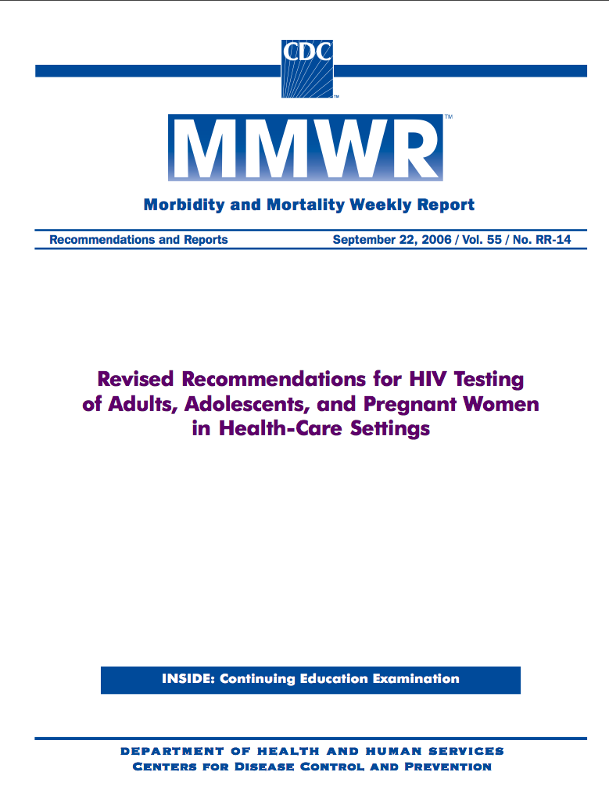
Routine HIV Screening in Health Care Settings
HIV Epidemiology
David Spach, MD Clinical Director Northwest AIDS Education and Training Center Professor of Medicine, Division of Infectious Diseases University of Washington Seattle
This project was funded under cooperative agreement number U65/PS000821 from the Centers for Disease Control and Prevention (CDC).
Notes:
1

Slide 2
HIV Epidemiology
HIV Incidence and Prevalence Definitions
HIV Incidence
HIV Prevalence
Knowledge of HIV Infection Status
HIV Testing Data
HIV/AIDS Deaths
Notes:
1

Slide 3
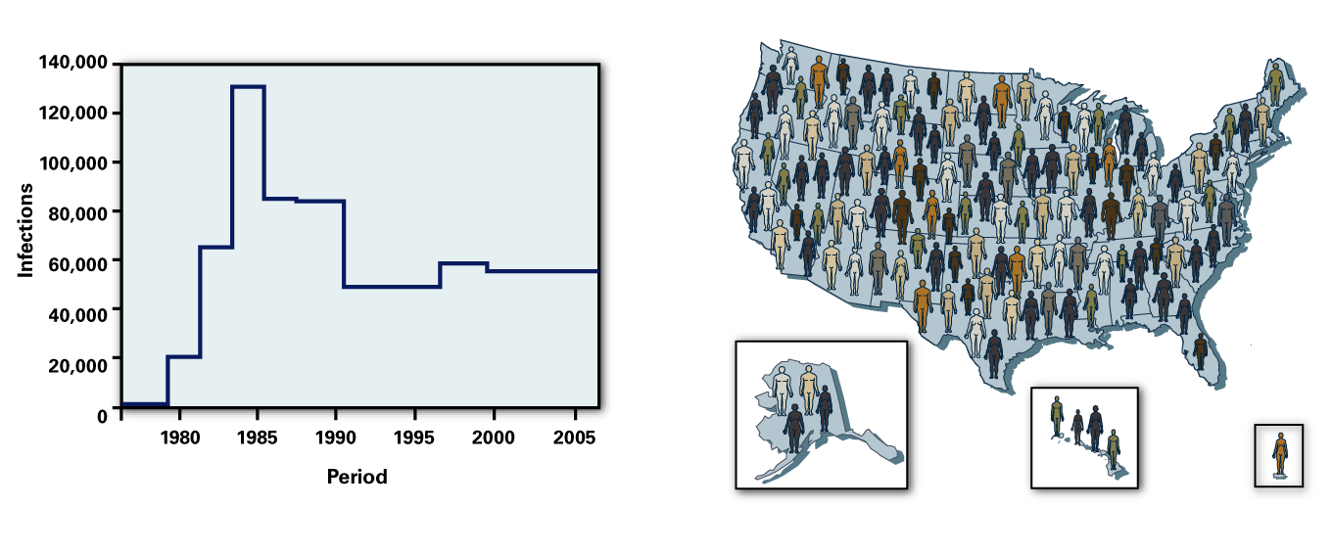
HIV Incidence and Prevalence
Source: Hall HI, et al. JAMA. 2008;300:520-9.
HIV Incidence. The number of people who become newly infected with HIV in a given period.
HIV Prevalence. The number of people living with HIV in a population at a point in time.
Notes:
1

Slide 4
HIV Incidence and Prevalence
HIV-Infected Persons
Source: Hall HI, et al. JAMA. 2008;300:520-9.
HIV Incidence. The number of people who become newly infected with HIV in a given period.
HIV Prevalence. The number of people living with HIV in a population at a point in time.
Notes:
1

Slide 5
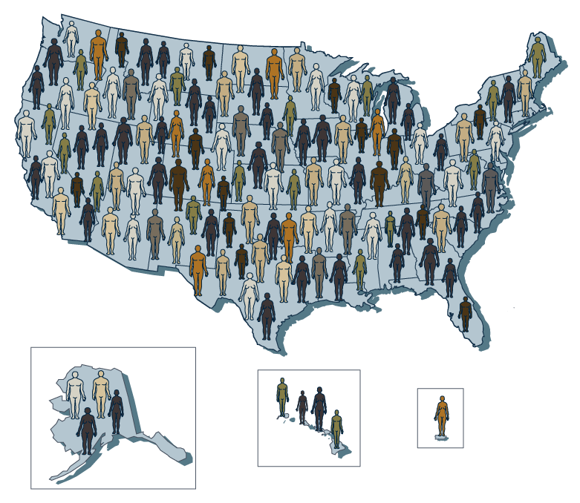
HIV Prevalence and Prevalence Rate
HIV-Infected Persons
HIV Prevalence. The number of people living with HIV in a population at a point in time.
HIV Prevalence Rate. The percentage of people infected with HIV in a population.
Notes:
1

Slide 6
HIV Epidemiology
HIV Incidence and Prevalence Definitions
HIV Incidence
HIV Prevalence
Knowledge of HIV Infection Status
HIV Testing Data
HIV/AIDS Deaths
Notes:
1

Slide 7
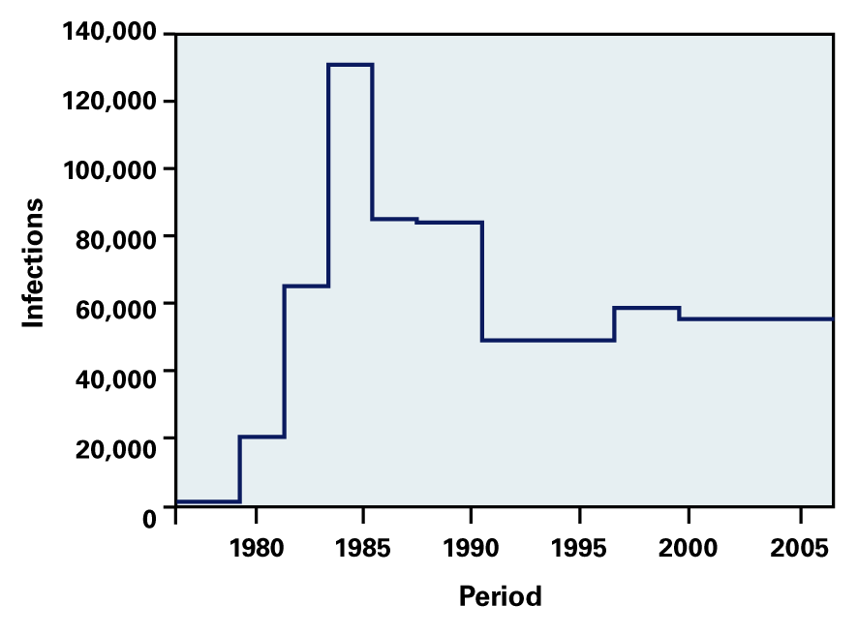
Estimated New HIV Infections, Extended Back Calculation Model, 50 US States and DC, 1977-2006
Source: Hall HI, et al. JAMA. 2008;300:520-9.
Notes:
1

Slide 8
Estimated New HIV Infections, Extended Back Calculation Model, 50 US States and DC, 1977-2006
HIV Incidence Estimated 56,300 new HIV infections in US in 2006
Source: Hall HI, et al. JAMA. 2008;300:520-9.
Notes:
1

Slide 9
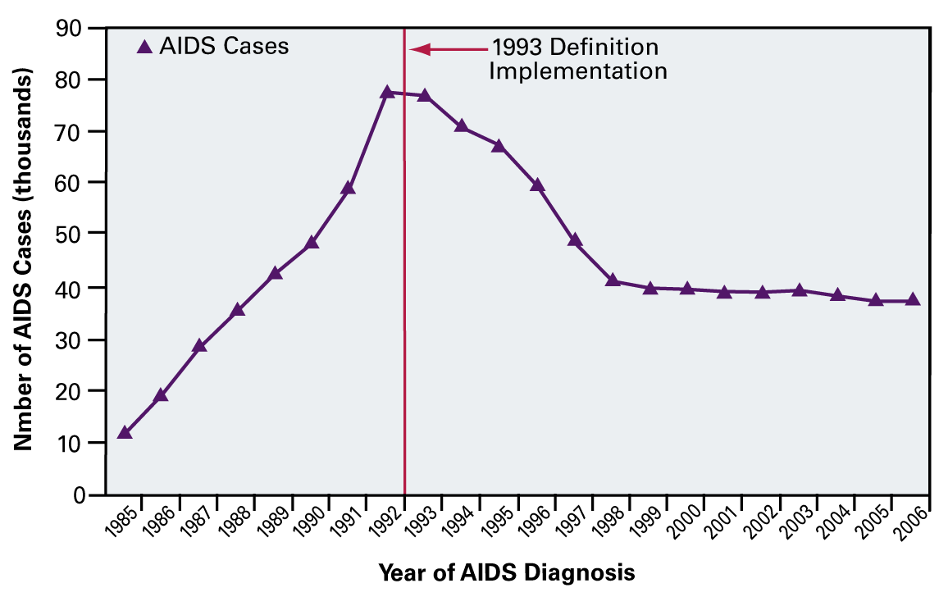
Estimated Number of AIDS Cases in US, 1985-2006
Source: Centers for Disease Control and Prevention
Notes:
1

Slide 10
Reported AIDS Cases and Annual Rates (per 100,000 population), by Area of Residence, 2007
Source: CDC. HIV/AIDS Surveillance Report. 2009; Vol 19:1-63.
Notes:
1

Slide 11
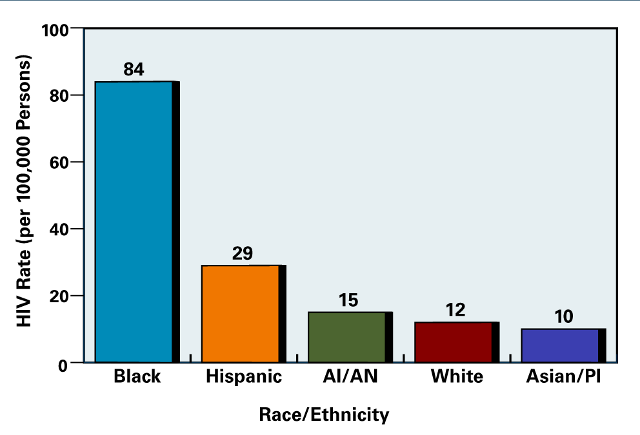
Estimated Rates of New HIV Infections in US, by Race/Ethnicity, 2006
Source: Hall HI, et al. JAMA. 2008;300:520-9.
Notes:
1

Slide 12
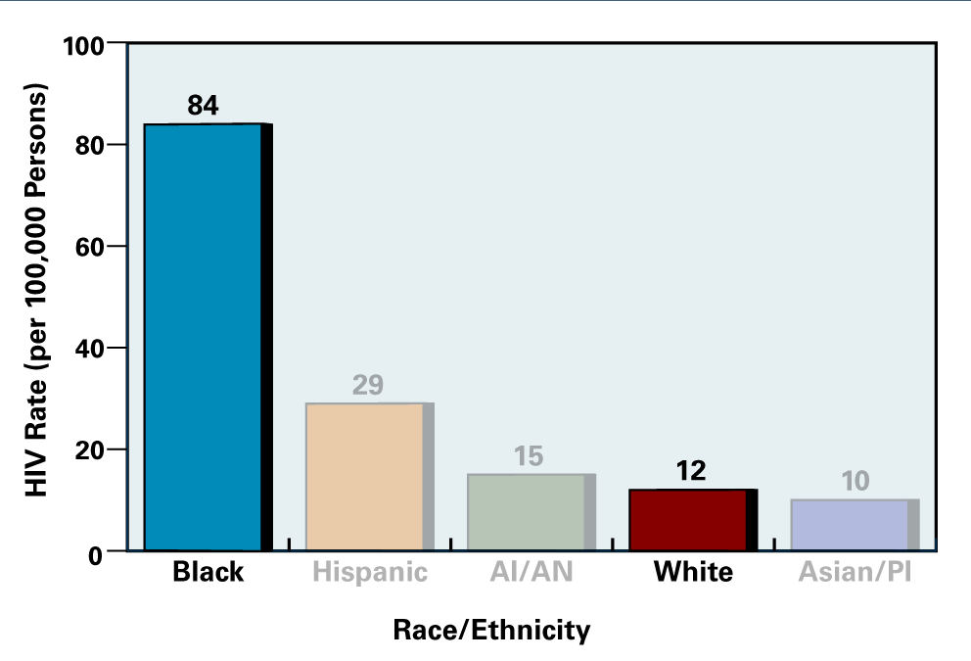
Estimated Rates of New HIV Infections in US, by Race/Ethnicity, 2006
Source: Hall HI, et al. JAMA. 2008;300:520-9.
Notes:
1

Slide 13
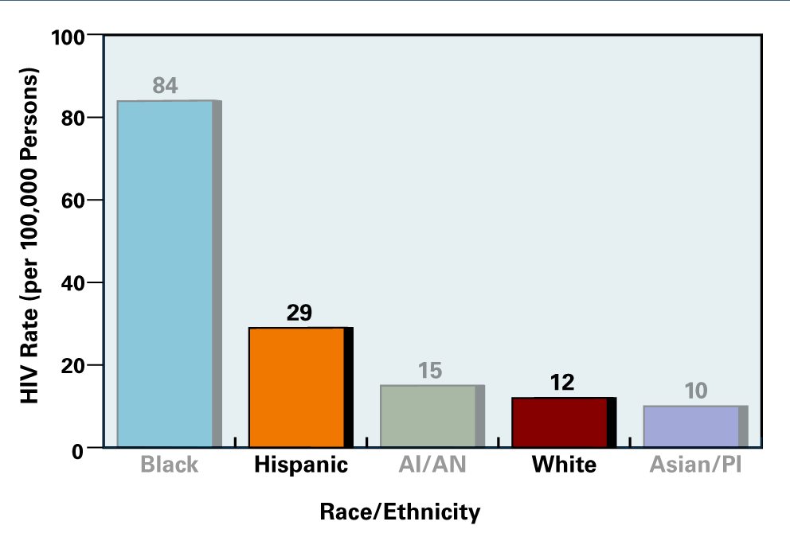
Estimated Rates of New HIV Infections in US, by Race/Ethnicity, 2006
Source: Hall HI, et al. JAMA. 2008;300:520-9.
Notes:
1

Slide 14
Estimated HIV Incidence in US, by Transmission Category, 2006
Total = 56,300
Male-Male Sexual Contact (53%)
Male-Male Sex & Injection Drug Use (4%)
Injection Drug Use (12%)
High-Risk Heterosexual Contact (31%)
Source: Hall HI, et al. JAMA. 2008;300:520-9.
Notes:
1

Slide 15
Estimated HIV Incidence in US, by Race/Ethnicity, 2006
Total = 56,300
Black (45%)
White (35%)
Hispanic (17%)
American Indian/Alaska Native (1%)
Asian/Pacific Islander (2%)
Source: Hall HI, et al. JAMA. 2008;300:520-9.
Notes:
1

Slide 16
Estimated HIV Incidence in US, by Sex, 2006
Total = 56,300
Source: Hall HI, et al. JAMA. 2008;300:520-9.
Notes:
1

Slide 17
HIV Epidemiology
HIV Incidence and Prevalence Definitions
HIV Incidence
HIV Prevalence
Knowledge of HIV Infection Status
HIV Testing Data
HIV/AIDS Deaths
Notes:
1

Slide 18
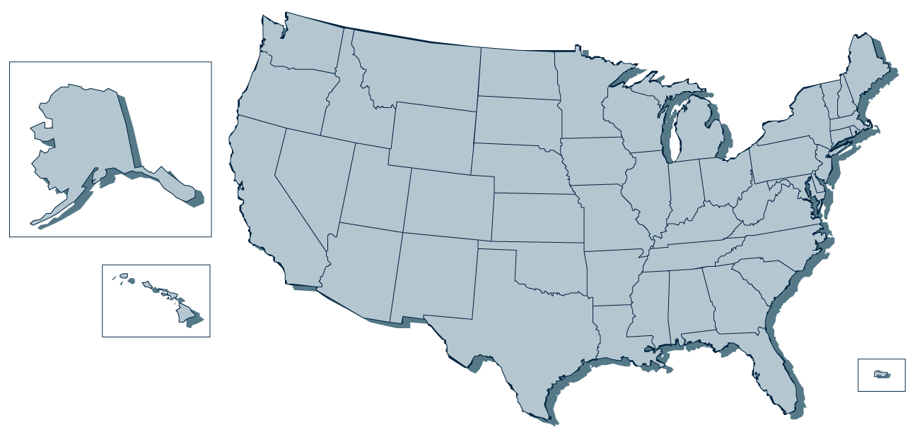
Estimated HIV Prevalence in US, 2006
1,106,400 Persons Living with HIV in US
Source: CDC. MMWR. 2008;57:1073-6.
Notes:
1

Slide 19
Estimated HIV Prevalence in US, 2006
1,106,400 Persons Living with HIV in US
Prevalence Rate = 448/100,000 population
Source: CDC. MMWR. 2008;57:1073-6.
Notes:
1

Slide 20
Estimated HIV Prevalence in US, 2006
1,106,400 Persons Living with HIV in US
Prevalence Rate = 448/100,000 population
0.4% of Population Living with HIV
Source: CDC. MMWR. 2008;57:1073-6.
Notes:
1

Slide 21
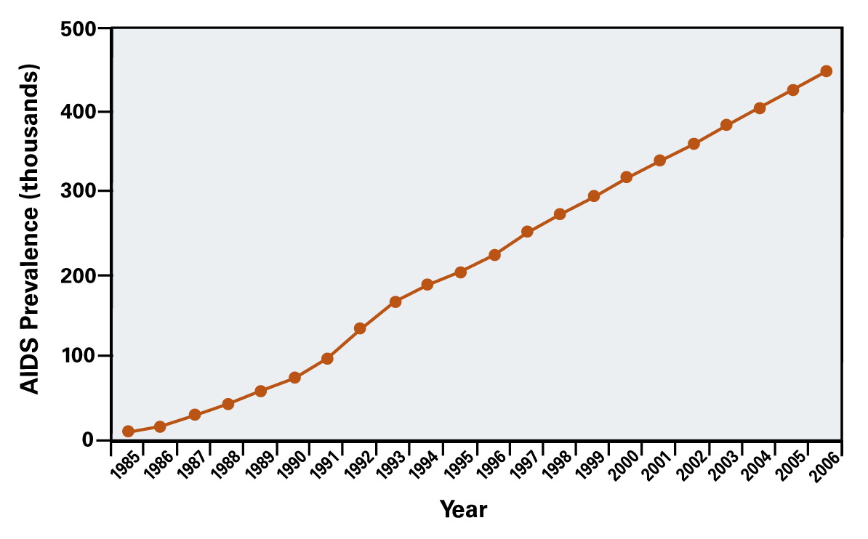
Estimated AIDS Prevalence, US, 1985-2006
Source: Centers for Disease Control and Prevention
Notes:
1

Slide 22
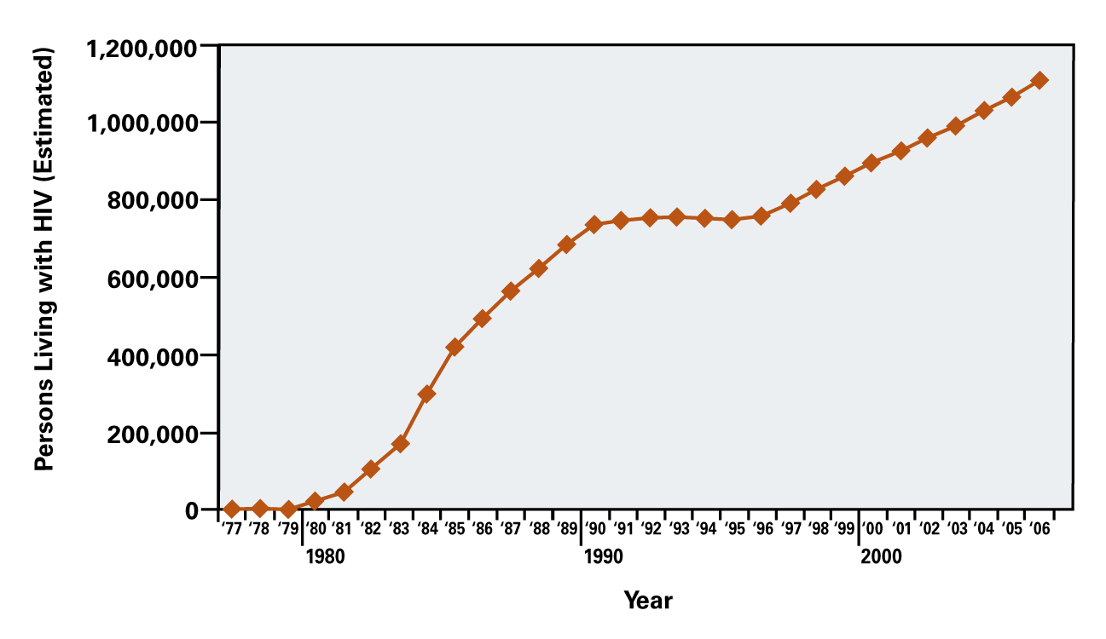
Estimated HIV Prevalence, US, 1977-2006
Source: Campsmith M, et al. CROI 2009: Abstract 1036.
Notes:
1

Slide 23
Estimated Percentage of Persons Living with HIV in US, by Sex, 2006
Female 25.2%
Male 74.8%
Source: CDC. MMWR. 2008;57:1073-6.
Notes:
1

Slide 24
Estimated Percentage of HIV-Infected in US, by Transmission Category, 2006
Male-Male Sex & Injection Drug Use (5.0%)
Male-Male Sexual Contact (48.1)
Injection-Drug Use (18.5%)
High-Risk Heterosexual Contact (27.6%)
Other* (0.8%)
Other* = hemophilia, blood transfusion, perinatal exposure, and risk factors not identified
Source: CDC. MMWR. 2008;57:1073-6.
Notes:
1

Slide 25
Estimated HIV Prevalence In US, by Transmission Category, 2006
_{HIV Prevalence}
_{Transmission Category}
MSM
IDU
(48.1%)
(18.5%)
HRHC
(27.6%)
MSM + IDU
(5%)
Other
(0.8%)
MSM = men who have sex with men IDU = Injection drug use HRHC = high risk heterosexual contact
Source: CDC. MMWR. 2008;57:1073-6.
Notes:
1

Slide 26
Estimated HIV Prevalence In United States, by Age, 2006
Age Category
Source: Campsmith M, et al. CROI 2009. Abstract 1038.
Notes:
1

Slide 27
Estimated HIV Prevalence In US, by Race/Ethnicity, 2006
Black (46.1%)
White (34.6)
Hispanic (17.5%)
American Indian/Alaska Native (0.4%)
Asian/Pacific Islander (1.4%)
Source: CDC. MMWR. 2008;57:1073-6.
Notes:
1

Slide 28
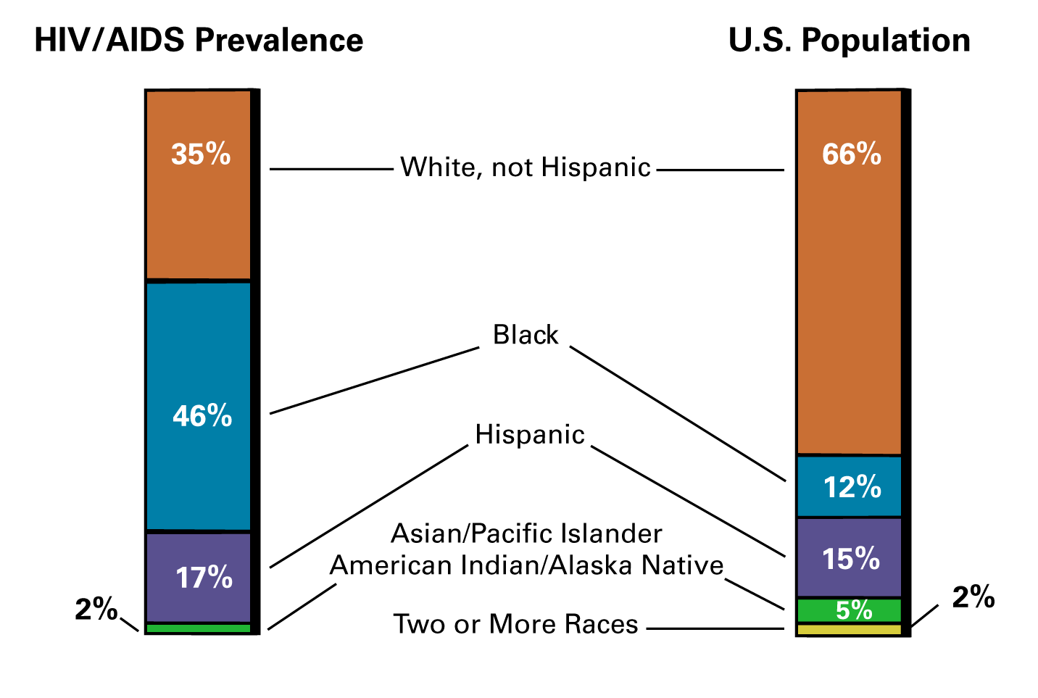
Estimated HIV Prevalence In US, by Race/Ethnicity, 2006
HIV/AIDS Prevalence (%)
U.S. Population
White, not Hispanic
Black
Hispanic
Asian/Pacific Islander American Indian/Alaska Native
Two or More Races
Source: CDC. MMWR. 2008;57:1073-6.
Notes:
1

Slide 29
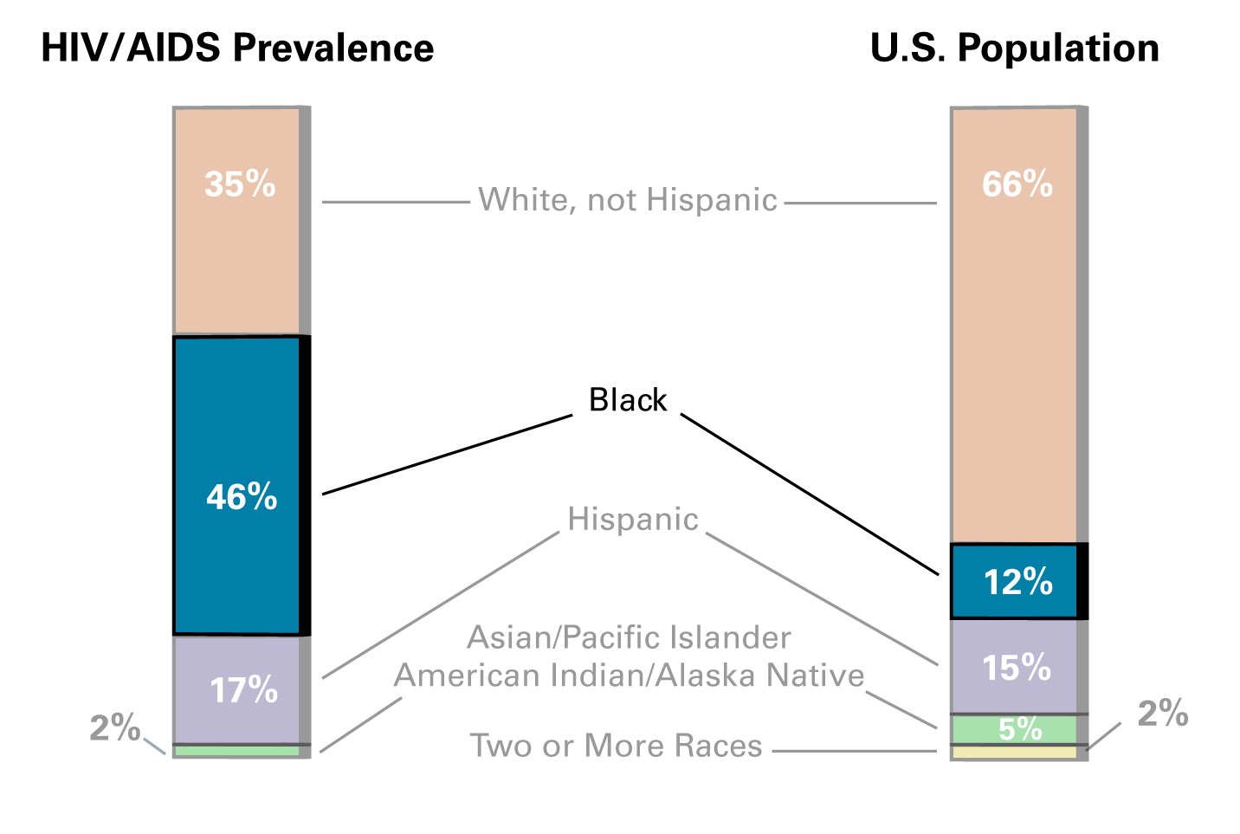
Estimated HIV Prevalence In US, by Race/Ethnicity, 2006
Black
Source: CDC. MMWR. 2008;57:1073-6.
Notes:
1

Slide 30
National Health and Nutrition Examination Surveys Prevalence Rate of HIV Infection in US, 1999-2006
US Household Population Aged 18-49 N= 11,928 participants HIV tested
Source: McQuillan GM, et al. J Acquir Immune Defic Syndr. 2010:53:117-23.
Notes:
1

Slide 31
HIV Epidemiology
HIV Incidence and Prevalence Definitions
HIV Incidence
HIV Prevalence
Knowledge of HIV Infection Status
HIV Testing Data
HIV/AIDS Deaths
Notes:
1

Slide 32
Knowledge of HIV Status, in US, at End of 2006
Unaware of HIV infection
21%
Aware of HIV infection
79%
Source: CDC. MMWR. 2008;57:1073-6.
Notes:
1

Slide 33
Knowledge of HIV Status, in US, at End of 2006
Unaware of HIV infection 21%
Aware of HIV infection 79%
Source: CDC. MMWR. 2008;57:1073-6.
Notes:
1

Slide 34
Estimated Undiagnosed HIV Infection, US
2003
2006
Unaware of HIV infection
Unaware of HIV infection
25%
21%
Aware of HIV infection
Aware of HIV infection
75%
79%
Source: CDC. MMWR. 2008;57:1073-6.
Notes:
1

Slide 35
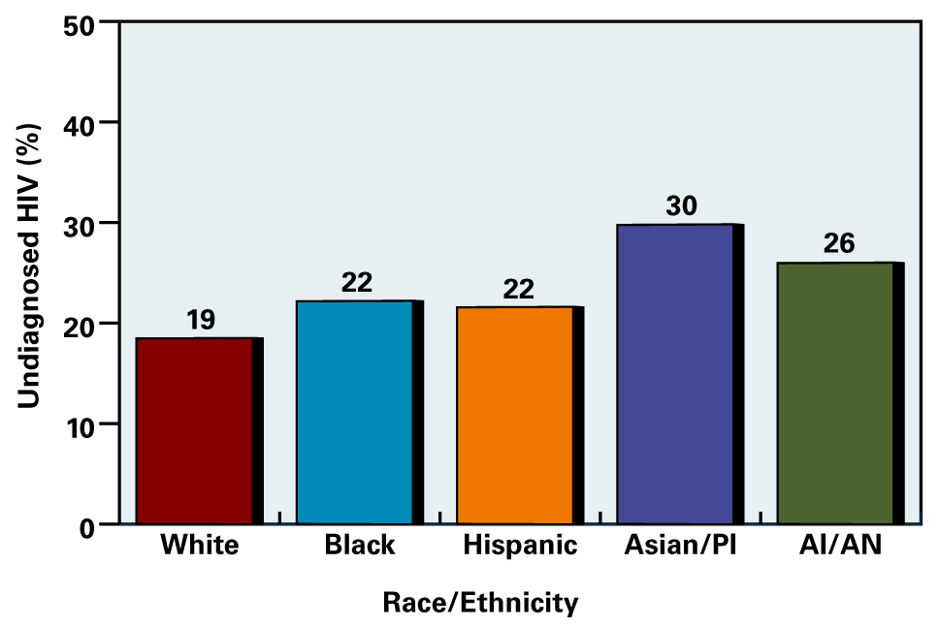
Undiagnosed HIV Infection in US Percent Undiagnosed by Race/Ethnicity, at End of 2006
Source: Campsmith ML, et al. J Acquir Immune Defic Syndr. 2009; Oct 15 (Epub ahead of print).
Notes:
1

Slide 36
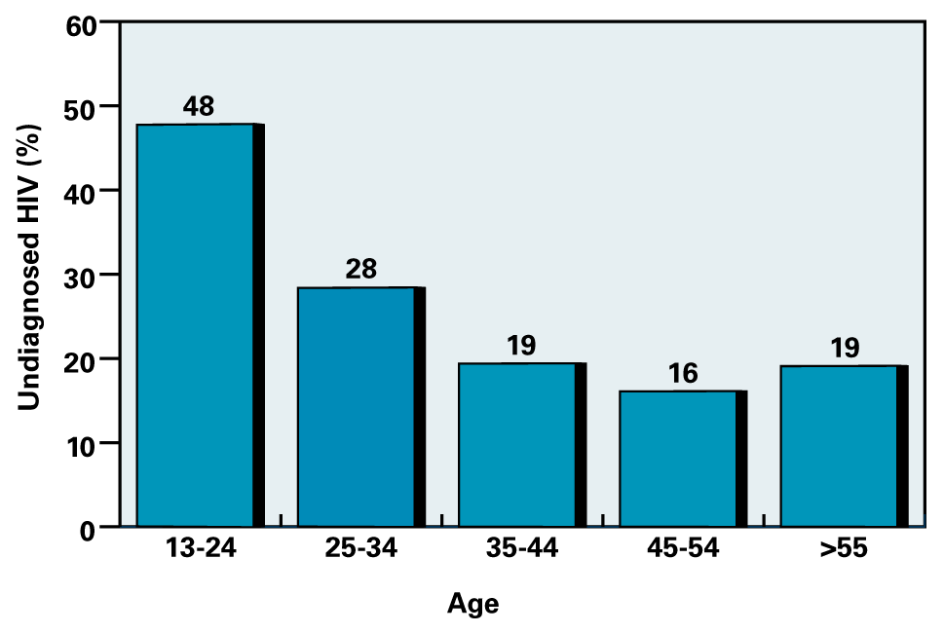
Undiagnosed HIV Infection in US Percent Undiagnosed by Age, at End of 2006
Source: Campsmith ML, et al. J Acquir Immune Defic Syndr. 2009; Oct 15 (Epub ahead of print).
Notes:
1

Slide 37
HIV Epidemiology
HIV Incidence and Prevalence Definitions
HIV Incidence
HIV Prevalence
Knowledge of HIV Infection Status
HIV Testing Data
HIV/AIDS Deaths
Notes:
1

Slide 38
CDC HIV Testing Data
HIV Testing Data
CDC analysis of HIV testing data from the National Health Interview Survey
Established baseline data prior to CDC 2006 HV screening recommendations
Source: CDC. MMWR 2008;57(31):845-9.
Notes:
1

Slide 39
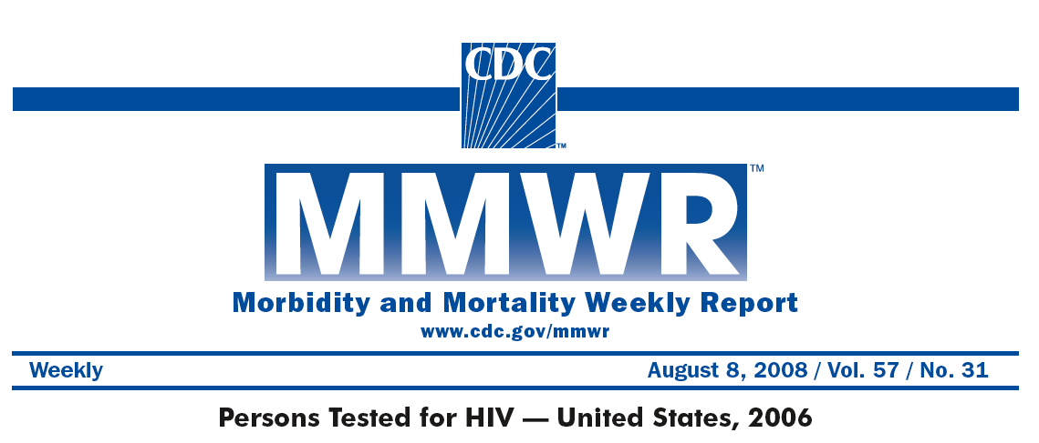
CDC HIV Testing Data
Source: CDC. MMWR 2008;57(31):845-9.
Notes:
1

Slide 40
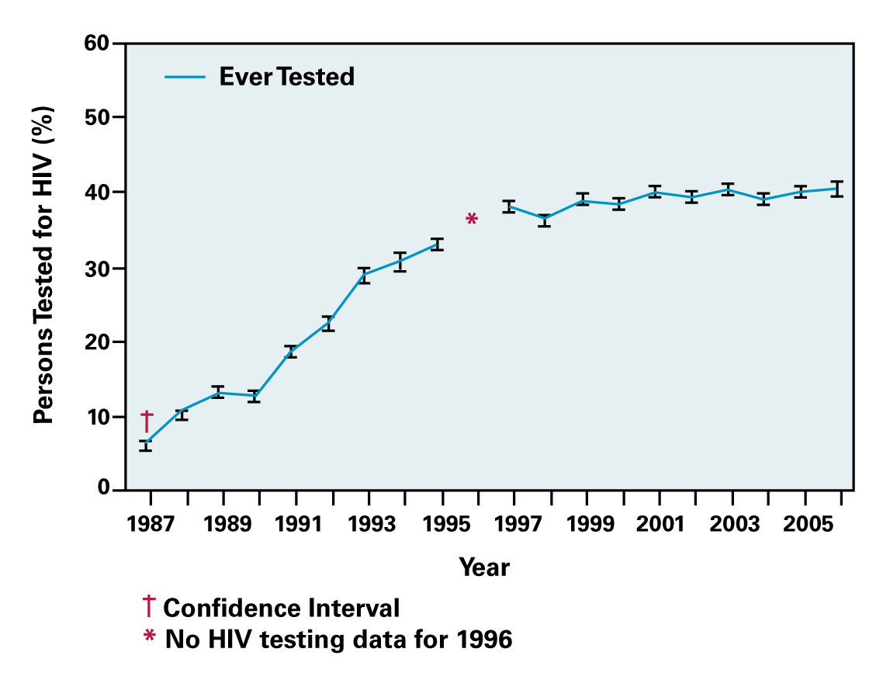
HIV Testing in Adults Aged 18-64, US 1987-2006
Source: CDC. MMWR 2008;57(31):845-9.
Notes:
1

Slide 41
HIV Testing in Adults Aged 18-64, US 1987-2006
Testing levels flat 2001-2006
Source: CDC. MMWR 2008;57(31):845-9.
Notes:
1

Slide 42
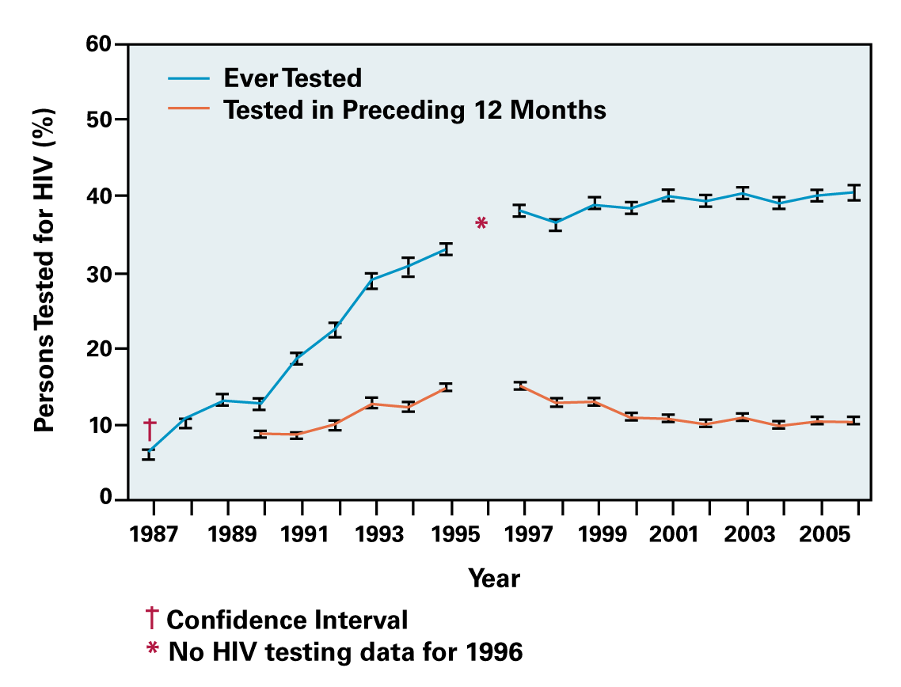
HIV Testing in Adults Aged 18-64, US 1987-2006
Source: CDC. MMWR 2008;57(31):845-9.
Notes:
1

Slide 43
HIV Testing in Adults Aged 18-64, US 1987-2006
Source: CDC. MMWR 2008;57(31):845-9.
Notes:
1

Slide 44
Setting for HIV Testing in Adults Aged 18-64, US, 2006
Non-Clinical
17%
Clinical
83%
Source: CDC. MMWR 2008;57(31):845-9.
Notes:
1

Slide 45
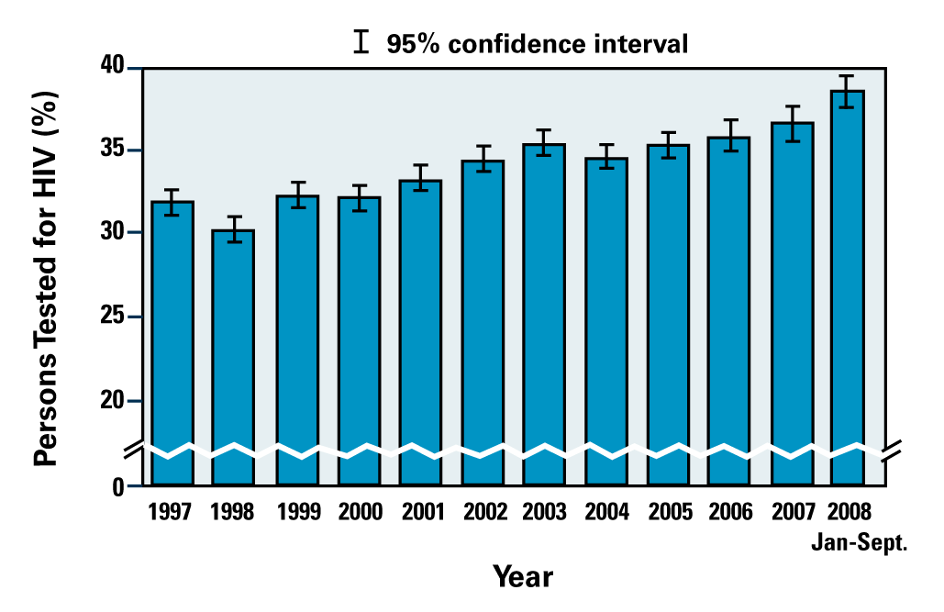
HIV Testing in Adults Aged 18-64 US, 1997-September 2008
Source: Centers for Disease Control and Prevention
Notes:
1

Slide 46
HIV Testing in Adults Aged 18-64 US, 1997-September 2008
Testing levels increased 2007-2008
Source: Centers for Disease Control and Prevention
Notes:
1

Slide 47
HIV Epidemiology
HIV Incidence and Prevalence Definitions
HIV Incidence
HIV Prevalence
Knowledge of HIV Infection Status
HIV/AIDS Deaths
Notes:
1

Slide 48
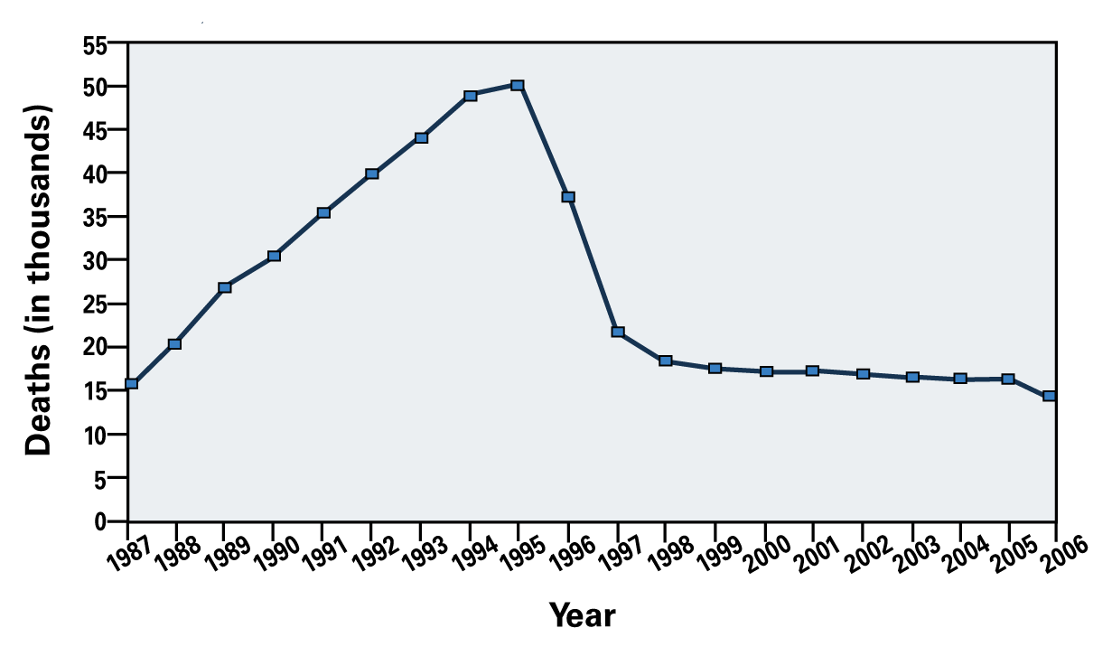
Deaths in Persons with AIDS, US, 1987-2006
Source: Centers for Disease Control and Prevention
Notes:
1

Slide 49
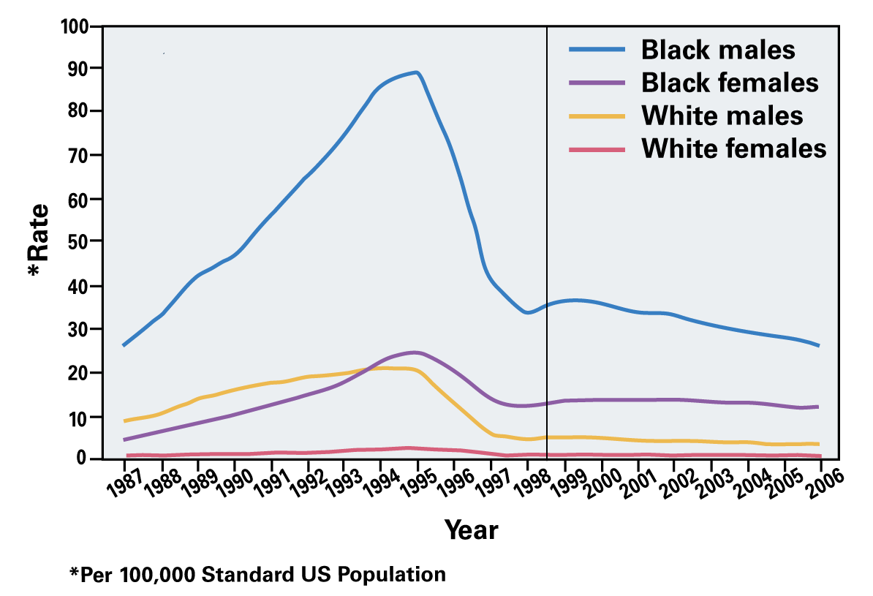
Age Adjusted Death Rates for HIV Disease, by Race and Sex*—US, 1987-2006
Note: in 1987, a new category for HIV infection added to ICD-9; in 1999, ICD-10 took effect, resulting in additional deaths classified as HIV/AIDS category; therefore death rates for 1987-1998 are not compatible with those computed after 1998.
Source: CDC. MMWR. 2008;57(30):830.
Notes:
1

Slide 50
Routine HIV Testing in Health Care Settings Summary Epidemiology Points
Approximately 1.1 million living with HIV in US
HIV and AIDS prevalence increasing in US
African-Americans disproportionately affected
21% of HIV-infected unaware of HIV status
MSM remains most common transmission category
Death rate higher in blacks than whites
Notes:
1

Slide 51
Acknowledgement
This project was funded under cooperative agreement number U65/PS000821 from the Centers for Disease Control and Prevention (CDC).
Notes:
1

