Slide 1
Addressing Disparities in HIV Care to Reach Zero Infections
Michael Hager
Manager of Communities of Learning, NQC
Justin Britanik
Quality Management Specialist, DOH HAHSTA
Notes:
Required slide. Please complete

Slide 2


Communities of Learning: collaborative, QI campaign, Regional Groups
Together, we can make a difference in the lives of people with HIV. NQC provides assistance to RWHAP recipients to improve HIV care since gaps in HIV care still exist and advances are uneven across HIV populations.
Consultation: On/off-site coaching of recipients to advance their clinical quality management programs
250 recipients (or over 700 individuals) participated in 25 Regional Groups
51% of all recipients joined the largest HIV QI campaign; viral suppression increased from 70% to 76%, a statistically significant improvement
Training and Educational Fora: monthly webinars, advanced trainings, online QI tutorials
40% of RWHAP recipients received TA and 95% would recommend TA to others
40 online QI tutorials are available; over 35,000 have been taken so far
Information Dissemination: monthly newsletters, websites, publications, exhibits, QI awards
Intensity
over 90% of the 587 RWHAP recipients accessed NQC services
~1,300 individuals (61% of recipients) graduated from 45 three-day advanced trainings
NationalQualityCenter.org | 212-417-4730

Slide 3

“It takes no compromise to give people their rights. It takes no money to respect the individual. It takes no political deal to give people freedom. It takes no survey to remove repression.”
- Harvey Milk

Slide 4


Learning Objectives
Examine disparities among the National HIV/AIDS Strategy subpopulations
Use two tools to address disparities along the Continuum (quality management plan and disparities calculator)
Review two improvement efforts by recipients to reduce disparities in HIV care

Slide 5
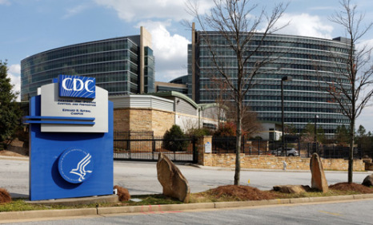
What is a Health Disparity?
“Differences in health outcomes or health determinants observed between populations”
– Center for Disease Control (CDC)

Slide 6

What is a Health Disparity?
“A population is a health disparity population if there is a significant disparity in the overall rate of disease incidence, prevalence, morbidity, mortality, or survival rates in the population as compared to the health status of the general population.”
– Minority Health and Health Disparities
Research and Education Act,
United States Public Law 106-525
(2000)

Slide 7
National HIV/AIDS Strategy - 2015
Office of National AIDS Policy, National HIV/AIDS Strategy. July 2015.

Slide 8

National HIV/AIDS Strategy - 2015
Step 3.A Reduce HIV-related disparities in communities at high risk for HIV infection
  3.A.1 Expand services to reduce HIV-related disparities experienced by gay and bisexual men (especially young Black gay and bisexual men), Black women, and persons living in the Southern United States
  3.A.2 Support engagement in care for groups with low levels of viral suppression, including youth and persons who inject drugs
Office of National AIDS Policy, National HIV/AIDS Strategy. July 2015.

Slide 9

“It is time to refocus, reinforce, and repeat the message that health disparities exist and that health equity benefits everyone.”
- Kathleen Sebelius

Slide 10


HIV Disparities at a Glance
12% of the U.S. population is African-American
44% of new HIV diagnoses are among African-Americans
U.S. Population
New HIV Diagnoses
http://www.cdc.gov/hiv/group/racialethnic/africanamericans/index.html
Notes:
Blacks represent 14% of the U.S. population but account for almost half (46%) of all people living with HIV in the U.S

Slide 11

Black lives lost to HIV/AIDS in 2013…
…account for 54% of total deaths due to the disease.
http://www.cdc.gov/hiv/group/racialethnic/africanamericans/index.html

Slide 12


HIV Disparities at a Glance
17% of the U.S. population is at the age of 13-24
26% of new HIV infections are among young persons
U.S. Population
New HIV Infections
Office of National AIDS Policy, National HIV/AIDS Strategy. July 2015
http://www.census.gov/popclock/
Notes:
Young persons aged 15–29 accounted for 39% of all new HIV infections in the U.S. in 2009, while representing only 21% of the U.S. population in 2010. ^{[4]}

Slide 13

What is a Health Disparity?
Supreme Court of the United States and Disparate Impact
  Disparate Impact examines Effect instead of Intent
  Applies to employment, housing, and other discrimination cases
  Statistical tests built on
  decades of precedents

Slide 14
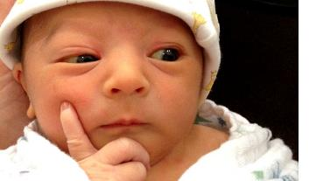
How do we assess EFFECT?
We DO NOT use our instincts, gut, or passions
We use statistics to identify where true disparities lie in health outcomes (aka evidence-based)

Slide 15

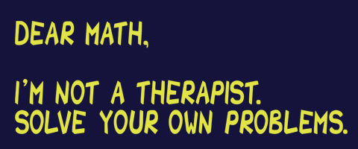


Slide 16
DC EMA Data:
Is there a disparity? Where is the disparity?
 | Viral Load Suppression (HAB) |  |  | Medical Visit Frequency (HAB)
 | Numerator | Denominator | % | Numerator | Denominator | %
TOTAL | 6256 | 8304 | 75.34% | 3199 | 6570 | 48.69%
Transgender People | 149 | 227 | 65.64% | 72 | 173 | 41.62%
MSM of Color | 1273 | 1681 | 75.73% | 672 | 1341 | 50.11%
Persons Earning < 100% FPL | 3883 | 5184 | 74.90% | 1678 | 4103 | 40.90%
Youth (aged 13-24) | 261 | 434 | 60.14% | 74 | 198 | 37.37%

Slide 17

NQC Disparity Calculation Tools
Notes:
17

Slide 18

Tabs in the Workbook
Instructions
  Descriptions of each tab and instructions for how to enter data
Stats Basics
  Refresher on statistics and terminology used in the calculator
Data Entry
  The SINGLE place to enter data in the calculator
Summaries
  Dashboard of final calculation results for quick sharing
Analyses
  Background statistical values that inform the summary
  dashboard for sharing with leaders and decision makers

Slide 19
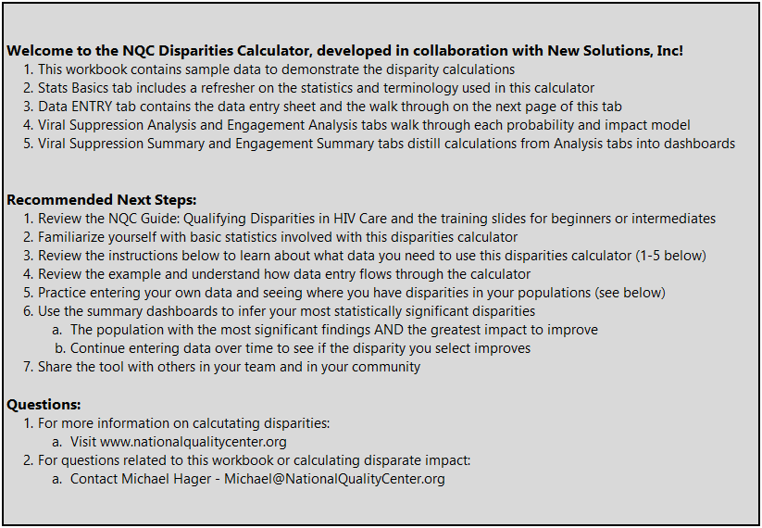
Instructions

Slide 20
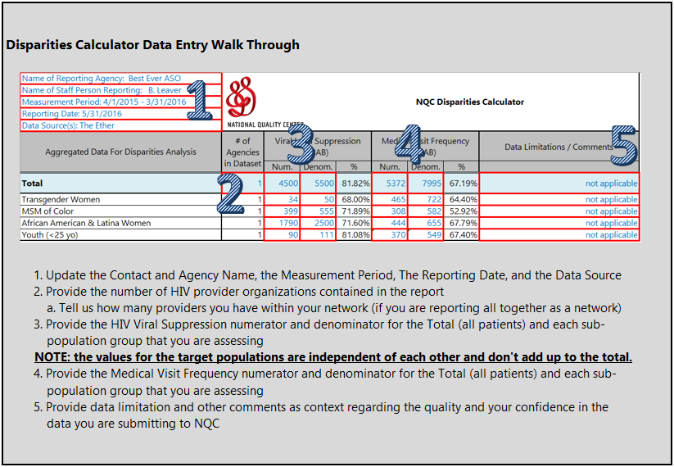
Instructions

Slide 21
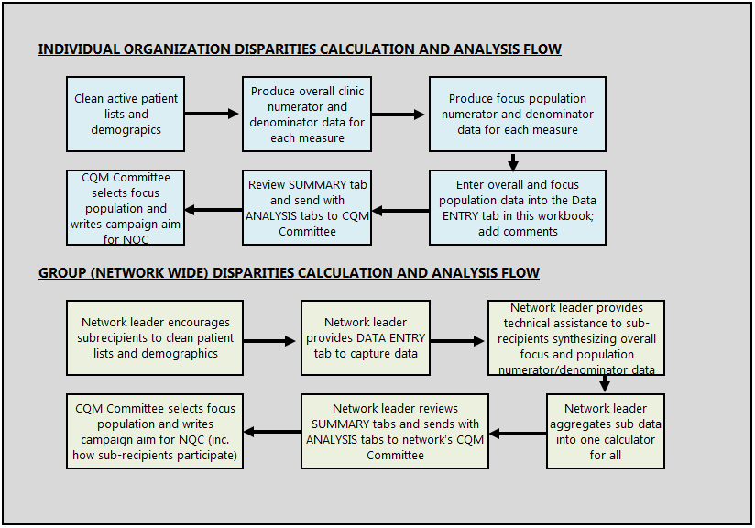
Instructions

Slide 22
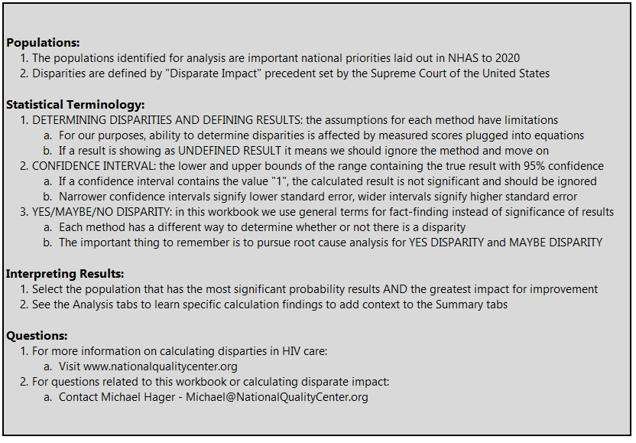
Stats Basics

Slide 23
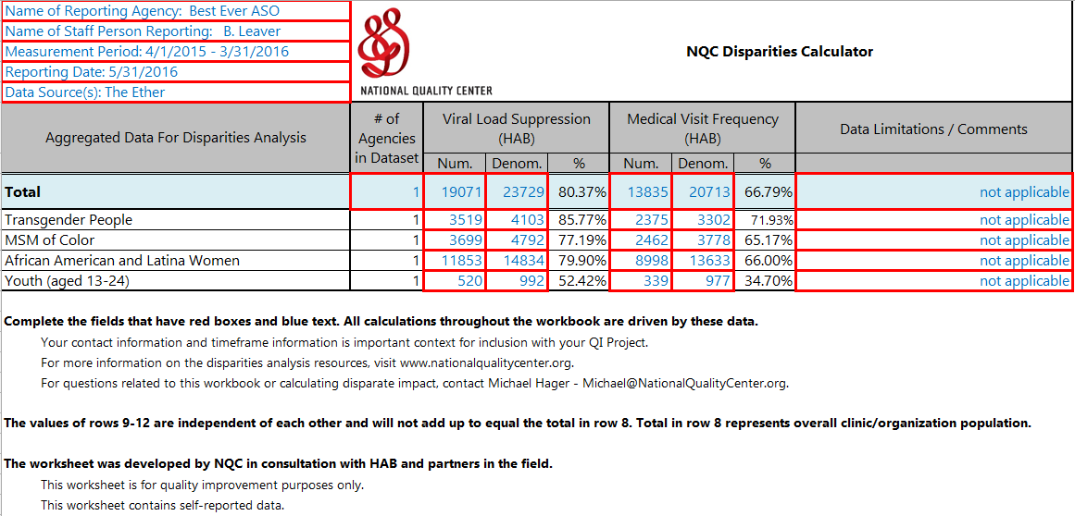
Data Entry

Slide 24
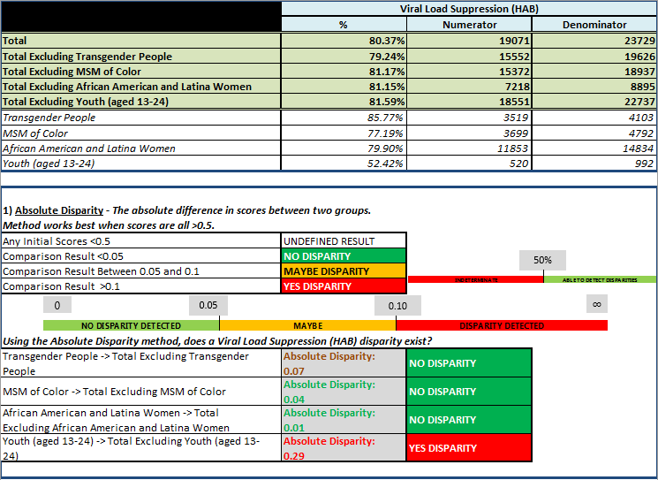
Analyses

Slide 25
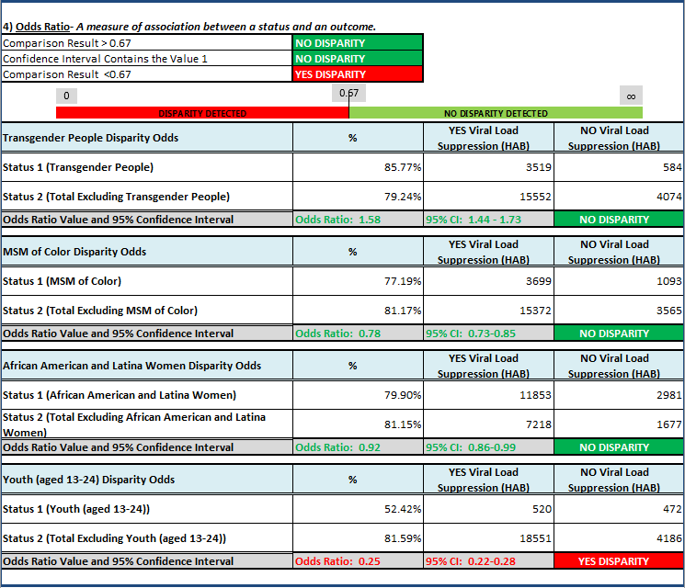
Analyses

Slide 26
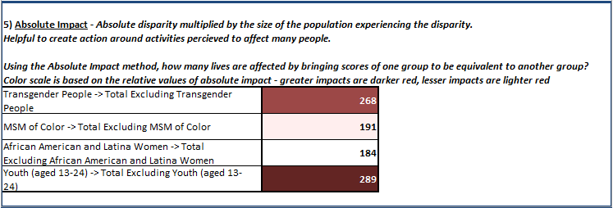
Analyses

Slide 27
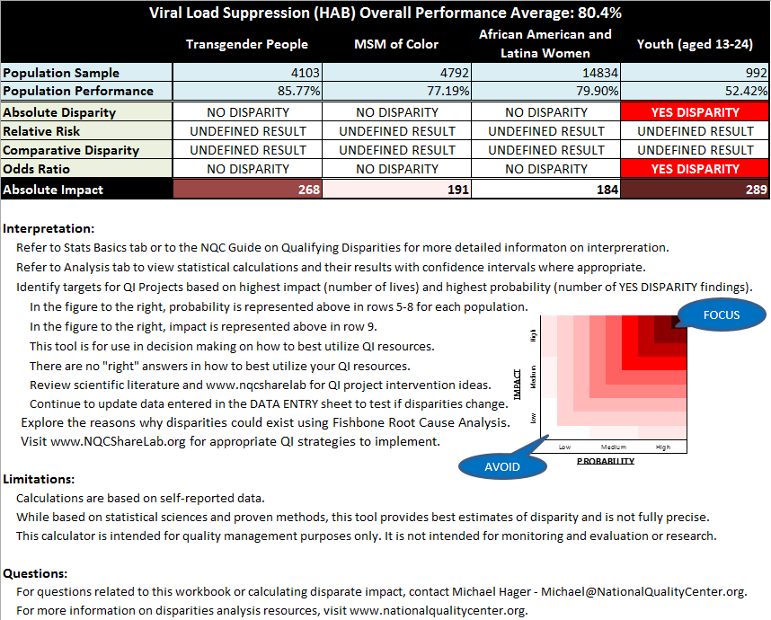
Summaries

Slide 28
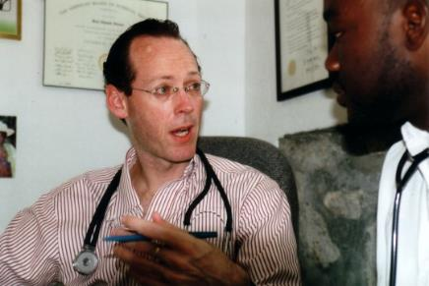
“The essence of global health equity is the idea that something so precious as health might be viewed as a right.”
- Paul Farmer

Slide 29
Determining Priorities for Disparities
FOCUS
AVOID

Slide 30
Intersecting Probability and Impact
We have limited time and resources and need to be focused in our activities
Which group in our assessment had the greatest number of SIGNIFICANT results across probability methods?
Which group in our assessment had the greatest number of lives that an be improved?
Often times the most probable and the highest
impact groups are not going to be the same. A
decision is made whether the impact or the probability
is more important.
Using the graphic to the right, focus your energy
where there is the deepest red. Avoid spending
your energy where there is white in the graphic
to the right
FOCUS
AVOID

Slide 31

NQC Disparity Calculator Workbook
Demonstration

Slide 32

Next Steps After Population Selection
Write an aim statement to charter your commitment to reduce disparities for your selected population
Continue to track progress over time using this calculator to ensure that disparities are closing
Share your progress in working with your selected population on www.nqcsharelab.org to spread your work!

Slide 33
NQC ShareLab Demonstration

Slide 34

Question & Answer
Additional disparities calculation and QI resources are available www.NationalQualityCenter.org
or email Michael@NationalQualityCenter.org

Slide 35
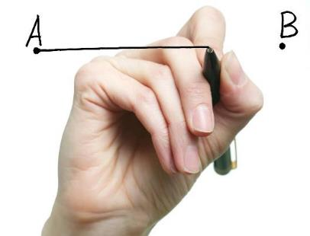
Ending disparities will end the HIV epidemic.

Slide 36

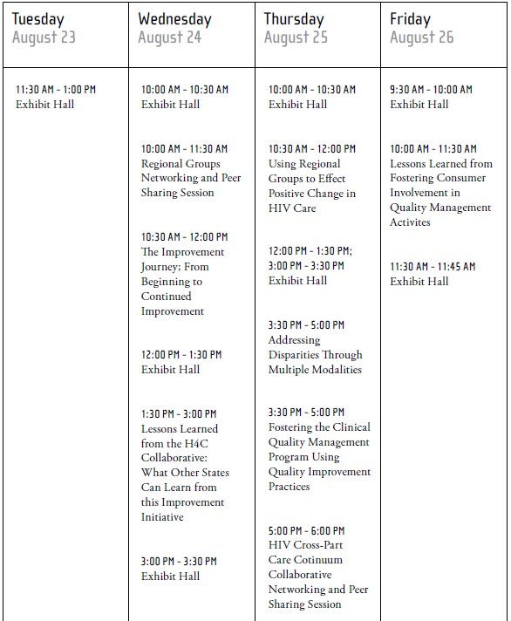
NQC is excited to offer a variety
of learning opportunities for you during the RW Conference.
Think big and start small.
NationalQualityCenter.org | 212-417-4730

Slide 37

Michael Hager, Manager of Communities of Learning, NQC
Michael@NationalQualityCenter.org

