Slide 1
HIV Among People Aged 50 and Older
Trainer Slides

Slide 2
Overview
Americans aged 50 and older have many of the same HIV risk factors as younger Americans.
Persons aged 55 and older accounted for 26% (313,200) of the estimated 1.2 million people living with HIV infection in the United States in 2011.
Older Americans are more likely than younger Americans to be diagnosed with HIV infection later in the course of their disease.
Source: Division of HIV/AIDS Prevention, NCHHSTP, CDC, http://www.cdc.gov/hiv/risk/age/olderamericans/ (accessed 4/21/15)
May 2015

Slide 3
New HIV Infections, 1 (Aged 55 & Older)
Of an estimated 47,500 new HIV infections in 2010, 5% (2,500) were among Americans aged 55 and older. Of these older Americans:
36% (900) of new infections were in white men, and 4% (110) were in white women;
24% (590) of new infections were in black men, and 15% (370) were in black women;
12% (310) of new infections were in Hispanic/Latino^{b} men, and 4% (100) were in Hispanic/Latino women.
Source: Division of HIV/AIDS Prevention, NCHHSTP, CDC, http://www.cdc.gov/hiv/risk/age/olderamericans/ (accessed 4/21/15)
May 2015

Slide 4
New HIV Infections, 2 (Aged 55 & Older)
In 2010, 44% (1,100) of the estimated 2,500 new HIV infections among people aged 55 and older were among gay, bisexual, or other men who have sex with men (MSM). Among MSM aged 55 and older, white MSM accounted for an estimated 67% (740) of new HIV infections, Hispanic/Latino MSM 16% (180), and black MSM 15% (160).
Source: Division of HIV/AIDS Prevention, NCHHSTP, CDC, http://www.cdc.gov/hiv/risk/age/olderamericans/ (accessed 4/21/15)
May 2015

Slide 5
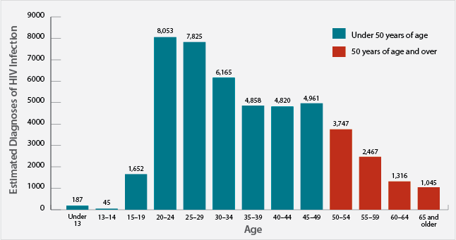
Estimated Diagnoses of HIV Infection by Age, 2013, United States
Source: Division of HIV/AIDS Prevention, NCHHSTP, CDC, http://www.cdc.gov/hiv/risk/age/olderamericans/ (accessed 4/21/15)

Slide 6
HIV and AIDS Diagnoses and Deaths
In 2013, there were an estimated 8,575 new HIV diagnoses among people aged 50 and over. Most (44%, 3,747) were among those aged 50-54.
In 2013, the estimated rate (per 100,000) of HIV diagnoses for blacks aged 50-54 was 59.3, compared to 23.3 for Hispanics/Latinos, and 8.7 for whites.
In 2013, people aged 50 and older accounted for 27% (7,108) of the estimated 26,688 AIDS diagnoses in the United States.
Of the estimated 13,712 deaths among people with AIDS in 2012, 8,093 (59%) were among people aged 50 and older.
Source: Division of HIV/AIDS Prevention, NCHHSTP, CDC, http://www.cdc.gov/hiv/risk/age/olderamericans/ (accessed 4/21/15)
May 2015

Slide 7
