Slide 1
e2AETC: Expediting CORE Immediate Post Survey (IP) Response Rates Jesse Thomas, RDE Systems, Project Director Daria Boccher-Lattimore, DrPH, Director and Co-PI, Northeast/Caribbean AETC, Columbia University
March 2019 AETC Program E-Learn Committee Call:
3/19/19 1:00-1:45 PM ET
Notes:
Intro and housekeeping

Slide 2
Learning Objectives – IP Surveys
Participants will learn and be able to interactively contribute to a list of common barriers and challenges surrounding the timely and complete collection of Immediate Post (IP) surveys.
Participants will see a novel approach to using adult learning techniques and mobile interactivity to capture IP surveys.
Participants will learn about using real-time dashboards to help improve IP survey response rates, reduce follow-up time, and QI and evaluation efforts.

Slide 3
Jesse Thomas
Jesse Thomas has over two decades’ experience serving public health and over fifteen years of experience in the field of HIV, which has become his passion. He and his team at RDE Systems create and manage HIV data systems and user-friendly tools for providers, recipients, and consumers using a human-centered approach to improve processes for more efficient care and support, and impact measurably impact clinical outcomes for people living with HIV. He has served as the technical director for over 19 HRSA Special Projects of National Significance (SPNS), and numerous HRSA Part C Capacity Development projects, for recipients, academic medical institutions, and community-based organizations nationwide.
Jesse strives to make the process of building and maintaining these tools understandable and fun.

Slide 4
Daria Boccher-Lattimore, DrPH
Dr. Boccher-Lattimore is Assistant Professor of Clinical Sociomedical Sciences (in Psychiatry) at the Columbia University College of Physicians and Surgeons. She has over 30 years experience in HIV/AIDS, behavioral health and community oriented primary care in community, clinical, academic and state government settings. She is experienced in assessing programmatic need, implementing evidence informed interventions, program evaluation, grants management, and continuing education. Dr. Boccher-Lattimore has been involved with the AETC Program since 2005. She is currently Director and Co-Principal Investigator of the Northeast/Caribbean AETC and President of the National Alliance of HIV Education and Workforce Development.

Slide 5
RDE Systems - About Us
HIV/AIDS Technical Assistance and Part A/B/C/D/ SPNS Partnerships for 15 years
First web-based HRSA RSR/ADR system
First to develop web-ACASI Consumer and Provider Needs Assessment and Satisfaction Surveys and Reporting tools
Improving processes and eliminating paper for public health 30+ Years
Process over Product Methodology

Slide 6
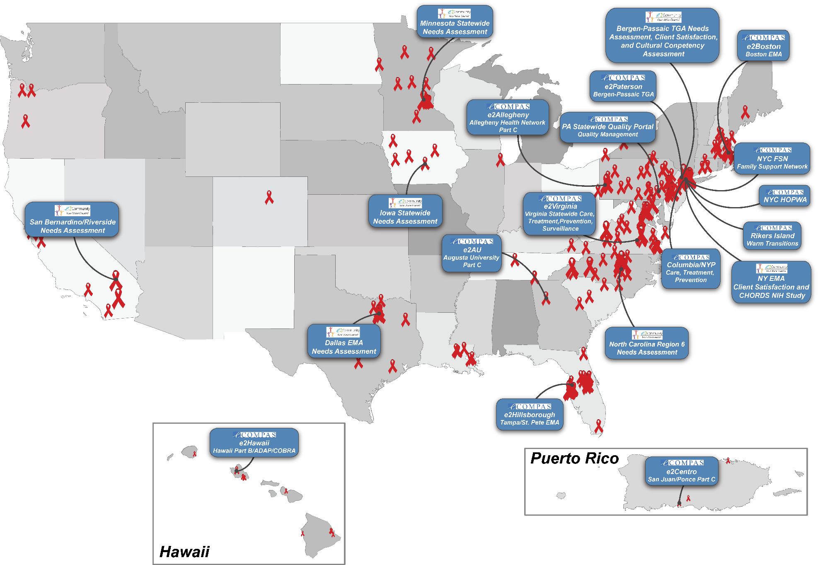

Slide 7
Who are you?

Slide 8
Problem Statement (Opportunities…)
Evaluation data is critical for compliance and continuous improvement
Immediate Post (IP) Survey Response Rates can be improved
IP survey distribution and collection can be time-consuming
Transcribing from paper is error-prone and a burden on staff
Paper forms are not suited for emerging eLearning technologies
Following-up after a training consumes time
People mean well but are forgetful and busy
Even electronic methods suffer from losses in responses and delay in recall of event
The time between an event and getting evaluation data for CQI is not ideal
The NECA AETC wants to get more complete, better data, faster to deliver value for CQI

Slide 9
Guiding Principles / Inspiration
Adult Learning Theory
Actionable Data Visualization
Practice Transformation
Continuous Quality Improvement
Transforming Compliance into Excellence

Slide 10
Our Vision
Improve the training experience for all
Simultaneously improve IP data collection and entry in real-time
Maximize IP response rates
Minimize human error and time spent on IP-related processes
Increase speed of training-evaluation feedback cycle
Deliver actionable feedback and value almost immediately to trainers and coordinators
Take a CQI-mindset with IP data, transforming a compliance requirement into tool for excellence
Maximize value of evaluation data

Slide 11
Leveraging Existing Resources
e2Polls - a real-time audience engagement tool
Developed internally for stakeholder engagement, pre/post trainings, system evaluations, and interactive engagement
e2Polls Red now offered for free to the HIV/AIDS community as part of the RDE Red program (rde.org/red)
NECA AETC was an early adopter, and wanted a new vision for AETC data systems and utilization
e2Polls as an integrated component of e2AETC

Slide 12
e2AETC – Broader Context

Slide 13
e2AETC Data Integration
PIF
ER
IP

Slide 14
The Key Innovation – e2Polls Hybrid
Use e2Polls for a synchronous, interactive, and engaging group activity at conclusion of each training
Seamlessly transition e2Polls public activity into asynchronous private IP survey.
Essentially keeping people’s attention before they leave, and not needing to have people fill out forms or click survey links on their own time
Use Visual Dashboards and real-time delivery of IP data to maximize response rates and deliver feedback to key stakeholders responsively for CQI

Slide 15
e2Polls Hybrid in Action

Slide 16
Please complete your IP survey on your mobile device. Your responses are confidential and will not appear on-screen.

Slide 17
e2AETC Dashboard

Slide 18
Motivation: Actionable Information
Am I reaching my IP response rate targets?
How can I easily follow-up with participants who did not complete their IPs?
Which professions are we reaching?
What are our trends?
How can I easily deliver actionable, valuable, real-time data to my stakeholders?

Slide 21
Opportunity for Impact Annually @ NECA AETC
14,000 Participants
9,400 Immediate-Post Evaluations Forms
1,400 Training Events
100+ Trainers
11 Regional Coordinators
1 Director

Slide 22
Final Thoughts

Slide 23
Thank you! Q & A

Slide 24
Contact Information & Resources
Jesse Thomas, Jesse@rdesystems.com
RDE.ord/Red
Daria Boccher-Lattimore, dmb82@cumc.columbia.edu

Slide 25
Next E-Learn Call
June 2019
Topic suggestions, comments, thoughts - contact Judy Collins: collinj3@sn.rutgers.edu

