Slide 1

National HIV Curriculum Promotional Slides
Please use any of these slides to promote the National HIV Curriculum. This free, up-to-date website is for clinicians and other healthcare professionals to learn about HIV diagnosis, treatment, and prevention.
Thank you for informing your audience about the National HIV Curriculum: www.hiv.uw.edu.
The University of Washington Infectious Diseases Education & Assessment (IDEA) Program (idea.medicine.uw.edu) developed and continually updates this website.
The National HIV Curriculum is an AIDS Education and Training Center (AETC) Program supported by the Health Resources and Services Administration (HRSA) of the U.S. Department of Health and Human Services as part of an award totaling $1,000,000 with 0% financed with non-governmental sources.
2nd Edition launched September 1, 2020
Notes:
New 3-year CE accreditation period began September 1,2020

Slide 2
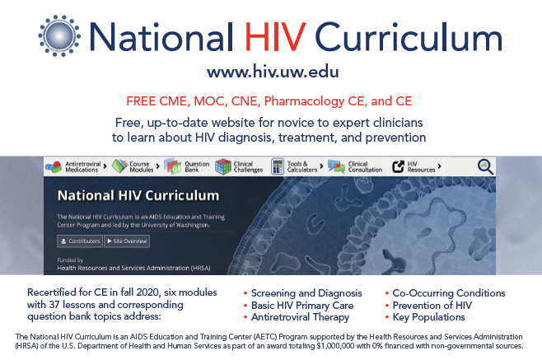
Notes:
Postcard Front

Slide 3
Notes:
Postcard back

Slide 4
National HIV Curriculum Features
Comprehensive and up-to-date resource
100% federally funded, free of commercial bias
37 lessons and corresponding question bank topics
Free CME/MOC/CNE/CE
17 clinical screening tools and calculators
In-depth antiretroviral medications section
Online learning group functionality for onboarding and training
Individualized and learning group progress trackers
Notes:
Key features summary for healthcare training programs

Slide 5
Six Modules: Lessons and Question Bank Topics
Recertified for CE in fall 2020, six modules with 37 lessons and corresponding question bank topics address:
    Screening and Diagnosis
    Basic HIV Primary Care
    Antiretroviral Therapy
    Co-Occurring Conditions
    Prevention of HIV
    Key Populations
97 free CME credit, MOC points, CNE contact hours, and CE contact hours; 70 pharmacology CE for advanced practice nurses
(A learner needs about 1 hour to earn 1 CE)
University of Washington Certificates of Completion are also available
Notes:
List of Modules and information about CE

Slide 6
National HIV Curriculum Features:
Antiretroviral Medications
Course Modules
Question
Bank
Tools and Calculators
49 Medications
6 Modules
37 Lessons
462
Questions
17
Tools/ Calculators
51.5
CE Credits
46
CE Credits
97.5
Total CE Credits
Notes:
70 pharmacology CE for advanced practice nurses

Slide 7
General Principles of National HIV Curriculum
Address comprehensive spectrum of HIV clinical care
Make relevant for broad range of healthcare providers
Base recommendations on U.S. federal guidelines
Develop core competencies to inform curriculum
Create a free educational resource
Provide dual functionality: quick access and longitudinal
Offer online learning group functionality to onboard and train healthcare professionals

Slide 8
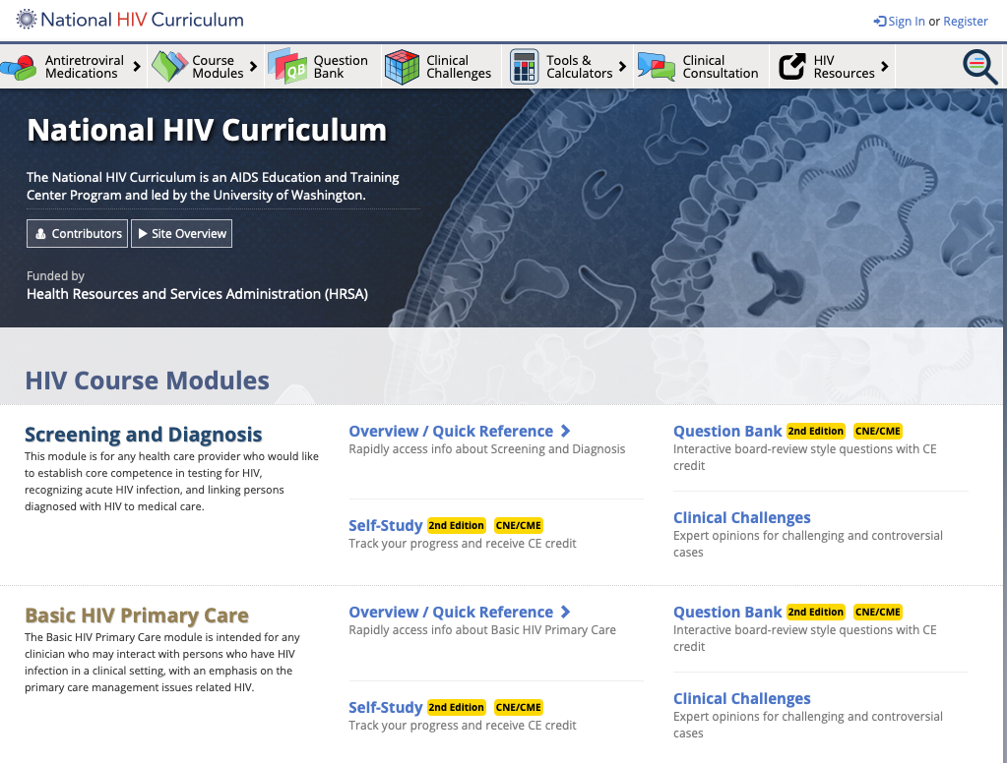
An AIDS Education and Training Center Program led by the University of Washington
Editor-in-Chief: David H. Spach, MD
Funded by a grant from the Health Resources and Services Administration
Notes:
Dr. David Spach is also Editor-in-Chief of the National STD Curriculum, Hepatitis C Online and the Hepatitis B Online. All four federally funded curricula offer free CE and are part of the Infectious Disease Education and Assessment (IDEA) e-learning platform.

Slide 9
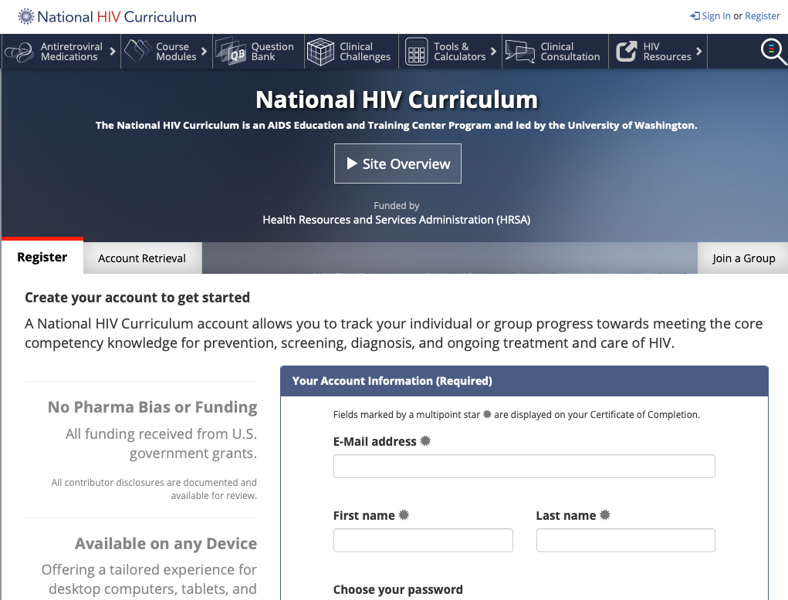
Dual Functionality
Quick Reference
Highly organized interface
Quick search
On demand topics
Downloadable PDF option
Ideal for staying updated
Self-Study (Modular)
Sequential (Step-by-Step) or choose topics
Flexible modular options
Certificate program
Ideal for training programs
Notes:
Click on ”Register” on the upper right, watch the site overview video, and complete the participant form. The same user name and password on the National STD Curriculum, Hepatitis C Online, and Hepatitis B Online.

Slide 10
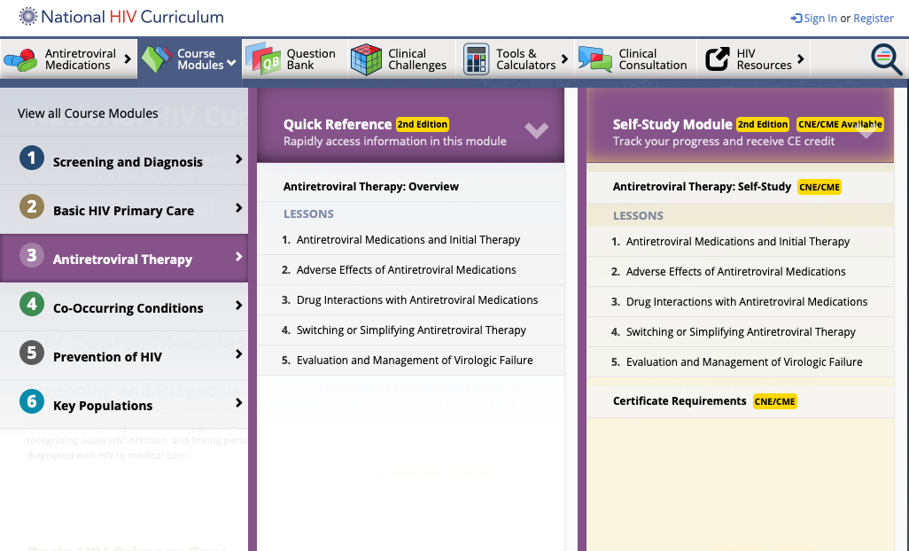
Drop down menu gives dual access for Quick Reference or Self Study
Notes:
6 modules: 37 lessons. The amount of CE available in the self-study lessons varies. The 37 question bank topics mirror the lessons.

Slide 11
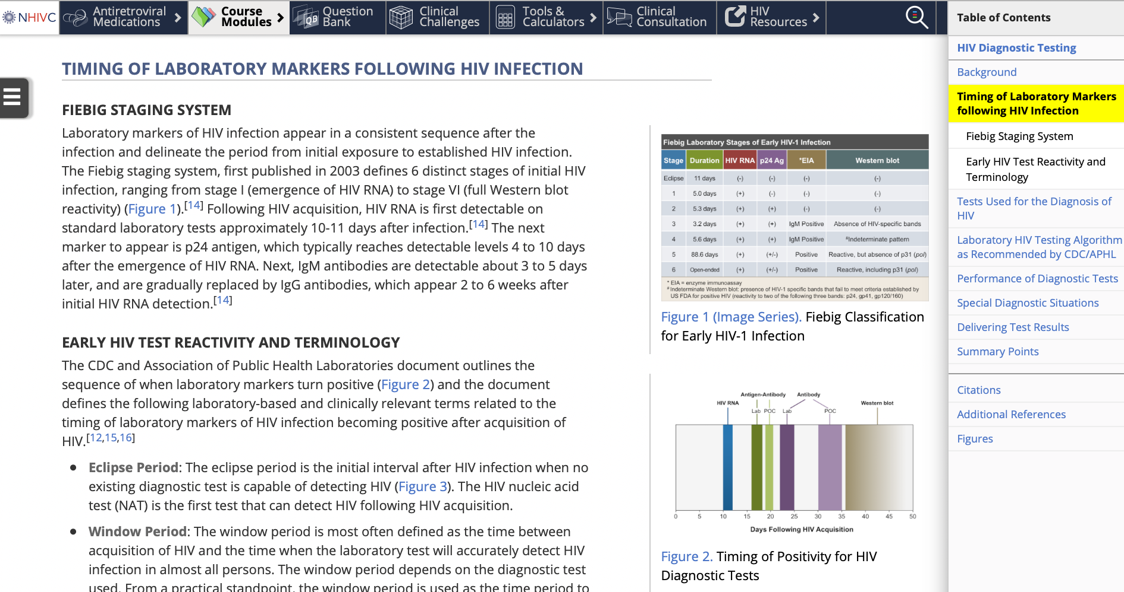
Modules cover 37 major HIV topics
Notes:
An example of one lesson and the available navigational tools. The site has an extensive bibliography.

Slide 12
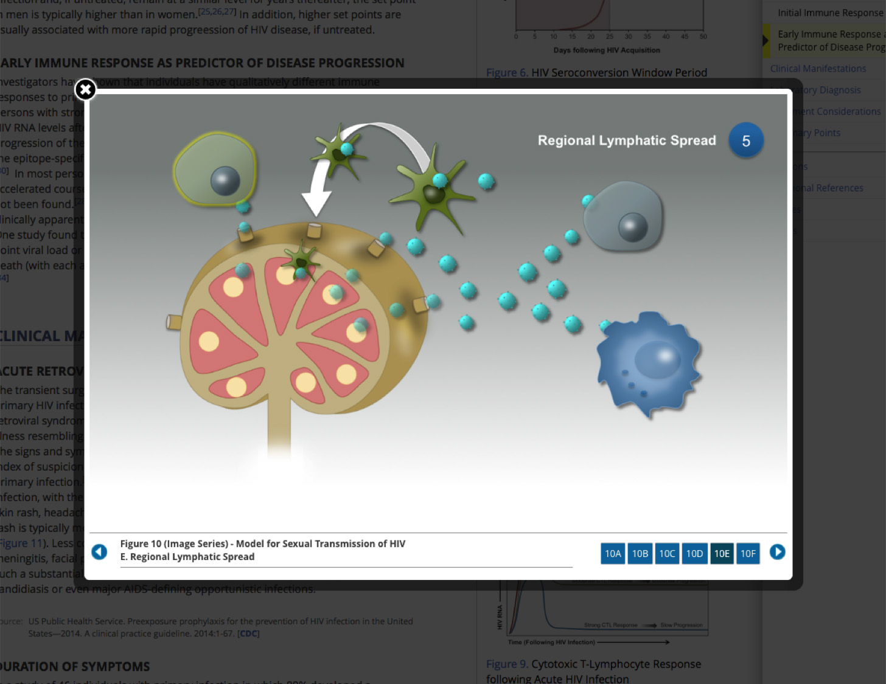
Image Series: Concepts
Notes:
The site features easy-to-understand, high-resolution images which demonstrate complex clinical events.

Slide 13
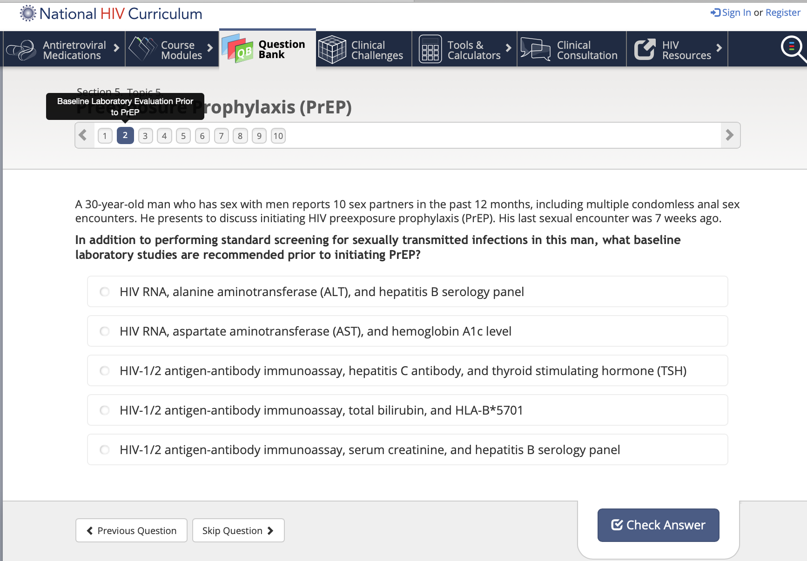
Question Bank
450+ Board Review Style Learning and Assessment Questions
Notes:
Question bank topics mirror the lessons. Any user can access question bank topics but to track progress, the user must register on the site. Registered learners can earn CME and CNE credit when at least 80% of a topic’s answers are correct. Available CE credit varies by the number of questions but, generally, five questions are equivalent to .5 CE. This sample unit has 1.0 CE available.

Slide 14
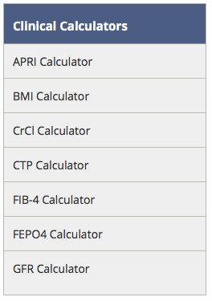
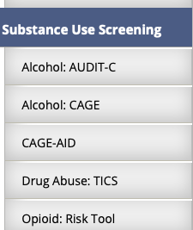
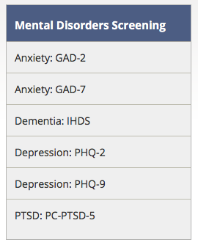
17 Clinical Calculators & Screening Tools
Using your own electronic device, you can access:
Notes:
Free and easily accessible calculators and tools that users can access on their phones or other electronic devices to help with clinical decision making.

Slide 15
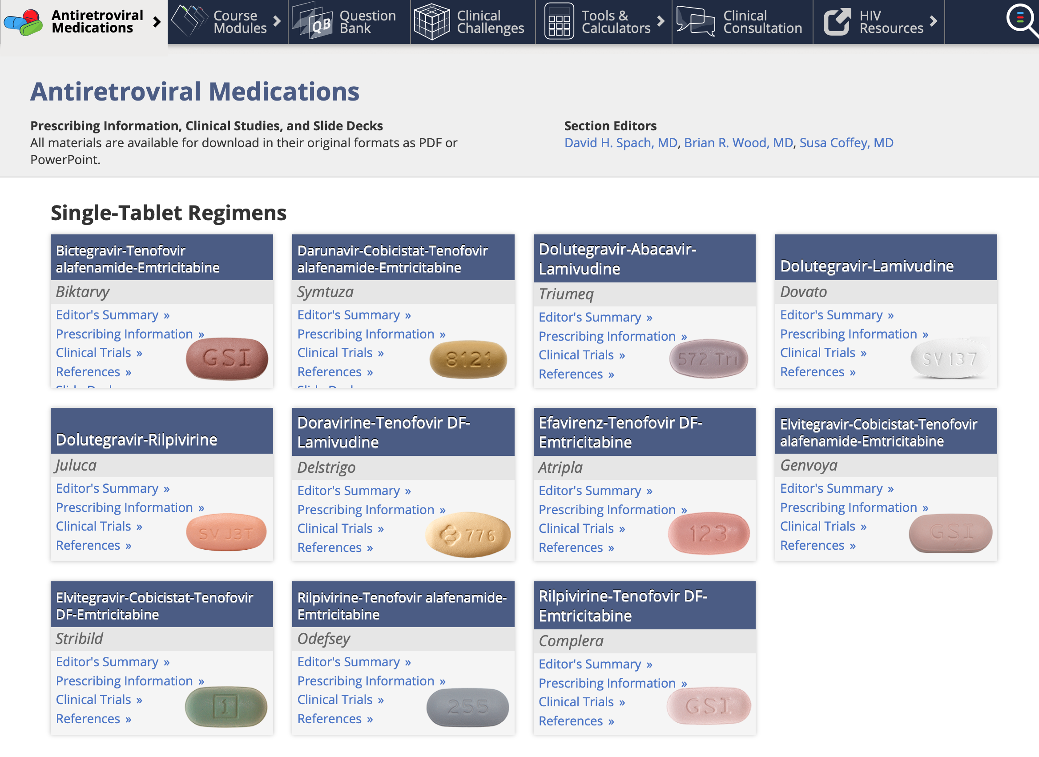
Antiretroviral Medications
Notes:
Downloadable prescribing information, clinical studies, and slide decks are only one click away. Treatments not approved by the FDA are clearly marked “Investigational” with a blue triangle icon.

Slide 16
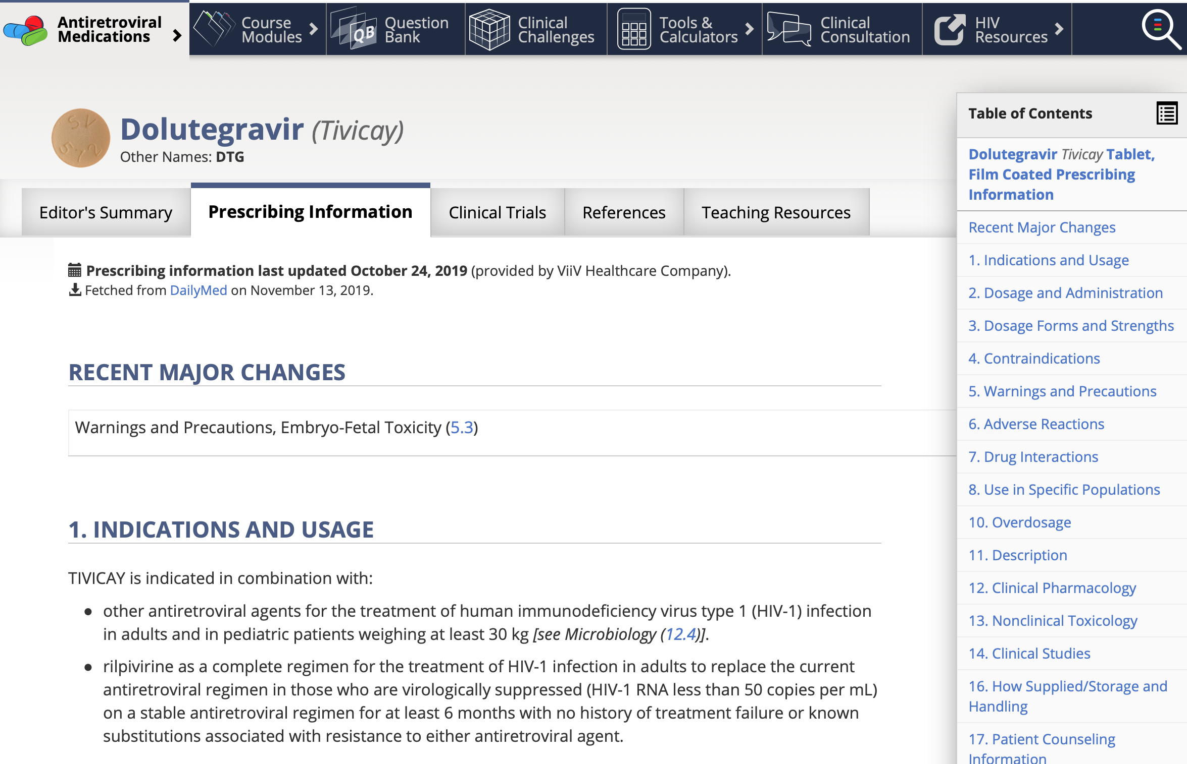
Antiretroviral Medications
Comprehensive ARV medications resource, including Power Point slides for trials
Notes:
An example of what information is available on ARV medications and the many navigational tools which can be used to move quickly through the section.

Slide 17
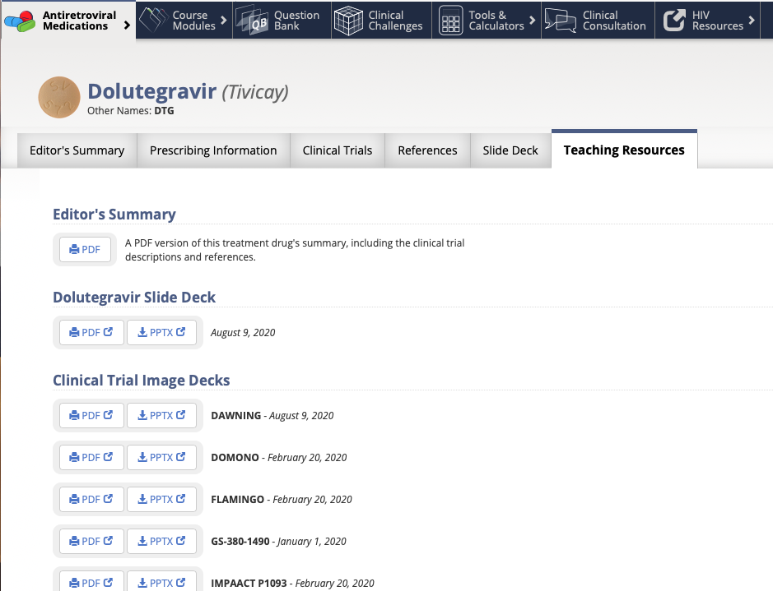
Antiretroviral Medications
Teaching Resources: Downloadable PDFs and PowerPoint Slide Decks
Notes:
Slide decks can be downloaded and used without permission.

Slide 18
Why Online Learning Groups are Formed
Train or onboard staff and residents by assigning selected topics
Review group progress and analytics reports to track CE and shape future trainings
Implement a training plan across multiple locations
Augment medical, nursing, pharmacy, dental and other healthcare professionals training programs

