Slide 1
Implications of Communication on Providing Care to the LGBTQ Community
Russell “Rusty” Rooms, MSN, APRN-CNP
OU Medicine Health Equality Coordinator
Diversity Family Health Nurse Practitioner
Notes:
v1020

Slide 2
Conflict of Interest Disclosure Statement
The planners and presenters of this activity have no relevant financial relationships with any commercial interests pertaining to this activity.
This project is supported by the Health Resources and Services Administration (HRSA) of the U.S. Department of Health and Human Services (HHS). Under grant number U1OHA33225 (South Central AIDS Education and Training Center). It was awarded to the University of New Mexico. No percentage of this project was financed with non-governmental sources. This information or content and conclusions are those of the authors and should not be construed as the official position or policy of, nor should any endorsements be inferred by HRSA, HHS, or the U.S. Government.

Slide 3
Sexual Orientation and Gender Identity
All people have a sexual orientation and a gender identity
How people identify can change
Terminology varies
Gender identity & sexual orientation are separate concepts
Straight/Hetero
Lesbian
Gay/Homo
Bisexual
Queer
Cisgender
Transgender
Non-Binary
Intersex
Asexual or Ally
Notes:
Everybody has a sexual orientation and a gender identity. The words people use to describe their sexual orientation and gender identity varies between people and across cultures . Keep in mind that sexual orientation and gender identity are not the same thing, although they are often confused. The next slides will explain them further.

Slide 4
Sexual Orientation
Sexual orientation is how a person characterizes their physical and emotional attraction to others
It has 3 dimensions:
Identity
Do you consider yourself gay, lesbian, bisexual, straight, queer, something else?
Behavior
What gender(s)
do you have sex with?
Attraction
What gender(s) are you attracted to?
Notes:
Sexual orientation is how a person characterizes their sexual and emotional attraction to others. It can be helpful to think of sexual orientation as consisting of three parts or dimensions – 1) behavior, 2) attraction, and 3) identity. It is important to realize that some people have same-sex partners (behavior) but do not think of themselves as lesbian, gay, or bisexual (identity). Others are attracted to people of the same sex (attraction) but are not sexually active with members of the same sex (behavior).
A person’s sexual identity, behavior, and attraction can change over time. While sexual orientation is not a choice, a person’s stage of development, cultural environment, etc. can shape their own awareness and self-acceptance of their sexuality.

Slide 5
Improving Communication in Healthcare for LGBT+
Safety symbol on entering the building/reception area/exam room
On registration forms have places to put other genders than male (M) & female (F)
(MTF, FTM, NB)

Slide 6
Improving Communication in Healthcare for LGBT+
On Review of Systems (ROS) include:
Have there been any changes to your sexual behaviors since we saw you last?
Do you want to talk about your sexual health today?
History forms include not only sexual orientation, but also behaviors and attractions
Give the opportunity to talk about sex!

Slide 7
Transmission Risks of Different Exposures
Exposure | Risk/10,000 exposures | 95% CI
Blood transfusion | 9250 | 8900-9610
Needle-sharing IDU | 63 | 41-92
Needle stick | 23 | 0-46
Receptive AI | 138 | 102-186
Insertive AI | 11 | 4-28
Receptive PVI | 8 | 6-11
Insertive PVI | 4 | 1-14
Receptive oral | Low | 0-4
Insertive oral | Low | 0-4
Mother-to-child | 2260 | 1700-2900
KEEP IN MIND:
ANAL is not just for boys!!!
Parenteral
TERMS
Bottoming
Topping
Verse
Give Blow Jobs
Get Blow Jobs
Sexual
Vertical
These are average estimates. There are many mitigating factors, the most important of which is HIV viral load.
AIDS. 28(10):1509-1519, June 19, 2014.
DOI: 10.1097/QAD.0000000000000298

Slide 8
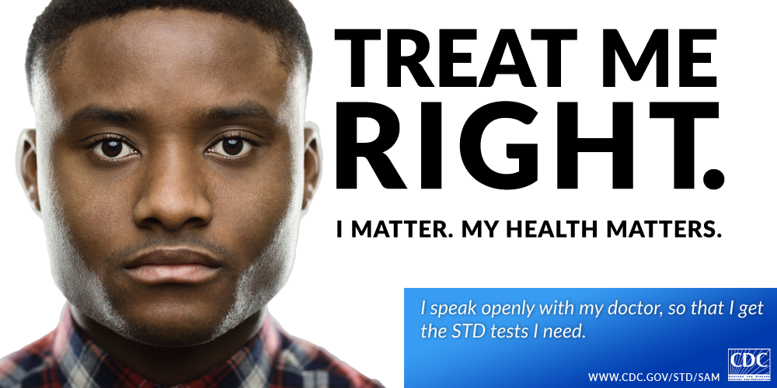
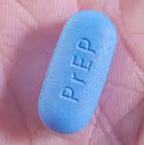
Summary
Getting to know your patients by taking a sexual history can improve the provider/patient relationship and allow you to protect them against HIV and other STI’s
Understanding the culture and being purposeful at creating a safe environment will remove barriers and permit the LGBT patients to talk more openly with you.
Check your own morality at the door.
You don’t have to understand, you just have to care

Slide 9
Questions

Slide 10
Resources
Clinical Consultation Center http://nccc.ucsf.edu/
HIV Management
Perinatal HIV
HIV PrEP
HIV PEP line
HCV Management
Substance Use Management
Additional Trainings scaetcecho@salud.unm.edu www.scaetc.org
AETC National HIV Curriculum https://aidsetc.org/nhc
AETC National HIV-HCV Curriculum https://aidsetc.org/hivhcv
Hepatitis C Online https://www.hepatitisc.uw.edu/
AETC National Coordinating Resource Center https://targethiv.org/library/aetc-national-coordinating-resource-center-0
Notes:
Find an HIV TeleECHO clinic in your area: https://echo.unm.edu/locations-2/echo-hubs-superhubs-united-states/
AETC National HIV Curriculum: 6 core modules for self study; regularly updated; CME, CNE

