Slide 1
The Role of Institutions of Higher Education in Ending the HIV Epidemic
October 8, 2020

Slide 2
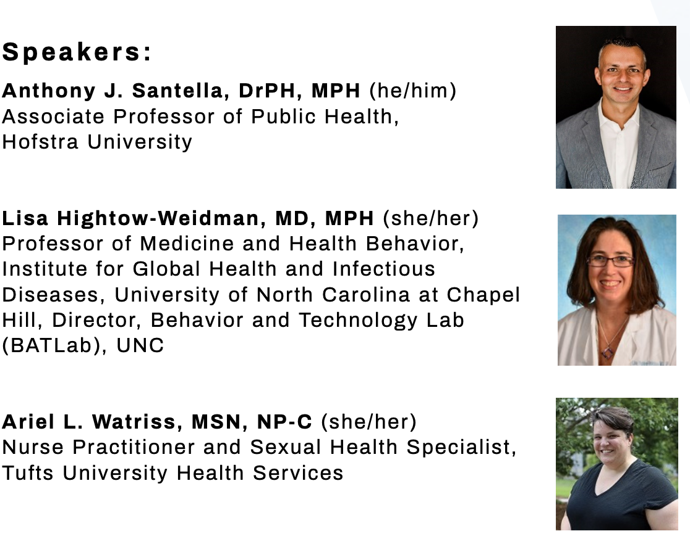
Presentation Speakers

Slide 3
Presentation Objectives
Describe the epidemiology of HIV/AIDS among adolescents and young adults (13-24 years).
Explain why the college campus is a unique setting to deliver HIV testing and make college students aware of their serostatus.
Explain why college health centers are uniquely positioned to offer PrEP as a routine part of their services.
Discuss how college students can engage their campuses and classmates in local EHE implementation strategies.

Slide 4
Epidemiology of HIV/AIDS Among Adolescents and Young Adults

Slide 5
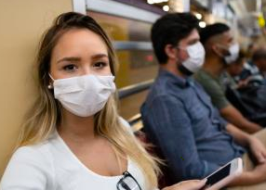
Public Health Crises

Slide 6
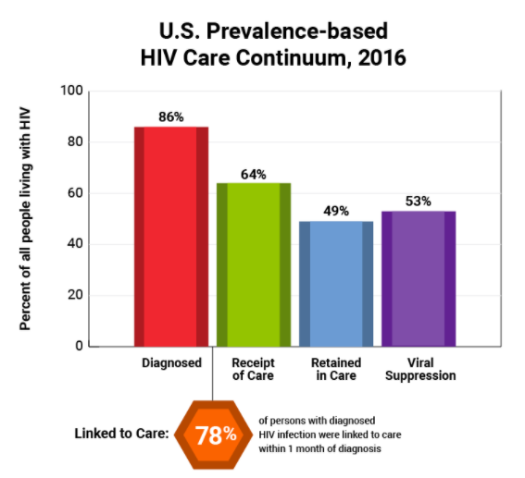
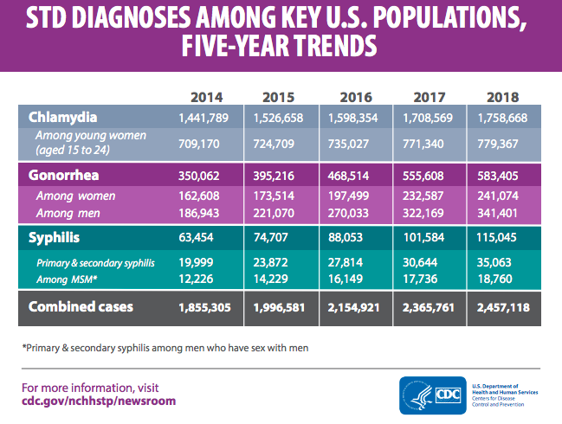
HIV and STD Epidemics
Sources: (1) CDC, HIV Care Continuum. Available at https://www.hiv.gov/federal-response/policies-issues/hiv-aids-care-continuum (2) Hess, K. L., Hu, X., Lansky, A., Mermin, J., & Hall, H. I. (2017). Lifetime risk of a diagnosis of HIV infection in the United States. Annals of Epidemiology, 27(4), 238-243. (2) CDC, 2018 STD Surveillance Report. Available at https://www.cdc.gov/nchhstp/newsroom/2019/2018-STD-surveillance-report.html#Graphics,

Slide 7
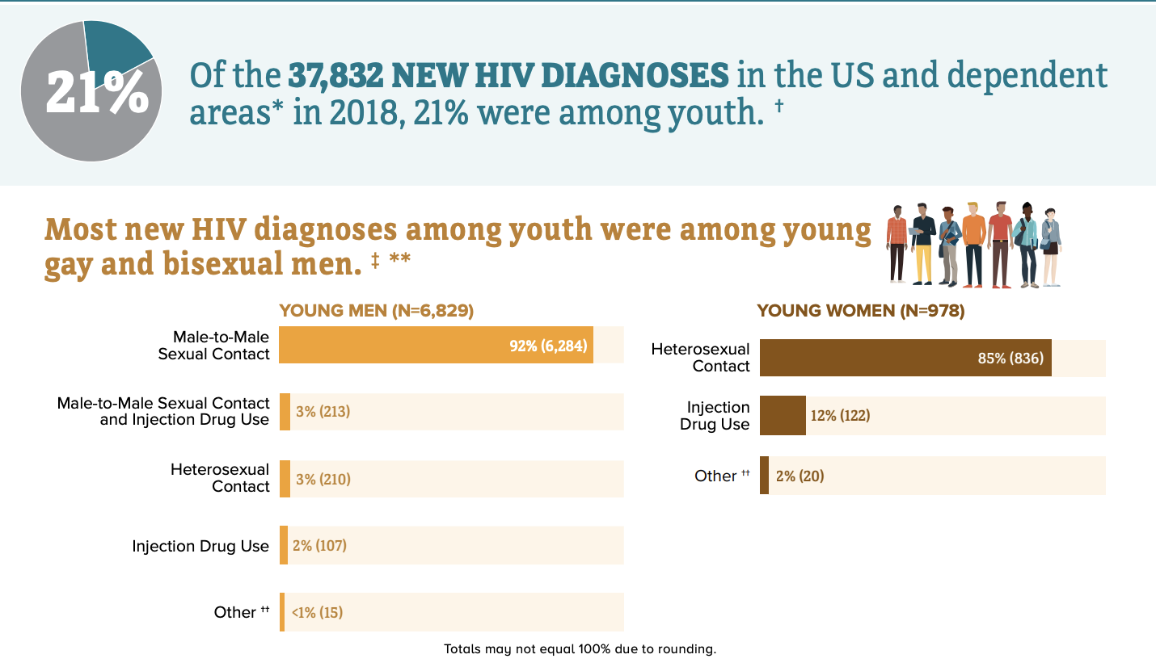
HIV and Youth: New Diagnoses
Source: CDC, HIV and Youth. Available at https://www.cdc.gov/hiv/pdf/group/age/youth/cdc-hiv-youth.pdf

Slide 8
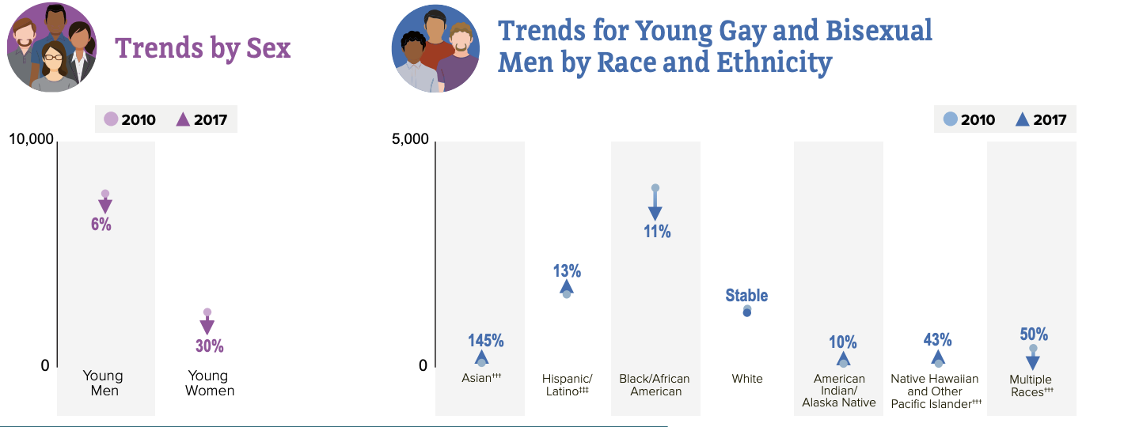
HIV and Youth: Trends in New Diagnoses
Source: CDC, HIV and Youth. Available at https://www.cdc.gov/hiv/pdf/group/age/youth/cdc-hiv-youth.pdf

Slide 9
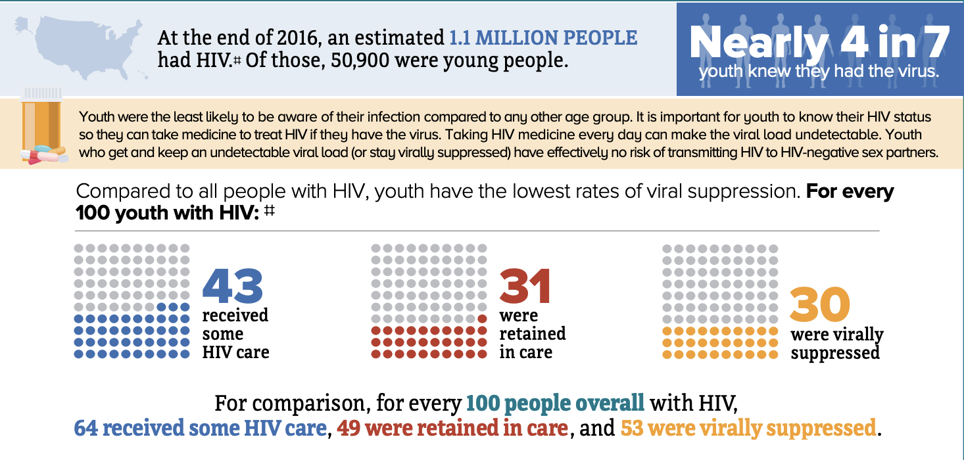
HIV and Youth: Viral Suppression
Source: CDC, HIV and Youth. Available at https://www.cdc.gov/hiv/pdf/group/age/youth/cdc-hiv-youth.pdf

Slide 10
HIV and Youth: Challenges
Source: CDC, HIV and Youth. Available at https://www.cdc.gov/hiv/pdf/group/age/youth/cdc-hiv-youth.pdf

Slide 11
U=U
People living with HIV can feel confident that if they have an undetectable viral load and take their medications as prescribed, they cannot pass on HIV to sexual partners (Undetectable = Untransmittable U=U)
Living with HIV in college– stigma, discrimination, access, support
Source: Prevention Access Campaign. Available at https://www.preventionaccess.org/undetectable

Slide 12
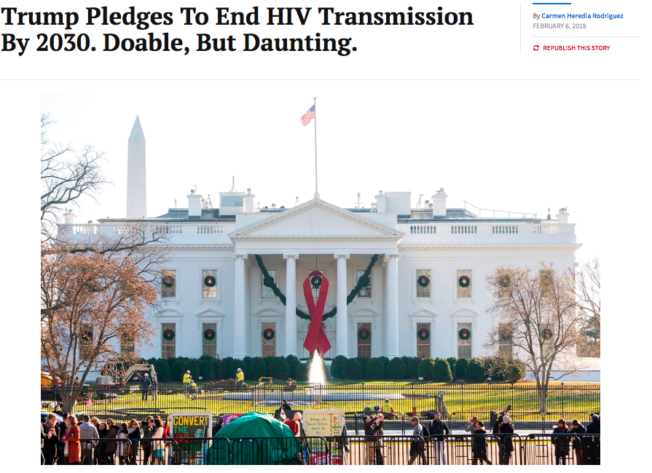
Motive Behind a New Federal Initiative
New federal plan (2020-2030)
Without intervention another 400,000 Americans will be newly diagnosed over 10 years
Federal government spends $20 billion in annual direct health expenditures for HIV prevention and care
Risk of an HIV resurgence
Source: US Department of Health and Human Services, Ending the HIV Epidemic. Available at https://www.hiv.gov/federal-response/ending-the-hiv-epidemic/overview

Slide 13
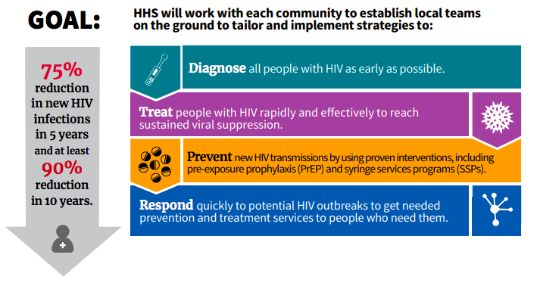
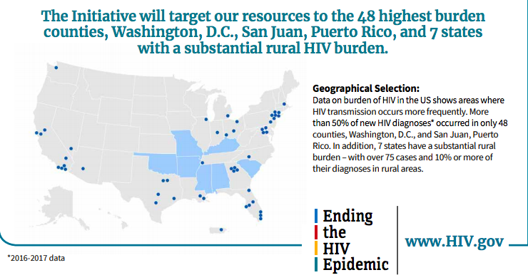
Goals and Priorities of the New Federal Initiative
Source: US Department of Health and Human Services, Ending the HIV Epidemic. Available at https://www.hiv.gov/federal-response/ending-the-hiv-epidemic/overview

Slide 14
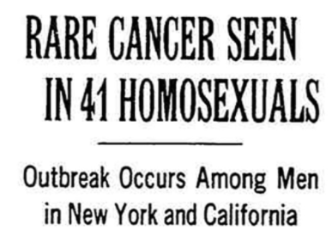
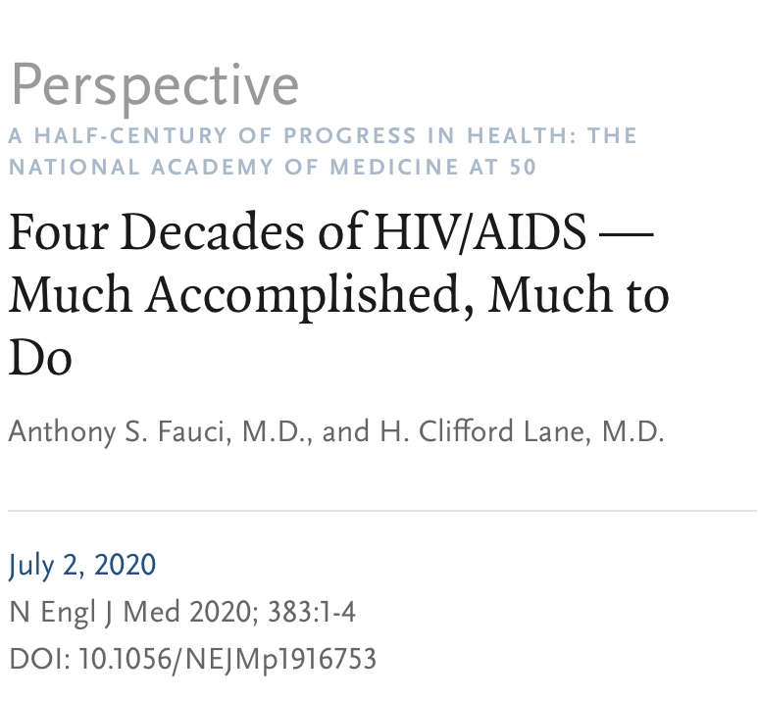
Much Accomplished, Much to Do….
“The challenge before us is to deploy — for everyone who needs them — the innovative strategies for HIV prevention and treatment that have resulted from the unprecedented basic scientific and clinical advances made over the past four decades.”
Dr. Anthony Fauci
Director, National Institute of Allergy and Infectious Diseases
Sources: (1) Altman, L. Rare Cancer Seen in 41 Homosexuals. New York Times, July 3, 1981. Available at https://www.nytimes.com/1981/07/03/us/rare-cancer-seen-in-41-homosexuals.html (2) Fauci, A. S., & Lane, H. C. (2020). Four Decades of HIV/AIDS—Much Accomplished, Much to Do. NEJM, 383(1), 1-4.

Slide 15
HIV Testing and College Students

Slide 16
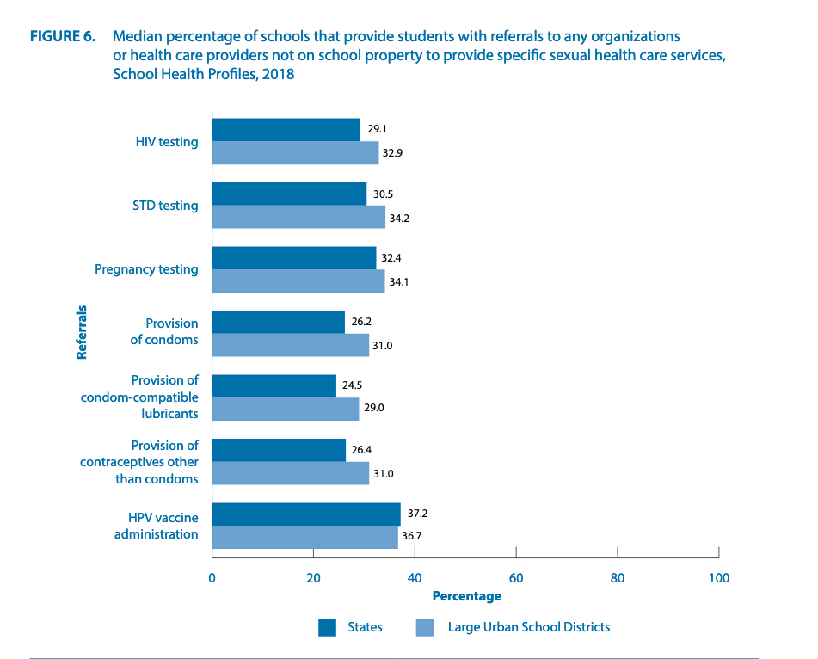
Inadequate Sex Education for High School Students
CDC 2018 School Health Profiles

Slide 17
Promotion of Prevention on Campus
A variety of sexual risk behaviors place college students at higher risk for STIs/HIV including:
high rates of sexual activity
numerous sexual partners
inconsistent condom use
sex under the influence of drugs or alcohol
College presents a unique opportunity for health education and health promotion, as young adults are more receptive to health messages and adopting healthy lifestyles at an early age has long-term benefits.
Promoting healthy HIV prevention behaviors in this population may have long-term implications on reducing the prevalence of HIV.

Slide 18
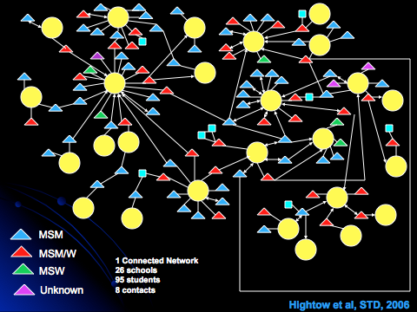
Early Work
J Acquir Immune Defic Syndr 2005;38:531–537

Slide 19
Strength through Youth Livin’ Empowered
Clinical care for Young GBMSM living with HIV
Focus on linking to care and retention in care
HIV care provided at 2 local clinics by staff physician
Support and Client Services
Case management
Support groups
One-on-one support by outreach staff
Outreach and education in the community
Rapid HIV Counseling and Testing
College Testing Tour

Slide 20
Style Core Component: Testing
College/Venue based Rapid HIV testing tour
Over 3000 NC college students tested
10 new positives identified and linked to care
Mix of schools (Duke, UNC-Chapel Hill, NC State, NC Central, Shaw, St. Augustine’s, Livingstone) also includes testing events at churches
Youthful testing staff, buy-in from campus groups drives high turnout (as many as 250 students at an event)
Core component is confidentiality for positive clients (space/ logistics)
MD on site/on call of immediate linkage to confirmatory testing and care

Slide 21
Unique Aspects of Style Testing Events
Free, rapid, oral testing
Group or individual pre-test counseling encouraging “friends” coming in for testing together
Graduate students as counselors - promotes youth-friendly environment
Close enough in age to undergrads to be seen as understanding, but removed from undergraduate social circles - less confidentiality concerns
Physician on-site for referral of all positive cases
Co-sponsorship with campus organizations promotes student buy-in

Slide 22
National College Health Assessment
HIV Testing Behaviors
17% reported testing for HIV in past 12 months
11% reported testing >12 months ago
Sexual Behaviors
55% engaged in vaginal intercourse in past 12 months
10% engaged in anal sex in past 12 months
Of those reporting having vaginal intercourse in past 12 months: 15% of males and 17% females reported that they or their partner used emergency contraception ("morning after pill" or "Plan B")
Fall 2019: National reference group of 38,679 college students

Slide 23
HIV Testing and Sexual Behaviors
HIV risk assessment at four HBCUs in a southern state
Among participants (N = 615), most identified as African American (578, 94.8%), female (377, 61.3%) and 18-24 years old (540, 87.9%)
Many (42.3%) had never been tested for HIV
Most reported they had been sexually active in the last year (533, 86.8%) with many reporting 2-5 partners (270, 43.9%)
Among males (n = 236), 8.6% reported same sex partners
Many participants reported inconsistent condom use during vaginal sex (242, 46%)
Most participants had not heard of PrEP (473, 86.2%)
Marshall, 2020

Slide 24
HIV and Stigma
Nationally representative survey of 1,794 young adults ages 18-30 years
Comfortable having someone with HIV as friends (65%) or work colleagues (66%)
Uncomfortable having a roommate with HIV (51%) or having their food prepared by someone with HIV (58%)
Three quarters (73%) respond that are “very uncomfortable” having a sexual partner with HIV, another 18% say they would be “somewhat uncomfortable”
More than half (54%) of young adults report never having been tested for HIV
Nearly two-thirds (63%) say they have never talked with a health care provider about HIV
National Survey of Young Adults on HIV/AIDS, Kaiser Family Foundation, Nov 2017

Slide 25
HIV Knowledge, Testing History and Stigma
A random sample of 2343 students, over the age of 18, attending a large university in the southeastern United States completed the survey in January 2016
majority of the respondents were white (72%), female (63%), and straight (87%)
72% sexually active (past 12 months)
34% ever tested for HIV
HIV testing history was associated with higher knowledge scores and higher knowledge scores were associated with lower stigma
Results suggest that HIV knowledge partially mediates the relation between HIV testing history and stigma
James, 2018

Slide 26
Why embrace sexual health and HIV/STI prevention on campus?
Colleges are microcommunities composed of individuals from all walks of life.
Reduces community burden of disease
Improves public health
Improves individual health and reduces long-term co-morbidities
Improves individual mental health
Reduces financial costs

Slide 27
Best Practices for Sexual Health Promotion and Clinical Care in College Health Settings
Sexual Health
“A state of physical, mental and social well-being in. relation to sexuality. It requires a positive and respectful approach to sexuality and sexual relationships, as well as the possibility of having pleasurable and safe sexual experiences, free of coercion, discrimination and violence.”
-World Health Organization (2006)
Combine sexual health information with general health information
Create a Welcoming Clinic Environment
Provide Inclusive Resources and Services
Orient Clinical Care Toward Prevention
Incorporate Pleasure and Intimacy into Sexual Health Efforts
Get students involved! Student activism gets things done

Slide 28
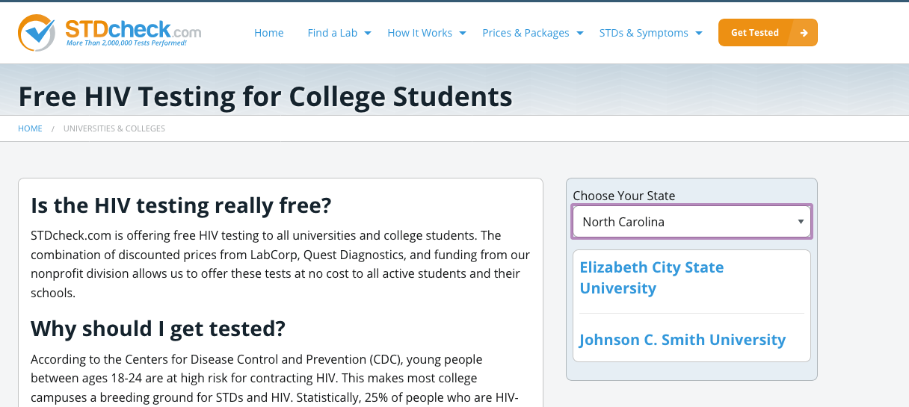
“Off Campus” Options

Slide 29
Conclusions
Sexual health is a wide-reaching topic that intersects with multiple dimensions of health and wellness
Young adults in college are at a crucial developmental stage where they are not only learning about themselves and their bodies, but also trying to navigate the healthcare system and develop healthy intimate relationships in a rapidly-changing social and political landscape
As such, college health practitioners are in a unique position to meet their need for holistic resources and care that consider their experiences and prioritize health equity

Slide 30
Why colleges student health centers are uniquely positioned to offer PrEP as a routine part of their services

Slide 31
Populations at need= the populations in college
Ages 13-24 are key population that needs more robust prevention approaches
New independence with minimal sex education knowledge
As seen on previous slides, we know this age group is particularly at risk for HIV
For most students, this is their first time navigating life/health issues on their own. For almost all students, they are coming into a new living/life context with little to know body knowledge

Slide 32
Themes of health needs in college
Sexual awareness/access changes
New autonomy
Perception of sexual worlds on campus - what is real?
Hook up culture, self vs perceived social expectations
Health knowledge gaps that need help being filled

Slide 33
Benefits of offering PrEP
Empowering, develop autonomy
Various ways to implement- telehealth, in person, video appts
Can be managed by multiple provider types
Another preventative health measure
Campuses generally already offering other HIV prevention methods (condoms, etc.)
Invites student into learning about science and health

Slide 34
Comprehensive STI prevention care must include PrEP
Every STI testing appointment is an opportunity to talk about PrEP
More significantly, every positive STI diagnosis is a massive opportunity to bring up PrEP
Rates of missed opportunities
HIV and other STIs
Other STIs that impact mucosal membranes, increase inflammation with outbreaks, can enhance HIV transmission
Notes:
It can seem like a big task to take on, implementation of PrEP. It can be incorporated

Slide 35
Quote
"American College Health Association (ACHA) believes the ongoing HIV epidemic is an urgent health priority and that college health centers can make a significant impact in the health of young adults by offering PrEP as a standard health care service," says Devin Jopp, EdD, Chief Executive Officer of ACHA. "College health services are uniquely positioned to implement comprehensive, evidenced-based prevention strategies that can help end the HIV epidemic among young adults.“
From the ACHA PrEP guidelines, published in Jan 2019

Slide 36
Implementation concerns/challenges
Stigma
‘Discussions around sexual behavior can uncover implicit bias among health care providers and other staff. It is important to think carefully about our own biases and try to limit how they affect our treatment in nonscientific ways. Some providers may feel uncomfortable talking about sexual behavior, but it is a learnable skill, and the ability to talk with patients about sexual behavior is a key part of every PrEP visit.’ (ACHA Guidelines)
If your clinic offers access to contraception, it is able to offer PrEP
Notes:
Stigma around sexual health can limit opportunities to engage with students around an area of health they very much want more

Slide 37
Implementation concerns cont’d
Access over the summer:
Most insurance companies covering 3-4 months at a time
Find local to student access point- preplocater.org
Online/virtual options
Cost:
Monthly copays vary by insurance company
Some states have financial support programs available
Adherence:
How do other students with daily meds create habits? What teaching can be done? What are the barriers to daily adherence?
Impact/increase ‘risky’ behavior
Risk compensation shown not to be as big a factor as previously thought
Notes:
virtual PrEP telemedicine visits with self-collection of blood (finger stick) for HIV, syphilis, creatinine, and HCV and self-collected urine and extragenital site GC/CT NAATs sent to lab in box they send with supplies

Slide 38
ACHA Guidelines - HIV PrEP
Offers review of evidence-based support around implementation
Reviews the science of the medication itself
Addresses common concerns around PrEP implementation, cost and access
Offers protocol samples to assist in the implementation process
Available at acha.org

Slide 39
References
Michael J. Huey, Margaret Higham & Ariel L. Watriss (2020) Viewpoint: Why you should provide HIV pre-exposure prophylaxis (PrEP) at your college health center, Journal of American College Health, 68:2, 119-123, DOI: 10.1080/07448481.2018.1529673
USPSTF Recommendation Statement “Prevention of Human Immunodeficiency Virus (HIV) Infection: Pre-Exposure Prophylaxis” at https://www.uspreventiveservicestaskforce.org/Page/Document/RecommendationStatementDraft/prevention-of-human-immunodeficiency-virushiv-infection-pre-exposure-prophylaxis#consider
https://www.acha.org/documents/resources/guidelines/ACHA_HIV_PrEP_Guidelines_Jan2019.pdf
Petsis D et al. HIV testing among adolescents with acute sexually transmitted infections. Pediatrics 2020 Apr; 145:e20192265. (https://doi.org/10.1542/peds.2019-2265)

Slide 40
Engaging College Students in EHE Efforts: A Case from Long Island, New York

Slide 41
Long Island ETE Campus Advisory Committee Background
College students represent an untapped population in ending the HIV epidemic efforts
4 out of 5 young adults newly diagnosed with HIV were between 20 and 24 years old
About 28% of college students reported getting tested for HIV
Risk behaviors such as inconsistent and incorrect condom use are prevalent among this population
American College Health Association recently published PrEP Guidelines to help college health centers initiate PrEP
No EHE plan to our knowledge strategically and intentionally incorporated the voice of college/university students

Slide 42
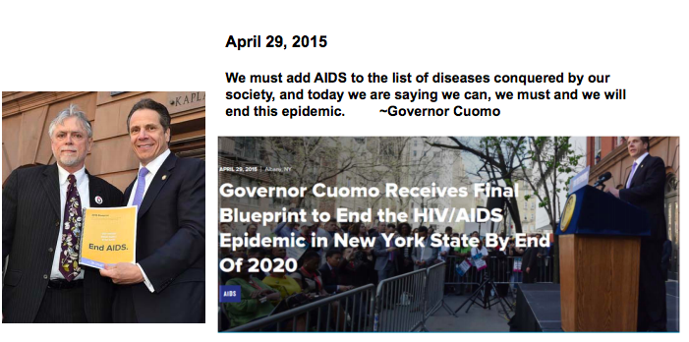
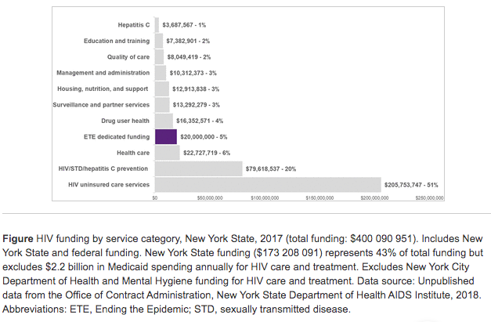
New York Leading the Effort
Source: Morne, JE., Tesoriero, JM., Martin, EG et al. Ending the HIV Epidemic: New York’s quest to become the first state to reduce HIV prevalence. Public Health Rep. 2020;135(suppl 1):65S-74S

Slide 43
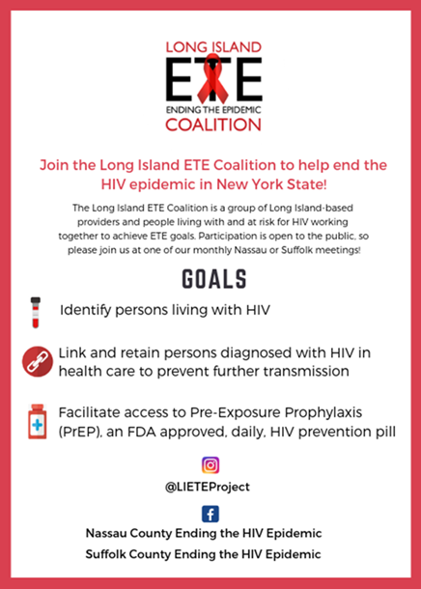
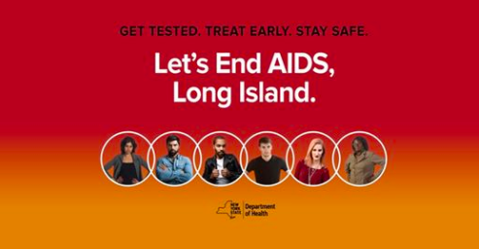
Long lsland EHE Response

Slide 44
Program Description
The Nassau and Suffolk County Regional Committees and the Long Island HIV Community Mobilization Coalition developed the Long Island Ending the Epidemic (ETE) Campus Advisory Committee
Funding provided by NY State DOH AIDS Institute ETE Special Projects Grant for 1-year pilot
The Committee serves as campus champions by:
Promoting ETE meetings, events, and campaigns
Engaging young adults in ETE efforts by co-sponsoring events
Reviewing ETE promotional materials
Assisting ETE members with outreach/education at community events, Promoting service-learning opportunities
Committee members receive $250 gift card for participation between October 2019-May 2020

Slide 45
LI ETE Campus Advisory Committee Recruitment
All 12 higher education academic institutions on Long Island invited to participate
Invited students by contacting college/university leadership through the Long Island Council of Student Personnel Administrators and through direct emails to the university leadership
Application: (1) demographic characteristics, (2) interest in joining the Board, (3) student-related organizations they belong to, (4) time commitment during the 2019-2020 academic year, and (5) their ideas for how they can work with both ETE Committees to achieve their missions
Applications were limited to Sophomores and Juniors as we hope to continue their engagement past this initial year
Applications reviewed by Anthony Santella and chairs of Nassau and Suffolk County ETE Regional Committee using a grading rubric
Initial plan was to select two students from each institution; didn’t happen
Formal announcement was circulated with ask for all institutions public relations to post it to create a “buzz” around this new group

Slide 46
Committee Members
Llima Berkley | Adelphi University
Sophia Gomes | Farmingdale Stage College
Andy Charlorin | Farmingdale State College
Khadija Ali | Farmingdale State College
Lauren Gentile | Farmingdale State College
Abby Briggs | Hofstra University
Daniela Fraticelli | Hofstra University
Moran Yazdani | Hofstra University
Saher Chaudhry | Hofstra University
Kayla Halper | Long Island University Post
Madison Baker | New York Institute of Technology College of Osteopathic Medicine
Sarah Gilman | New York Institute Of Technology College of Osteopathic Medicine
Elisabeth Frankini | New York Institute of Technology College of Osteopathic Medicine
Angela McDermott | St. Joseph's College
Yashasvi Bajaj | Stony Brook University
Kacper Iwanowski | Stony Brook University
Samkaris Oghenekome | Suffolk County Community College
Stefani Gallagher | Suffolk County Community College - Riverhead Campus
Brittney Canada | SUNY Old Westbury

Slide 47
What We Did
Received 50 applications; 24 students selected; 18 remained by second semester
Orientation
Training: HIV 101, PrEP, HIV testing, and TGNC
Fall 2019 Requirements
Attend group training
Attend an HIV/sexual health meeting such as a Ryan White Planning Council meeting
Assist a local organization with HIV-related community outreach and education
Collect information on student groups and faculty/staff at their respective college to help establish a database for campus outreach
Spring 2020 Requirements
Attend group training
Implement 2 Long Island ETE Community Presentation on your campus
Attend 1 HIV-related meeting
Participate in 2 campus health tabling/health fair and distribute 50 ETE flyers total
Have 2 groups on your campus promote the Nassau ETE OR Suffolk ETE Facebook pages

Slide 48
Desired Outcomes
Improve knowledge of the New York State ETE pillars of both our Committee members and the students they engage with
Improve community outreach and engagement skills among our Committee
Improve campus awareness of ETE efforts through the actions facilitated by their respective Committee members

Slide 49
Challenges

Slide 50
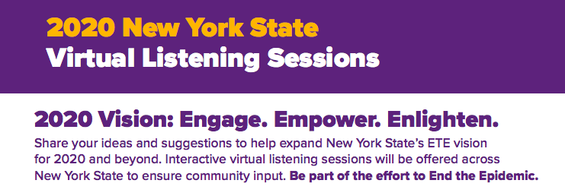
Next Steps
Involve pilot participants in re-envisioning Committee
Expand Committee to be state-wide
Explore new Committee opportunities based on New York State ETE 2020 and Beyond
Seek sustainable funding

Slide 51
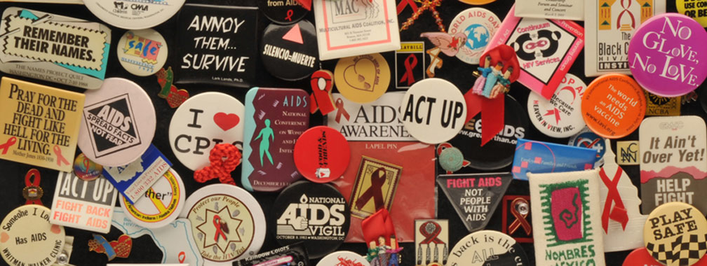
Questions?

Slide 52
Thank you for attending!
You will receive an e-mail with the link to the evaluation. Please complete by Thursday, October 15th.

