Slide 1
: Getting Set Up

Slide 2
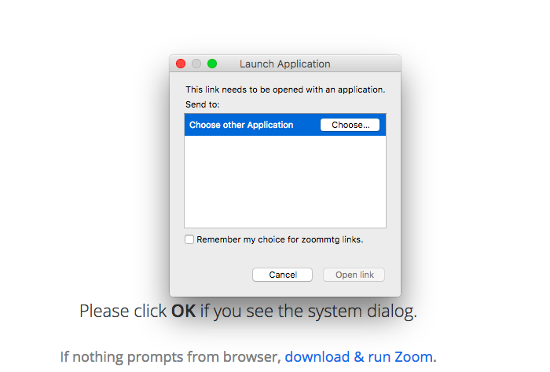
Launch Zoom
After clicking the Join URL, you’ll see the below prompt.
If you’ve never used Zoom, you will need to download it.

Slide 3
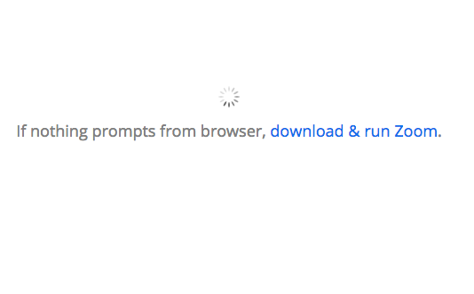
Download Zoom
Your computer may help by automatically starting the download.
If it doesn’t, you can click the “download & run Zoom” option:

Slide 4
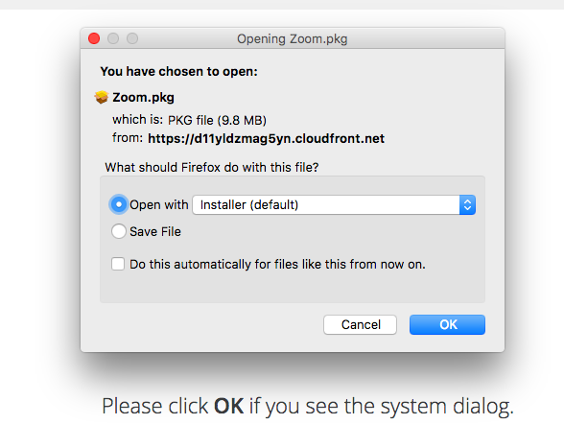
Download Zoom
Open and save the file, following the prompts from your computer

Slide 5
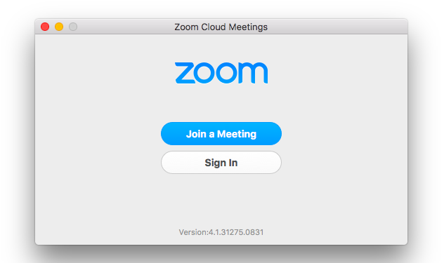
Joining the call
Once you’ve downloaded Zoom, you’ll see the below prompt.
Select “Join a Meeting”
Do NOT select “Sign In”

Slide 6
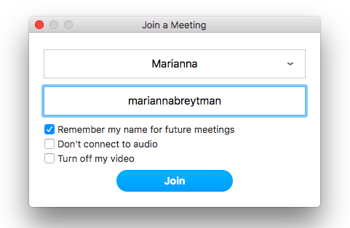
Joining the call
Next, you’ll see a prompt that looks like this.
Write your name so that everyone on the call knows who you are!
Then, select “Join”!
1
2

Slide 7
That’s all it takes! We look forward to seeing you on Zoom.

