Slide 1
Guidelines for Prevention and Treatment of Opportunistic Infections in HIV-Infected Adults and Adolescents
Bartonellosis Slide Set
Prepared by the AETC National Coordinating Resource Center based on recommendations from the CDC,
National Institutes of Health, and HIV Medicine Association/Infectious Diseases Society of America

Slide 2
About This Presentation
These slides were developed using recommendations published in May 2013. The intended audience is clinicians involved in the care of patients with HIV.
Users are cautioned that, because of the rapidly changing field of HIV care, this information could become out of date quickly. Finally, it is intended that these slides be used as prepared, without changes in either content or attribution. Users are asked to honor this intent.
– AETC National Resource Center
http://www.aidsetc.org

Slide 3
Bartonellosis
  Epidemiology
  Clinical Manifestations
  Diagnosis
  Prevention
  Treatment
  Considerations in Pregnancy

Slide 4
Bartonellosis: Epidemiology
Bartonella spp. cause variety of infections, including cat-scratch disease, retinitis, trench fever, relapsing bacteremia, endocarditis
In immunocompromised: also bacillary angiomatosis (BA) and peliosis hepatis
BA usually caused by B henselae or B quintana
  Typically occurs late in HIV infection; median CD4 count <50 cells/µL
  B henselae linked to cat scratches from cats infested with fleas, cat fleas
  B quintana associated with louse infestation

Slide 5
Bartonellosis: Clinical Manifestations
In HIV-infected persons, symptoms often chronic (months-years)
May involve nearly any organ system
  BA of the skin: papular red vascular lesions, subcutaneous nodules; may resemble Kaposi sarcoma or pyogenic granuloma
  Osteomyelitis (lytic lesions)
  Peliosis hepatica (B henselae)
  Endocarditis
Systemic symptoms of fever, sweats, weight loss, fatigue, malaise

Slide 6
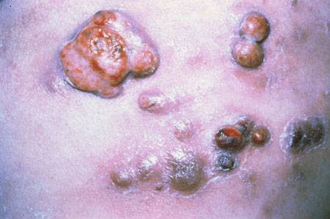
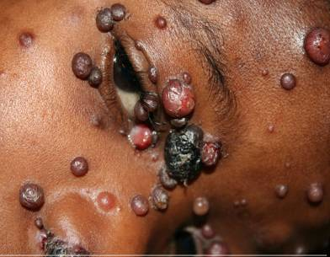
Bartonellosis: Clinical Manifestations (2)
Skin lesions of Bartonella
Credit: P. Volberding, MD, UCSF Center for HIV Information Image Library
Skin lesions of Bartonella (2)
Credit: G. Beatty, MD; A. Lukusa, MD, HIV InSite

Slide 7
Bartonellosis: Diagnosis
Tissue biopsy: histopathologic examination
Serologic tests (available through the CDC and some state health labs)
  Up to 25% of patients with advanced HIV infection and positive blood cultures for Bartonella may not develop antibodies
  Antibody levels can indicate resolution and recrudescence of infection
Blood culture
PCR not widely available

Slide 8
Bartonellosis: Preventing Exposure
If CD4 count <100 cells/µL, high risk of severe disease if infected by B quintana or B henselae
Advice to patients:
  B quintana
    Consider risks of contact with cats
    If acquiring a cat: cat should be >1 year of age, in good health, free of fleas
    Avoid cats with fleas, stray cats
    Avoid cat scratches
    Avoid contact with flea feces
    Control fleas
  B henselae
    Eradicate body lice, if present

Slide 9
Bartonellosis: Preventing Disease
Primary chemoprophylaxis not recommended
  Macrolide or rifamycin was protective in a retrospective case-control study

Slide 10
Bartonella Infection: Treatment
No randomized controlled trials in HIV-infected patients
BA, peliosis hepatica, bacteremia, osteomyelitis
  Preferred:
    Doxycycline 100 mg PO or IV Q12H
    Erythromycin 500 mg PO or IV Q6H
  Alternative:
    Azithromycin 500 mg PO QD
    Clarithromycin 500 mg PO BID
  Duration: at least 3 months

Slide 11
Bartonella Infection: Treatment (2)
CNS infections
  Preferred: doxycycline 100 mg PO or IV Q12H +/− rifampin 300 mg PO or IV Q12H
Endocarditis (confirmed Bartonella)
  Doxycycline 100 mg IV Q12H + gentamicin 1 mg/kg IV Q8H x 2 weeks, then doxycycline 100 mg IV or PO Q12H
  If renal insufficiency: doxycycline 100 mg IV Q12H + rifampin 300 mg IV or PO Q12H x 2 weeks, then doxycycline 100 mg PO Q12H
Other severe infections
  Doxycycline 100 mg PO or IV Q12H + rifampin 300 mg PO or IV Q12H
  Erythromycin 500 mg PO or IV Q6H + rifampin 300 mg PO or IV Q12H

Slide 12
Bartonellosis: Starting ART
Bartonella CNS or ophthalmic lesions: if not on ART, probably should treat with doxycycline + a rifamycin for 2-4 weeks before initiating ART

Slide 13
Bartonellosis: Monitoring and Adverse Effects
Check Bartonella IgG titer at diagnosis and (if positive) every 6-8 weeks until 4-fold decrease
Oral doxycycline: risk of pill-associated ulcerative esophagitis
Rifamycins have significant interactions with many ARVs; some combinations must be avoided
IRIS has not been described

Slide 14
Bartonellosis: Treatment Failure
Consider alternative second-line regimens (above)
If positive or increasing Ab titer, treat until a 4-fold decrease

Slide 15
Bartonellosis: Preventing Recurrence
Secondary prophylaxis:
  In case of relapse after ≥3 months of treatment, long-term suppression is recommended while CD4 count <200 cells/µL: doxycycline or macrolide
Discontinuing suppressive therapy:
  After 3-4 months of therapy and CD4 count >200 cells/µL for ≥6 months; some also require a 4-fold decrease in Bartonella titers

Slide 16
Bartonellosis: Considerations in Pregnancy
No data on Bartonella infections during pregnancy in HIV-infected women; in HIV-negative women, B bacilliformis associated with increased complications and risk of death
Diagnosis as in nonpregnant women
Treatment: erythromycin recommended; avoid tetracyclines (hepatotoxicity and staining of fetal teeth)
  Alternative: 3rd-generation cephalosporins (1st- and 2nd-generation cephalosporins not effective against Bartonella)

Slide 17
Websites to Access the Guidelines
http://www.aidsetc.org
http://aidsinfo.nih.gov

Slide 18
About This Slide Set
This presentation was prepared by Susa Coffey, MD, for the AETC National Resource Center in June 2013
See the AETC NRC website for the most current version of this presentation: http://www.aidsetc.org

