Slide 1
Sexually Transmitted
Infections
Kimberly A. Workowski, MD, FACP, FIDSA
Professor of Medicine
Emory University
Atlanta, Georgia
AU EDITED: 12/09/15
New Orleans, Louisiana: December 15-17, 2015

Slide 2
STI Testing during HIV care
Initial care visit
  Syphilis serology, NAAT at sites of exposure (gonorrhea, chlamydia)
  Hepatitis A, B, C
  Women
    Trichomonas testing (NAAT, culture)
    Cervical pap test per existing guidance (HIV OI guidelines)
More frequent screening dependent on risk
  New sex partner, partner with concurrent partners or more than one partner, or partner with an STI
High risk behavior
  Partner services, prevention counseling
2015 Treatment Guidelines, HIVMA 2014

Slide 3
Proportion of MSM* Attending STD Clinics with Primary and Secondary Syphilis, Gonorrhea or Chlamydia by HIV Status†, STD Surveillance Network (SSuN), 2014*
2014 data are preliminary

Slide 4
Syphilis serologic screening algorithms
Traditional
Reverse sequence
Quantitative RPR
RPR+
RPR-
TP-PA
or other
trep. test
TP-PA+
Syphilis
(past or present)
TP-PA-
Syphilis unlikely
EIA or CIA
EIA/CIA+
EIA/CIA-
Quantitative
RPR
RPR+
Syphilis
(past or present)
RPR-
TP-PA
TP-PA-
Syphilis unlikely
TP-PA+
Syphilis
(past or present)
Early primary, requires RPR (active), false +
Active infection, F+, miss early
MMWR 60(5);2011

Slide 5
Evaluation of CNS Involvement
Neurologic, ocular, auditory signs/sxs
CNS invasion in early syphilis +/- HIV or neuro
  Clinical significance unknown (protein, pleocytosis)
  Neurosyphilis - combination of tests + clinical
    Higher cut off for CSF >20 WBCs may improve specificity of NS diagnosis
LP: neuro/ocular sx, serologic treatment failure, tertiary
  Some studies - clinical and CSF consistent with NS
    RPR ≥ 1:32 and/or CD4 ≤350
  Unless neurologic sx, CSF exam has not been associated with improved clinical outcomes
2015 STD Treatment Guidelines; Marra 2004; Libois A, STD 2007 ; Ghanem CID;Marra CID 2008

Slide 6
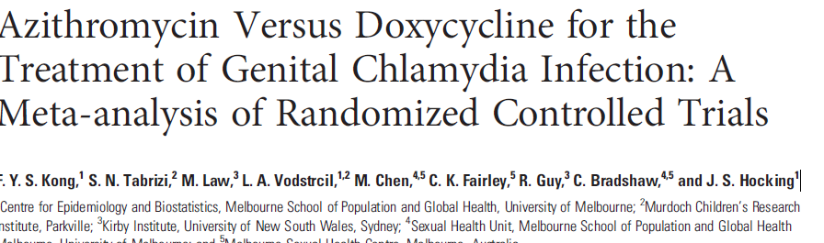
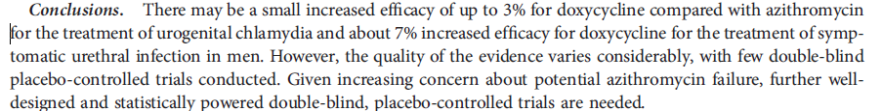

Slide 7
Recurrent NGU
MSW > MSM (T. vaginalis)
Urethral meatus (HSV); insertive rectal IC (E coli)
Mycoplasma genitalium
  15-25% of NGU, no FDA cleared test
  Azithromycin>doxycycline (3 RCTs)
  Azithromycin efficacy declining (Manhart, CID 2013)
  Moxifloxacin for recurrence (resistance reported)

Slide 8
Uncomplicated Gonococcal Infections of
Cervix, Urethra & Rectum
Ceftriaxone 250 mg as a single intramuscular dose
PLUS
Azithromycin 1 g orally
Alternative:
If Ceftriaxone is not available:
  Cefixime 400 mg PLUS azithromycin 1 gram
Test of cure not needed after treatment for urogenital/ rectal infection, but for pharynx (alternative)
2015 CDC STD Treatment Guidelines

Slide 9
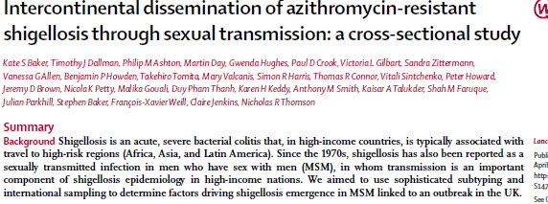
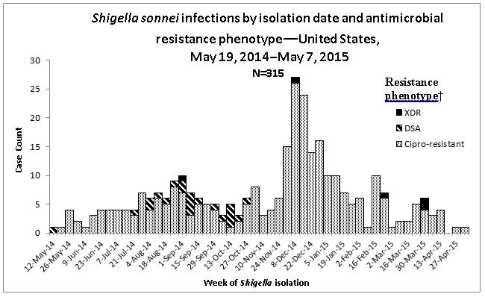
Antimicrobial Resistant Shigella in MSM

Slide 10
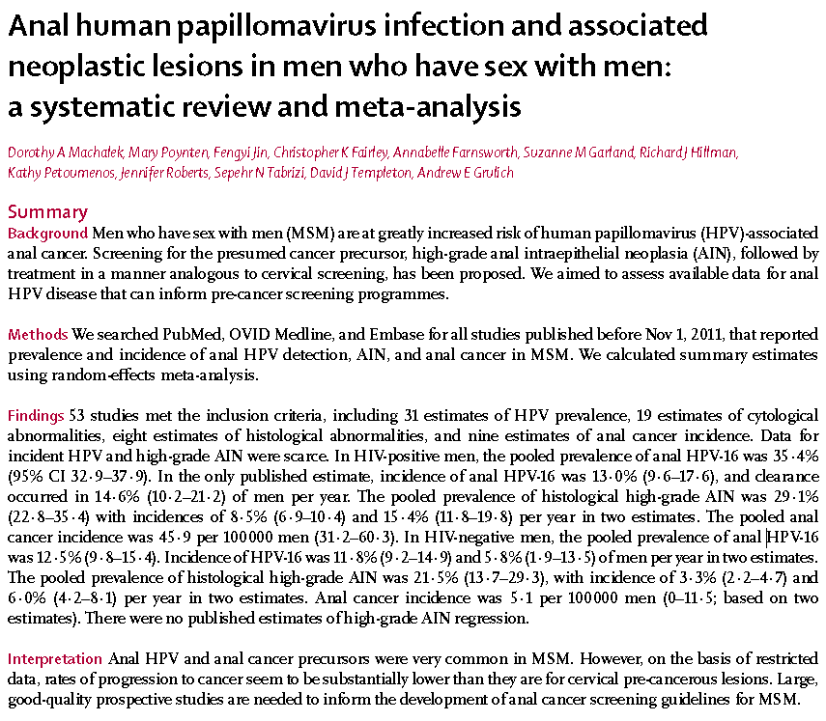
Notes:
Machalek DA, Poynten M, Jin F et al. Anal human papillomavirus infection and associated neoplastic lesions in men who have sex with men: a systematic review and meta-analysis. Lancet Oncol. 2012 May;13(5):487-500.

