Slide 1
State of the Art in Hepatitis C Virus Infection in HIV/HCV-Coinfected Patients
David L. Wyles, MD
Associate Professor of Medicine
University of California San Diego
San Diego, California
FORMATTED: 11/17/15
New Orleans, Louisiana: December 15-17, 2015

Slide 2
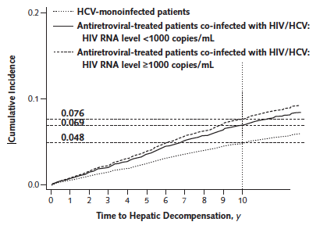
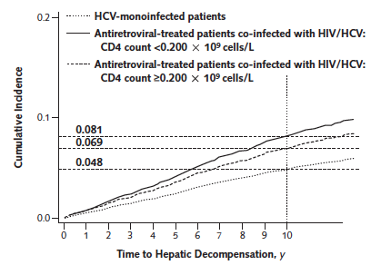
HIV treatment does not completely abrogate the negative effect
ART decreases hepatic decompensation events: 0.72 (0.54-0.94).
Notes:
HR decreases with longer time since ART initiation: 0.53 at >4 years

Slide 3
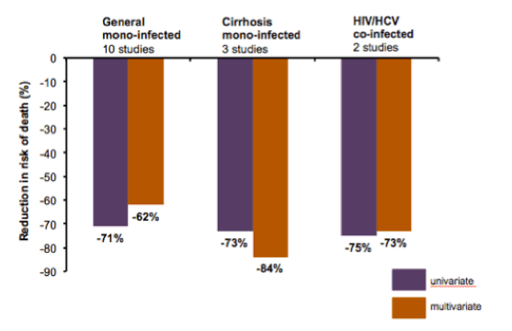
Treating HCV is a good thing…whether you are co-infected or not.
SVR vs. non-SVR
Notes:
Meta-analysis of 129 studies with almost 35,000 patients.

Slide 4
Unique Aspects in the Evaluation of the Co-Infected Patient
A detailed ART history is critical
Regimens, virologic failures (How likely is an M184V?)
Resistance genotypes when available
Role for Archive resistance testing?
HIV VL as a built in measure of adherence
…of course, you can still be “fooled”
Staging- the options are the same
Required for medication approval
FIB-4 evaluated in co-infection (Berenguer J. CID 2015)
>3.25 suggestive of advanced fibrosis
ATV can impact directed biomarker tests
Know when to refer and don’t forget HCC screening!
Notes:
F2: >1 FIB-4
F3-4: >3.25
<1.45 to rule out significant fibrosis

Slide 5
Treatment naïve GT1
Recommended
 |  | SOF/LDV | OBV/PTV/r+DSV | SOF/SMV | SOF/DCV
GT1a | Non-cirrhotic | 12 wks | + RBV 12 wks | 12 wks | 12 wks
 | Cirrhosis | 12 wks | +RBV 24 wks | 24 wks* (RBV) | 24 wks (
GT1b | Non-cirrhotic | 12 wks | 12 wks | 12 wks | 12 wks
 | Cirrhosis | 12 wks | 12 wks | 24 wks ( | 24 wks (
* Unclear role of Q80K testing.

Slide 6
Treatment experienced GT1
Failed | Cirrhosis status | SOF/LDV | PrOD (1a/1b) | SOF+SMV | SOF+DCV
PEG/RBV | NC | 12 | 12+R/12 | 12 | 12
 | C | 12 + R or 24 | 24+R/12# | 24 (RBV)* | 24 (RBV)
PEG/RBV + PI | NC | 12 | NR | NR | 12
 | C | 12 + R or 24 | NR | NR | 24 (RBV)
PEG/RBV + SOF (or SOF/RBV) | NC | 12 (+R) | 12+R/12 | 12 | 12 (+R)
 | C | 12 + R or 24 | 24+R/12# | 24 (RBV)* | 24 (RBV)
#TURQ-III: 100% SVR12 in GT1b without RBV (n=60) Feld JJ. 15th ISHVLD 2015.
*Role of Q80K unclear; associated with lower response rate with 12 weeks of therapy.

Slide 7
GT2/3 Guideline Recommendations
 |  | Option-1 | Option-2 | Option-3
GT2 | Naïve | SOF/RBV 12-16 wks | SOF/DCV 12 wks | --
 | Exp | SOF/RBV 16-24 wks | SOF/PEG/RBV 12 wks | SOF/DCV ( 24 weeks
GT3 | Naive | SOF/PEG/RBV 12 wks | SOF/DCV 12-24 weeks | SOF/RBV 24 wks (alternative)
 | Exp | SOF/PEG/RBV (12 wks) | SOF/DCV ( 12-24 weeks
GT3: Patients with cirrhosis are recommended to receive 24 weeks of SOF/DCV due to lower response with just 12 weeks pending additional data.

Slide 8
Drug interaction scorecard
 | SOF | SOF/LDV | SMV | DCV | PrO-D | GZP/EBR
TDF |  | RAL/DTG
 |  | HIV PI/EFV (⬆TDF)
EFV |  | (⬆TDF) | ⬇SMV | DCV 90mg |  | ⬇GZP
RLP |  |  |  |  | ⬆RLP
RAL/DTG
ATV/r |  | ABC | ⬆SMV | DCV 30mg |  | ⬆GZP
 |  | ⬆TDF
DRV/r |  | ABC | ⬆SMV |  | ⬇DRV | ⬆GZP
 |  | ⬆TDF
EVG/c/FTC/TDF |  |  | ⬆SMV* | DCV 30mg* |  | ⬆GZP
EVG/c/FTC/TAF |  | No data
*not studied, based on predicted interactions.

Slide 9
Summary
HCV treatment should be a priority in those with HIV
Efficacy is not an issue when considering treatment for HCV in those with HIV
I would not use 8 weeks in those with HIV
Keep a Pharmacist close by…drug interactions are the major consideration
Carefully review HIV treatment history before switching to accommodate HCV therapy
Re-infection can and will happen…counsel your patients on re-infection risks.

